Slide 1
Welcome to Safety and Health Management System Principles
While we wait for the Workshop to start:
  Please listen in via computer audio or phone call by selecting Audio on the control panel
    If you choose Computer Audio, double check that your speakers are on and your microphone is muted.
    If you choose Phone Call, please note you will be given a telephone # to call, and an access code and audio pin that is unique to you.
  You are welcome to unmute your phone/computer / laptop / microphone to ask or answer questions (we love questions!)
  Please note the ‘raise hand’ feature to the left of your control panel
Feel free to network with other attendees while we wait for the Workshop to start

Slide 2
Introduction to the Principles of effective
Safety & Health
Management Systems
Welcome!
1005
Notes:
The primary emphasis of the workshop is to introduce you to the seven elements within the Oregon OSHA’s model for managing safety and health in the workplace. We’ll take a look at the design factors of each element and the processes that help to ensure effective performance of the safety and health management system.

Slide 3

Oregon OSHA Public Education Mission:
Page 2
Consultative Services
Enforcement
Public Education and Conferences
Standards and Technical Resources
We provide knowledge and tools to advance self-sufficiency in workplace safety and health.
Oregon OSHA Mission:
To enhance and improve workplace safety and health for all workers in Oregon.

Slide 4
As a courtesy to others, put cell phones on vibrate.
Please Mute Your Audio
Restrooms / Breaks
Handouts / Overheads
Speaker Introduction

Slide 5

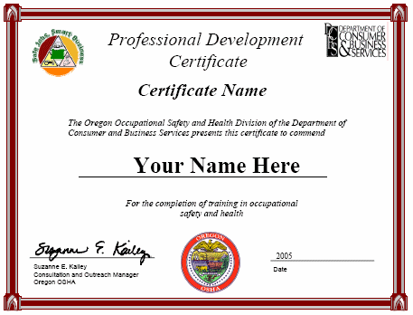
Contact us
Page 2
Field Offices:
Portland 503-229-5910
Salem 503-378-3274
Eugene 541-686-7562
Medford 541-776-6030
Bend 541-388-6066
Pendleton 541-276-2353
Salem Central:
Toll Free English: 800-922-2689
Toll Free Spanish: 800-843-8086
Website: osha.oregon.gov
Additional Public Education Services
  Safety for Small Business workshops
  Interactive Internet courses
  Professional Development Certificates
  On-site training requests
  Access workshop materials
  Spanish training aids
  Training and Education Grants
  Continuing Education Units/Credit Hours
For more information on Public Education services, please call (888) 292-5247 Option 2

Slide 6
Page 3
  Goals
  1. Gain a greater understanding of SHMS.
  2. Be familiar with OR-OSHA’s core elements of a safety management system.
  3. Be able to discuss the key processes within each of the core elements.
Notes:
Understanding the big picture is critical to successfully managing a company’s safety and health management system. Peter Drucker, a well-known management consultant said it this way, "The first duty of business is to survive and the guiding principle of business economics is not the maximization of profit, but the avoidance of loss."
To get the most out of this course, it’s important that everyone freely share their knowledge and experience with the class, so please don’t hesitate.
The Page # in the upper left corresponse with the correct page in your workbook.

Slide 7

Trainer Introduction Page

Slide 8
Page 3
Form Groups
Introductions
Elect a chairperson
Select a spokesperson
Name your corporation
Notes:
Because this is a VIRTUAL class, we will not be breaking into groups, eliminating the need for a chair and a spokesperson!

Slide 9

Page 4
What's Inside
The Oregon-OSHA Safety and Health Management System Model
1. Management Leadership
  2. Worker Participation
  3. Hazard Identification & Assessment
  4. Hazard Prevention & Control
  5. Education & Training
  6. Program Evaluation & Improvement
  7. Communication & Coordination
Notes:
Here are 7 critical components and characteristic of an effective SHMS.
I want to spend a little time talking about a safety and health management system…

Slide 10
Safety & Health Management System
Page 4
SMHS can be defined as a…:
  businesslike approach to safety.
  systematic, explicit and comprehensive process for managing safety risks.
  system that provides for goal setting, planning, and measuring performance.
  system that is woven into the fabric of an organization.
  part of the culture, the way people do their jobs.

Slide 11
Page 5
The basics: What’s a safety and health management system?
What is the difference between a “program” and a “system”?
  A program is independent
  A system is interdependent
Notes:
A program tends to be stand-alone (LOTO, PRCS, HazCom, Respiratory, EMP, EAP, etc.) and independent of other programs.
A system tends to be interdependent and interactive, not stand-alone. It is not so much one or the other, rather it is one with the other, with the rest… They each affect and build upon each other. When working well, each makes the other stronger,

Slide 12
Page 5
Every system contains structure, inputs, processes and outputs
Structure
Notes:
This is a simple structure. In smaller organizations, one person may wear one than one of these hats. In larger organizations, you may have multiple people wearing some of these hats. Not shown, but vital would be an Industrial Hygienist in the role of safety manager or at least safety engineer
The SM is the subject matter expert in OSHA regulations. Emphasize reporting to the production/operations manager, not human resources.
The SE is usually a maintenance person. They need training in machine guarding, other engineering type training.
HR programs include EAP, DFW, Workplace Violence, Early Return to Work, Accountability, Incentive/Recognition, and of course claims management. Supports safety in a staff role, not the hub of the safety wheel.
SC members are the eyes and ears. An internal problem-solving team. Helps, but does not “do” safety. That’s the line organization’s job.

Slide 13

Page 6
Inputs
  Tools Equipment
  Machinery Materials
  Facilities People
  Time Money
The goal is to have the highest quality inputs as possible.
Management commitment is measured, in part, by the quality of inputs to the system.

Slide 14
Page 6
Processes – System Design
1. Commitment - leading, following, managing, planning, funding
2. Accountability – role, responsibility, discipline
3. Involvement - safety committees, suggestions, recognizing/rewarding
4. Identification - inspections, audits, observation, surveys, interviews
5. Analysis – incidents, accidents, tasks, programs, system
6. Controls - engineering, management, PPE, interim measures, maintenance
7. Education - orientation, instruction, training, personal experien
8. Evaluation - judging effectiveness of conditions, behaviors, systems, results
9. Improvement - change management, design, implementation
Safety is one aspect of process quality.
Notes:
A system may be thought of as an orderly arrangement of interdependent activities and related procedures which implement and facilitate the performance of a major activity within an organization. (American Society of Safety Engineers, Dictionary of Terms)

Slide 15
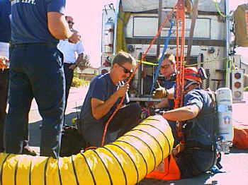
Page 6
Outputs - Conditions,
Behaviors, Results
Safe/Unsafe conditions, behaviors
Many/Few incidents and accidents
High/Low accident costs
High/Low productivity, morale, trust
Notes:
Behaviors are the most direct effect of the safety management system. Next are conditions. These are leading indicators. Accident stats are trailing indicators. (more on that later!)

Slide 16

Page 6
What does this statement mean?
“Every system is designed perfectly to produce what it produces”
Notes:
* A system is a group of interrelated processes with a common purpose.
* All safety "programs" are systems. Think of programs as systems. Semantics.
* Each system includes more than one process.
* Each system includes inputs, processes, and outputs.
* Inputs act as antecedents/activators.
* Process includes steps/events and behaviors/performance.
* Outputs include results... products/service quantity/quality/safety.
* Each process within a system includes inputs, the process itself, and outputs.
* All process outputs support the system's purpose.
* There are possibly many levels of process in a system...like an onion.
* Inputs design process and influence outputs.
* Behaviors/performance within each process is initially set in motion by inputs.
* Behaviors/performance is sustained by consequences.

Slide 17

Page 6
Where do we look to evaluate how well the safety management system is working?
What are the most immediate and observable outputs of a safety and health management system?
Outputs
Behaviors
Notes:
Outputs include the results... products/service quantity/quality/safety.
Safety Performance will indicate the effectiveness of the SHMS. Safe behaviors will be immediate and observable outputs that tell you the SHMS is working (or not)

Slide 18
Safety & Health Management System (SHMS)
Page 7
methodical
structured
established
approach
Intended to
explain the
arrangement
or working
of a whole
to managing
A system of managing systems
systems
doctrines
programs
principles
policies
procedures
Within the system
  Management Leadership
  Worker Participation
  Hazard Identification and Assessment
  Hazard Prevention & Control
  Safety Education and Training
  Program Evaluation and Improvement
  Communication and Coordination
S&H
Management
System
Notes:
18
Effective safety and health management programs involve the development and the implementation of a system of managing systems. When I think about it, a system of managing systems sounds a bit confusing. What I mean is...
“effective safety and health management programs
incorporate a methodical, structured and established approach...
to managing...
an organized set of doctrines, policies, programs or principles
which are intended to explain the arrangement or working of a whole.”
. . . again, a system of managing systems!

Slide 19
Components of an Organizational
Safety and Health System
Page 7
Cultural Component
Operational Component
Managerial Component
The Way We Do It Here
  Management Leadership (Items 1-14)
  Employee Participation (Items 15-20
Finding and Fixing
  Hazard Identification & Assessment (Items 21-29)
  Hazard Prevention & Control (Items 30-39)
Managing the Work
Safety & Health Training (Items 40-43)
Program Evaluation & Improvement (Items 44-47)
Communication & Coordination (All)
Notes:
19
(Trainer)
Remember, the major elements (categories or sub-components) fall within the 3 Components of an Organizational Safety and Health Management System.
This Slide is primarily to illustrate where each of the attributes or sub-elements reside, while re-illustrating the relationship of the components and sub-components (or major elements) .

Slide 20
Cultural Component
Page 7
The cultural component contains two of the major elements and 20 attributes
Contains those attributes that measure the organizational values that govern the managerial and operational attributes.
Notes:
(Trainer)
The Cultural Component deals with “How We Do Things Here”

Slide 21
Cultural
Page 7
Management Leadership is needed to initiate change toward an improved safety and health culture
There may be non-safety cues that indicate the existence of a positive safety culture
  Profit sharing
  Continuing Education
  Child care
  Wellness programs
Notes:
(Trainer)
The culture in our workplace is affected by management leadership as much as it is affected by employee participation (the ability and success of employees to be meaningfully and actively involved in the safety program.

Slide 22
Cultural (Continued)
Page 7
Worker Participation is necessary to nurture and grow that culture
You know a sound safety and health cultural component exists when everyone believes they have a
  Right to safety and health
  Responsibility for their own safety and health
  Duty to protect co-workers
Notes:
(Trainer)
The culture in our workplace is affected by employee participation ,specifically in the opportunities for employees to be involved, the importance and depth of their involvement.
Are employees finding and correcting hazards? Are they meaningfully involved in training programs? In planning activities? Do they help evaluate Safety and health performance?

Slide 23
Operational Component
Page 7
This component contains two of the major elements and 19 attributes that measure the actual activities that are taking place to find and fix hazards.
Notes:
(Trainer)
The 19 attributes (questions) deal with “methods we use to anticipate and detect workplace hazards” and with how effective we are at preventing and controlling hazards in the workplace

Slide 24
Operational
Page 7
Concerned with how effectively proactive the workplace is in identifying, preventing, and controlling hazards
Also reveals if quality feedback loops exist to promote continuous improvement
Notes:
(Trainer)
The Operational component deals with the operations end of what we do. The shop floor and/or production areas. From receiving, through production to shipping.
Are we finding and fixing hazards in a timely manner?
Do we have systems in place to promote continuous improvement?

Slide 25
Managerial Component
Page 7
This component contains three of the major elements and 8 attributes that measure the level of organization that exists to establish, facilitate, and maintain the operational attributes.
Notes:
(Trainer)
The Managerial Component attributes deal with how safety and health gets managed.
Are we evaluating and analyzing injury and illness data, hazard incidence data, goals and objectives, and our S&H management systems?
How do we assign responsibility, resources and authority? How does accountability work here? Do policies promote safety performance?
Who is trained in what and how? Is training effective?

Slide 26
Managerial
Page 7
Concerned with traditional management functions such as
  Planning - Coordinating
  Directing - Controlling
  Staffing - Staff Development
  Communicating - Organizing
  Motivating
Notes:
(Trainer)
The managerial component deals with traditionally think of as a management function, but it is not limited to management personnel, in that safety management is an US function, not them.

Slide 27
Page 8
Proactive Vs. Reactive Safety & Health Management
What's proactive safety?
What's reactive safety?
What programs are emphasized?
Notes:
Proactive: doing everything possible to anticipate and prevent mishaps.
Reactive: doing anything you can do to minimize LOSS after the mishap.
Proactive Approach is to prevent future mishaps. (LO/TO, PRCS, HazCom, appropriate discipline before injury, incentives for safe behaviors)
Reactive Approach is to reduce or limit cost due to mishap, injury or illness. (AI, Early Return to Work, incentives for not getting hurt)

Slide 28
LINE vs STAFF
Page 8
“LINE” refers to positions in the organization who to the actual work of the organization (production)
  In the Army, the line fights, and staff supports them in the fight
  The authority is legitimatized by a line of delegation from the top manager through production supervisors to line production.
“STAFF” refers to any position that is in support of the production group (human resources, clerical, services, are all support functions)
  Safety should report directly to Line management who have direct oversight of safety and health performance
Notes:
Top management should consider proficient safety and health staff to be an advisory resource provided to line managers and line supervisors, who have direct oversight of safety and health performance.
"In organizations, clients for the services provided by staff people are called line managers. Line managers have to labor under the advice of staff groups, whether they like it or not. But any staff function, by definition, has no direct authority over anything but its own time, its own internal staff, and the nature of the service it offers." Peter Block, Flawless Consulting

Slide 29
Page 9
ELEMENT 1 –
MANAGEMENT LEADERSHIP
For more on this topic take
Course 110, Safety Leadership, and
Course 112, Safety and the Supervisor

Slide 30
Page 9
ORS 654.010 Employers to furnish safe place of employment. Every employer shall…
  furnish employment and a place of employment which are safe and healthful for employees therein, and shall furnish and use such devices and safeguards, and
  adopt and use such practices, means, methods, operations and processes as are reasonably necessary to render such employment and place of employment safe and healthful, and
  do every other thing reasonably necessary to protect the life, safety and health of such employees.
Notes:
Also known as the “General Duty Clause”
The onus is clearly on the employer. From here on, we will refer to the employer as “management”

Slide 31
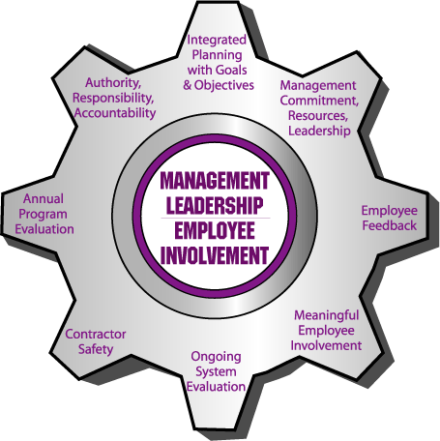
Management Leadership
Page 9
  Managers at all levels need to be actively involved in safety management and demonstrate their commitment to worker safety and health
  by establishing and
  maintaining programs
  for identifying hazards
  and reducing risks to
  employees.
Notes:
Ken

Slide 32
Leadership Elements Common to
World Class Safety Programs
Page 9
Upper management support and commitment for safety
  To provide resources to maintain long-term performance
Written standards or guidelines that provide minimum acceptable performance levels
  So people know what the expectations are
Designing in safety from the start
  Rather than fixing problems after operations begin
A good communication system
  All levels understand goals and objectives for reaching them
An evaluation process
  Checks actual performance against internal standards
Involvement at all levels
John Kanouse, VP
Johnson & Higgins/Marsh & McLennan
Notes:
John Kanouse, VP with Johnson & Higgens/Marsh & McLennan cites common elements seen in companies with world class safety performance.
These elements have little to do with government standards.
Implementing elements such as these demonstrate leadership and drive success in busienss

Slide 33
Page 9
ecessary
What is Top Management Commitment?
T M C Expression of leadership
ime
oney
oncern
Notes:
It takes a little “TMC”
Top Management Commitment is defined by how much Time, Money, and Concern the employer gives to safety.
The degree to which managers demonstrate TMC indicates their understanding of the benefits derived from an effective safety management system.

Slide 34
Page 9
What motivates management to make a commitment to safety?
Social obligation
Fiscal obligation
Legal obligation
How can you tell which obligation is driving decisions about safety?
Notes:
Management won’t make changes unless they are required by OSHA, save money, and/or save lives, depending on what is primarily motivates the employer. To get to know what’s driving the system, just try to change it.

Slide 35
Page 9
What motivates management to make a commitment to safety?
Employers are motivated by many factors. These may be social, fiscal, and legal obligations. The obligation considered most important, influences the level of management commitment.
To fulfill the legal obligation
  We must stay out of trouble
  Do only what we have to
This is the least effective strategy
To fulfill the fiscal obligation
  We must save money
  Do what we have to
This is a better strategy
To fulfill the social obligation
  We must save lives
  Do whatever it takes
This is the most effective strategy!
How can you tell which obligation is driving decisions about safety?
Notes:
Employers are motivated to make a commitment to safety to fulfil their obligations (legal, fiscal or social). The obligation considered most important will influence the level of management’s commitment. These imperatives are actually a continuum
You can tell what motivates an employer based on what they focus on...

Slide 36
Page 10
Leadership will shape a tough-caring safety culture
      Positive Reinforcement
Positive reinforcement exists when the perceived natural and system consequences increase the frequency of desired behaviors because they are considered positive or some kind of reward.
Notes:
Our SAFETY CULTURE is “how we do safety here” and our culture is influenced by how we use positive and negative reinforcement.
Positive reinforcement rewards the good (desired) behaviors, increasing the likelihood they will be repeated.

Slide 37
Page 10
    Negative Reinforcement
  Negative reinforcement exists when the perceived natural and system consequences are considered undesirable or some kind of punishment.
Notes:
Negative reinforcement punishes or calls out focus on negative behaviors.

Slide 38
Page 10
Extinction
Withholding positive reinforcement results in the extinction of desired behaviors.
Notes:
Extinction is the result of being ignored. Unfortunately, it’s the most common management response to good work in most workplaces.

Slide 39

Page 11
Step 6. Determine the Costs
Insured
(Direct) Costs
Oregon average to close a claim = $13,107
Unseen costs can sink the ship!
Uninsured
(Indirect) Costs
Oregon estimated average = $30,000
Total Oregon Average =
$43,000!
Unknown Costs

Slide 40
In 1998
The Average Total
Cost of an injury or
illness in Oregon
was approximately
$28,200 per claim.
We can easily calculate
the cost of workplace injuries to employers
It is nearly impossible to measure the pain and suffering incurred by injured employees and their families
By 2005
The Average Total
Cost of an injury or
illness in Oregon
had risen to about
$43,107 per claim.
By 2010
The Average Total
Cost of an injury or
illness in Oregon
had risen to about
$57,850 per claim.
By 2017
The Average Total
Cost of an injury or
illness in Oregon had
leveled off to about
$53,960 per claim.
Data from IMD Report: Average
Claim Costs for accepted disabling
Claims using a 1.5 to 1 ratio of
Indirect to Direct causes
Notes:
Indirect Costs include:
Time: lost by injured employee; lost by fellow employees; lost by supervisor; overhead costs while work was disrupted
Productivity: loss of efficiency due to break-up of crew; training costs for new/replacement workers; failure to fill orders/meet deadlines; loss of production for remainder of day of event.
Equipment Damage: major damage to tools or equipment; time damaged equipment is out of service; damage from accident-fire/water/chemical/biological;
Reputation:unknown and unknowable costs: Morale; product loss; market loss; customer loss, etc.

Slide 41
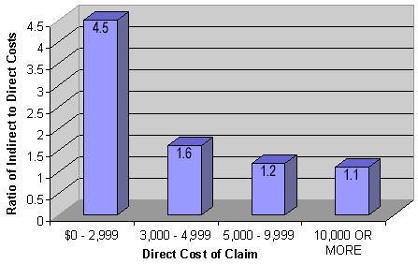
Page 11
Ratio of Indirect to Direct Accident Costs
Notes:
Studies show that the ratio of indirect costs to direct costs varies widely, from a high of 20:1 to a low of 1:1. OSHA's approach is shown here and says that the lower the direct costs of an accident, the higher the ratio of indirect to direct costs.
Said another way, the more serious the injury, the lower the ratio between indirect and direct costs.

Slide 42
Page 12
Workers' Compensation Made Simple
How are rates determined?
Manual Rating - Also called the “Pure Premium Rate,” this rate is applied to all industries of the same type or standard industrial classification (SIC). Expressed as:
Dollars per $100 dollars of payroll
Example: $3.15 per $100 dollars of payroll.
Experience Rating – Also called the “Modification or MOD Rate” is used to vary the company’s own rates, depending on its experience by comparing actual losses with expected losses.
Notes:
The pure premium rate is set every year. In Oregon, it has gone down or stayed flat every year for over two decades.
The Experience rating is also called the modification rate (or MOD rate) which is used to determine what you pay for insurance.

Slide 43
Page 12
Notes:
The manual rate is the same for all companies in a given SIC. The MOD rate will go up or down, based on your company’s past injury and illness performance.
The worse your accident record, the higher the MOD rate.

Slide 44
Page 12
If the company has a profit margin of 5%, additional business volume to replace $78,500 would be $1, 570,000!
Notes:
A higher MOD rate means you pay more for each dollar of insurance coverage.
With a mod rate of 1.3, this a company with $500,000 in payroll will have to pay $340,000 to get $261,500 worth of coverage.

Slide 45
Page 12
Wow! If you reduce your MOD Rate from 1.3 to .7, total savings will be $157,000. That’s $3.14 million in business volume saved!
Notes:
A lower MOD rate means you pay less for each dollar of insurance coverage.
With a mod rate of 0.7, this company with $500,000 in payroll will have to pay $183,000 to get $261,500 worth of coverage.
Having a good experience rating (MOD Rating) over time, can lead to substantially less $$ going into workers’ compensation costs. A good mod rate is realized by having fewer accidents than your industry average. The ability to have fewer accidents is enhanced by an effective SHMS!

Slide 46
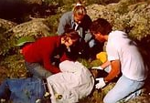
Page 13
Average Cost For Disabling Claims
By Event or Exposure
What injuries are causing the most claims in Oregon?
- Costs
Notes:
Ergonomic-related of soft tissue injuries consistently comes in at just under ½ of all claims costs.
Look at the top 10. Six of the top 10 are ergonomics-related injuries.

Slide 47
Page 13
Where's the "average"?
Page 10 of your book shows 2003 data.
Notes:
The material in your book shows data from 2003. The top 10 in any given year add up to between 65 and 70% of all disabling claims costs for that year.
The material in your workbook is from 2003, but the following slides will help you to access updated claims cost data…

Slide 48
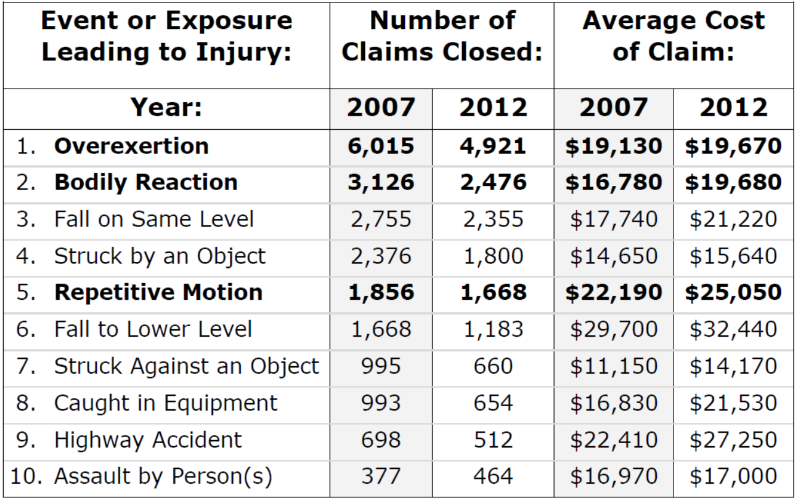
Use published data to help sell your recommendations to management
Page 13
Notes:
Again, an older slide, but you can see the top 10 claims closed, and the claims costs for both 2007 and 2012.
In 2007, Ergo counted for 58% (10,977 of 20,858) claims and 30% ($58,100 of $187,550) of claim costs.
In 2012, Ergo counted for 60% (9,065 of 14,893) claims and 30% ($64,400 of the $213,650) of claim costs.

Slide 49

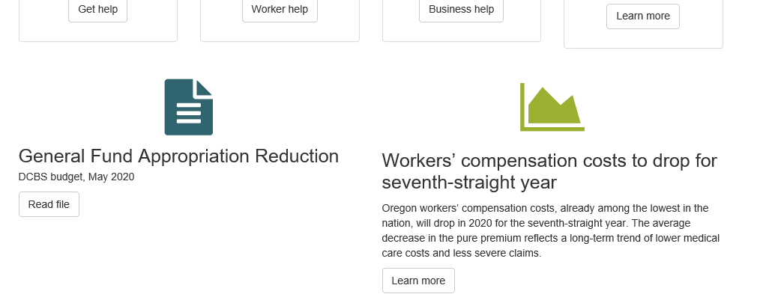
Where do we find the Data?
Page 13
Go to DCBS Home Page: https://www.oregon.gov/dcbs/Pages/index.aspx
Click on Learn More under the News and Information tab…
Notes:
Go to DCBS Home Page: https://www.oregon.gov/dcbs/Pages/index.aspx
Click on Learn More under the News and Information tab…

Slide 50

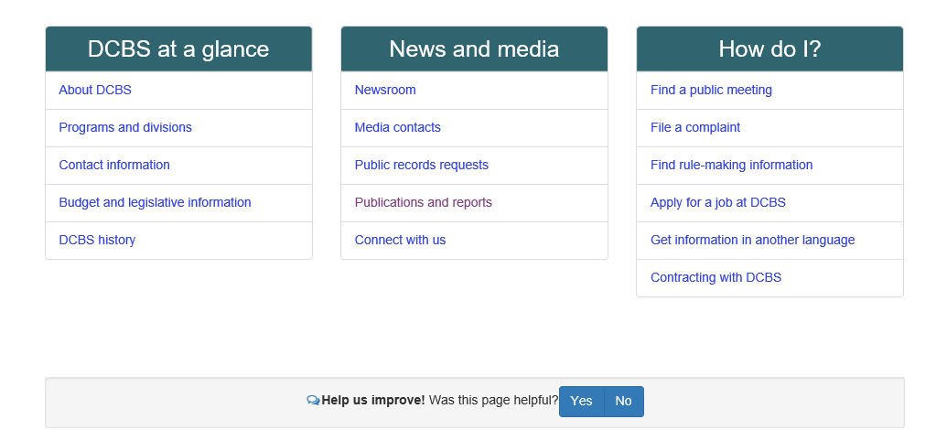
Where do we find the Data?
(continued)
Page 13
That takes you to the News and Information page.
From there, click on Publications and Reports

Slide 51
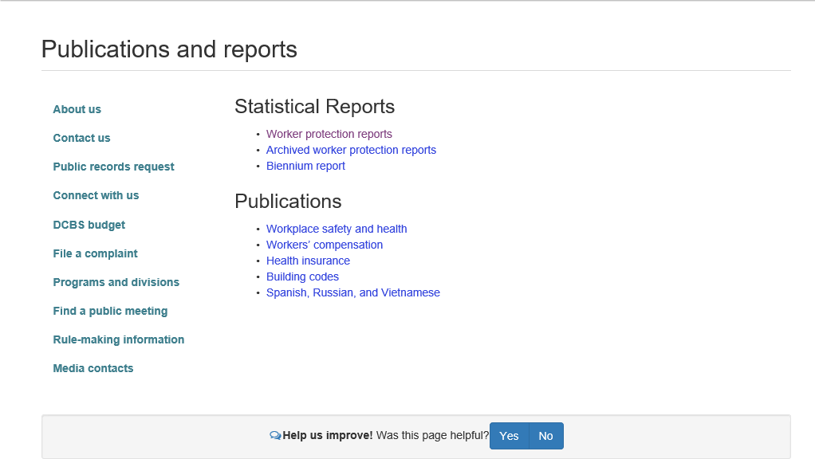
Where do we find the Data?
(continued)
Page 13
From Publications and Reports,
Under Statistical Reports,
click on Worker Protection Reports

Slide 52

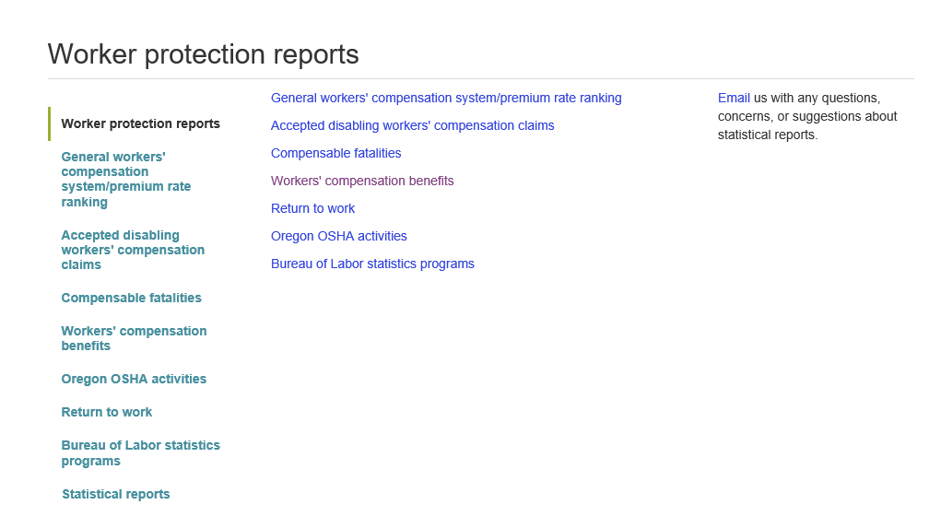
Where do we find the Data?
(continued)
Page 13
Under Worker Protection Reports,
click on Workers’ compensation benefits

Slide 53

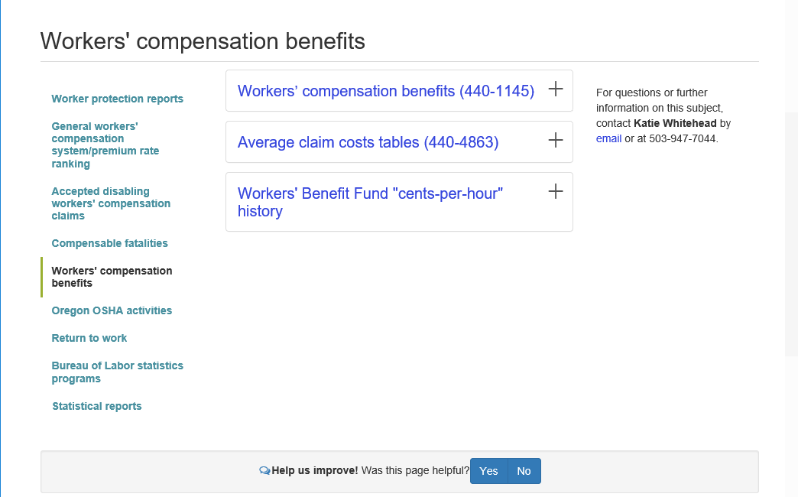
Where do we find the Data?
(continued)
Page 13
From Worker’s compensation benefits,
click on Average claim cost tables (440-4863)
That will insert a drop-down list of years, from 2017 through 2018 (currently).
Choose the year you want.

Slide 54
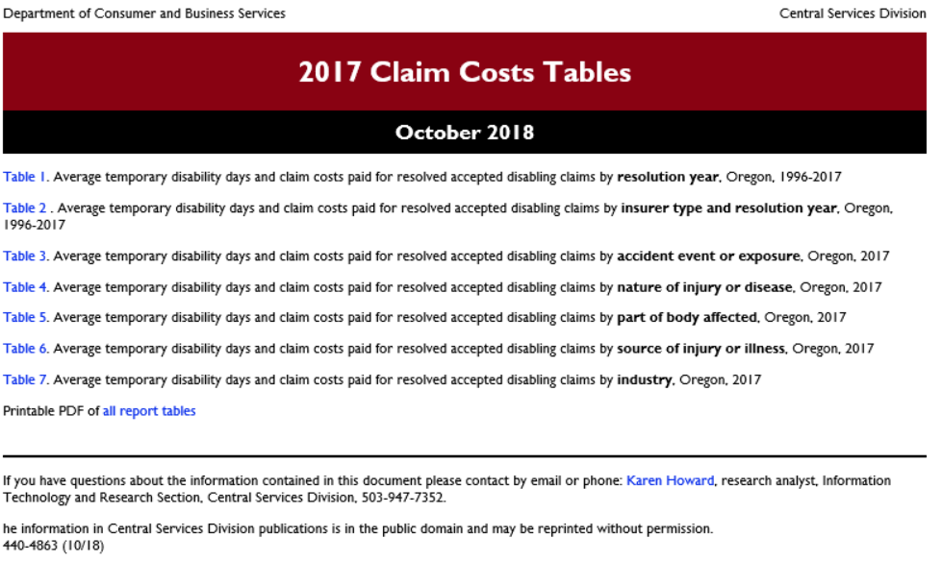
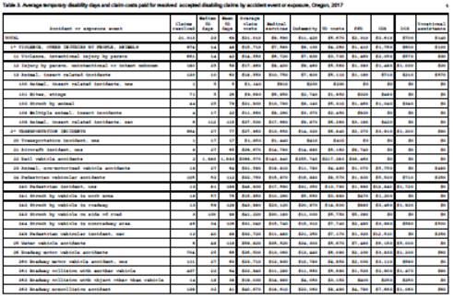
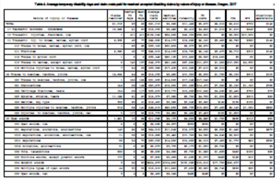
Where do we find the data?
Page 13
That brings you here…
Table 3
Average temporary disability days and claim costs paid for resolved accepted disabling claims by accident event or exposure
Table 4
Average temporary disability days and claim costs paid for resolved accepted disabling claims by nature of injury or disease
http://www.cbs.state.or.us/external/imd/rasums/4863/17web/17-4863.html

Slide 55
Page 14
ACCOUNTABILITY
A Big Part of
Management Leadership
Notes:
It’s important that the employer fulfill legal obligations to the law and every employee.
The "condition" of effective workplace safety accountability will exist if (1) appropriate behaviors are (2) objectively evaluated and (3) result in effective consequences.

Slide 56
Page 14
Effective
Accountability =
Behavior + Evaluation 4 Consequences
Appropriate
Objective
Significant
Accountability is:
Doing The Right Thing Consistently,
  day in and day out, in tasks and interactions to further the mission of the organization.
Taking Action Consistent With Desired Outcomes
  Doing those things necessary to achieve your goal(s)
Notes:
Discuss accountability as a “condition” in the safety management system. Accountability exists when appropriate behavior is effectively evaluated and results in significant consequences (good or bad)

Slide 57
Page 14
ORS 654.022 Duty to comply with safety and health orders, decisions and rules. Every employer, owner, employee and other person shall
  obey and comply with every requirement of every order, decision, direction, standard, rule or regulation …
  do everything necessary or proper in order to secure compliance with and observance of every such order, decision, direction, standard, rule or regulation.
Notes:
Oregon Revised Statute 654-022:
EVERYONE (employer, owner, employee and every other person) obey and comply and secure compliance.
If so, acknowledge, if not, hold accountable (answerable)

Slide 58
Page 14
OAR 437-001-0760 Rules for all Workplaces
(1) Employers’ Responsibilities.
  (a) The employer shall see that workers are properly instructed and supervised in the safe operation of any machinery, tools, equipment, process, or practice which they are authorized to use or apply.
  (b) The employer shall take all reasonable means to require employees to…
According to the rules above, what is the employer required to do?
Notes:
Oregon Administrative Rule 437-001-0760:
Everyone must Comply,
The employer (management) must Enforce, Instruct and Supervise!

Slide 59
Page 15
OAR 437, Div 001, Rule 0765(6)(f) Accountability. The safety committee shall evaluate the employer’s accountability system and make recommendations to implement supervisor and employee accountability for safety and health.
1.1. Formal standards and expectations performance
Why is it so important to write formal plans, policies, procedures and rules?
Why is it important to discuss why policies, procedures and rules are needed?
Notes:
Written plans clarify expectations responsibilities and lower stress. Everyone understands what to do.
According to research, the number one reason employees don’t do what they’re suppose to do in the workplace is because they don’t know “why” they need to do it.

Slide 60
Your Accountability System should:
Page 15
Seek to alter behaviors & improve skills
  Empower employees to take ownership of tasks
Deliver measurable results
  Include methods to analyze system results
Offer individual assessment
  Assess accountability attributes & behaviors individually
Incorporate high levels of interactivity
  Group training activities and sharing of experiences
Incorporate ongoing evaluation
  Holistic with follow-up, not a crash course
Notes:
Incorporating these five bullets will make your accountability system more effective

Slide 61
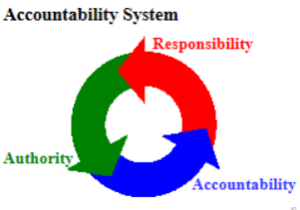
Page 16
1.2. Resources to meet/exceed expectations
Physical Resources
Social Support
If management fails to provide adequate resources and support, how does that affect the ability to hold employees accountable?
Notes:
Before management can hold employees accountable, they must first fulfill their obligation to provide employees with the tools to perform safely.
If management does not fulfill the obligation to provide resources, they are not justified in holding employees accountable. Employees do not have the ability to achieve standards of performance. They are “trapped”. Failure is predictable.

Slide 62
Page 7
1.3. A process to evaluate behaviors: It’s important that behaviors are measured and evaluated so that discipline is based on facts, not feelings.
Employees want to know what you want of them.
  CLEAR Goals - Objectives – Expectations
When employees equate being “held accountable” with demotion or job loss
  They will not accept responsibility for their work
If Management does not Model Accountability
  Blame and Finger-pointing become the norm
Why is this statement true?
“When an employee is disciplined, the fact that there was an accident is irrelevant.”
Notes:
Employees should be disciplined only for substandard behavior and the safety management system has not failed the employee. Punishing an employee for getting hurt is never justified.

Slide 63
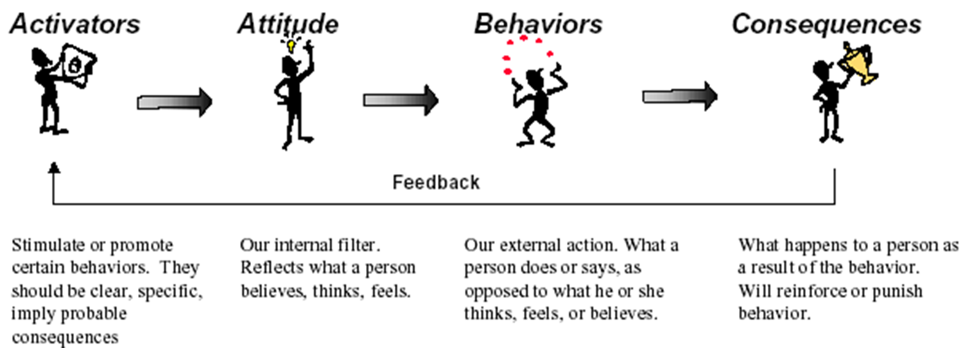
Page 17
Effective consequences
Why does discipline need to be progressively more significant to be effective?
Notes:
What is considered a significant consequence varies among employees. Effective discipline will change behavior in the desired direction. Discipline that changes the behavior of one employee may not change the behavior of another.

Slide 64
Page 18
1.5. Appropriate application of consequences
Without consequences, accountability does not exist.
Effective accountability systems ensure:
  that consequences exist,
  that consequences are appropriate, and
  that consequences are justified
Notes:
Appropriate consequences ensure discipline is justified and perceived as fair.

Slide 65
Effective Accountability System Consequences
Page 18
Fair
Uniformly Applied
Understood by all
Applied consistently at all levels
Rewards good behavior
Corrects deficient behavior
Notes:
Effective accountability systems apply consequences that are fair, uniformly applied and understood by all. An accountability system must be applied consistently at all levels (vertically) and all departments (horizontally). If rules apply to one, they apply to all. An effective accountability policy should reward good behavior while correcting deficient behavior.
It is important that an accountability program apply to everyone on the job, from senior management to the newest employee.

Slide 66

Page 18
E
For discipline to be justified, those in control should fulfill their obligations to the employee first. To make sure obligations are fulfilled, conduct a self-evaluation.
R
S
T
L
What questions should the supervisor or manager ask before administering discipline?
Trained
Have I ensured the employee is ____________?
Have I made sure the employee has _______________?
Have I effectively ______________safety rules?
Have I provided adequate _______________?
Have I demonstrated personal _________________?
Resources
Enforced
Supervision
Leadership
Notes:
Appropriate consequences ensure discipline is justified and perceived as fair.

Slide 67
Page 19
1.6. Evaluation of the accountability system: Essential to continuous improvement
Process for evaluating the accountability system
Identify
Analyze
Evaluate
Notes:
Identify. Inspect the various elements of your accountability system policies, procedures, processes and practices to determine what is present.
Analyze. Dissect and thoroughly study each accountability system policy, process, procedure and practice to understand what they look like and how they are being performed.
Evaluate. Compare and contrast the overall design and performance of the accountability system against best practices to judge of the system and how well it is working.

Slide 68
Page 20
ELEMENT 2 -
WORKER PARTICIPATION

Slide 69
Worker Participation
(Employee Involvement)
Page 20
  Employees must be actively involved in order to share ownership and foster an active role in the programs that are in place to protect employee safety and well being
Notes:
Ken

Slide 70
Employee Involvement
Page 20
Meaningful ways that affect S & H
Trained
  To do their jobs
  To understand processes
Receive feedback
Notified of rights
Understand their roles and responsibilies
Notes:
Safety Committees, Safety Sub-Committees, Program Owners, Evaluate/update/train, Safety Captains, Safety Champions, Quick Hit Teams, Kaizen Events, Safety Raids, Pre-Task Meetings, Program Evaluation, Planning/goal setting, Routine Analysis, Self Inspections, Pre-Use Analysis / MOC, Chemical Hazard Analysis, Accident/Incident Investigation, Trend Analysis, Training, Plan, Deliver, Critique, Improve

Slide 71
Page 20
What does an effective safety suggestion program look like?
What can we do to increase involvement in safety?
Depends on nature of the business, size of the company, etc. Timely response is critical. Recognizing everyone who submits a suggestion is critical. The “box” doesn’t usually work.
Depends on nature of the business, size of the company, etc. Recognition of worker participation is critical. Recognizing everyone who submits a suggestion is critical. Incentivize activities that workers can participate in.
Notes:
Depends on nature of the business, size of the company, etc. Timely response is critical. Recognizing everyone who submits a suggestion is critical. The “box” doesn’t usually work.
Incentivize activities that call for workers to participate. Regcognition of worker participation is critical

Slide 72
Making Employee Involvement Work
Page 20
Supported by management
  Trained & educated employees used to their potential
  Encourage Ownership
Supported by policies
  Provide & document employee involvement avenues
Enable employees to Continuously Improve
  Themselves (training, skills, productivity, teamwork)
  Conditions (hazard ID & control, problem resolution, flow)
  Process/Procedures (JSA, SOP, program review,)
  Quality (work, product, communication, feedback)
Notes:
72
Again, if management is going to spend the time, money and effort to train and educate employees, it only makes sense to utilize those trained and educated employees to the fullest potential.
Employee involvement should be provided for in the company safety program and should be actively supported and encouraged by all management personnel. The company safety policies should describe and document avenues for employees to be involved in the safety and health program, with specific information regarding employee involvement in problem resolution, investigation procedures, safety and health training, and hazard analysis, just to name a few!

Slide 73
Employee Involvement
Page 20
Involvement SHOULD BE EXPECTED
  By Company, By Co-Workers
Involvement in the safety program should be an individual responsibility and an expectation of employment
Have new employees team up with more experienced workers
Have the supervisor and safety personnel follow-up with the employee
Always ask for feedback from new employees

Slide 74
Employee Involvement cont.
Page 20
Employee performance reviews should include a section for safety participation
Employee advancement criteria should cover accomplishment of safety goals
Safety must be seen as integral to every job function
Employees need to know that management is dedicated to continued improvement

Slide 75
Page 20
What's wrong with this safety incentive program policy?
  "Every employee who works accident-free for a year will receive a $1,000 bonus on December 15th!"
What's being rewarded?
What is management's message?
How do we fix this?
Withholding injury reports
It’s all about money. Every time there’s an accident, it’s the employee’s fault!
Reward for consistent proactive (compliant) behaviors that prevent injuries! If you comply with safety rules, you’ll get your bonus! If an employee has an accident, yet didn’t violate a safety rule, they should still get their reward. Remember, the accident is irrelevant!

Slide 76
Page 21
    To be effective, recognition should be …
_____________ - after the behavior occurs.
Soon!
Sure!
______________ - the employee knows exactly why he or she is being recognized.

Slide 77
Page 21
Significant!
______________________ - The importance of the consequence is determined by the receiver.
Simple!
___________ - genuine approval for the right reasons.
Sincere!
___________ - genuine approval for the right reasons.
Notes:
Bottom Line: People do not care how much you know until they know how much you care.

Slide 78
Pages 22 - 27
INCENTIVES AND RECOGNITION
If you build it, they will come
    Take home exercise: Have your safety committee evaluate the safety and health incentive and recognition program by completing the following 6 page element/checklist and questions at your next meeting.
    Don't answer with a yes/no response. Rate effectiveness with criteria like:
    0 = Not Present,
    1 = Dysfunctional
    2 = Less Than Adequate,
    3 = Adequate,
    4 = Robust
    5 = Excellent.
Notes:
It's important that incentive, recognition, reward policies, and expectations are carefully formulated, clearly written, and effectively communicated to all employees.

Slide 79
Pages 22 - 27
Incentive and Recognition Program Evaluation Checklist: Take Home Exercise
Formal Standards and Expectations
  4 Check spots, 2 Questions to answer
Top Management Commitment
  6 Check spots, 3 Questions to answer
An Effective Evaluation Process
  8 Check spots, 3 Questions to answer
Application of Effective Consequences
  10 Check spots, 1 Question to answer
Appropriate Application of Consequences
  13 Check spots, 1 Question to answer
Evaluation of incentive/recognition system
  8 Check spots, 2 Questions to answer
Notes:
Do the Incentive/Recognition system exercises shown on pages 19 through 24 of your workbook at your next safety committee meeting.
There are no right or wrong answers, your safety committee will put in their recommendations in the blanks!

Slide 80
Page 28
ELEMENT 3 –
HAZARD IDENTIFICATION AND ASSESSMENT
NOTE: There is a LOT to this element, and it takes management leadership and worker participation to be successful

Slide 81
Page 28
OAR 437-001-0760(7) Inspections.
(a) All places of employment must be inspected by a qualified person or persons as often as the type of operation or the character of the equipment requires. Defective equipment or unsafe conditions found by these inspections must be replaced or repaired or remedied promptly.
(b) Wherever required in this safety code, a written and dated report, signed by the person or persons making the inspection, must be kept. …
Who should inspect?
The employer is required to. Management should inspect periodically.
Supervisors should inspect to keep tabs on the areas under their control.
The Safety Committee is required to inspect the entire workplace.
How often?
As often as deemed necessary!
Construction weekly, general industry at least monthly
Supervisors should do at least a monthly (preferably weekly) inspection.
The Safety Committee is required to do a quarterly inspection.
Notes:
Oregon Administrative Rule, Division 1 (rules for all workplaces) requires the employer to inspect the workplace to find and fix hazards.
All personnel who do inspections must be trained in hazard identification and control. I recommend managers and supervisors take off their manager/supervisor hat, and put on an inspector hat while they do the inspection. If not, it is too easy to confuse the roles.

Slide 82
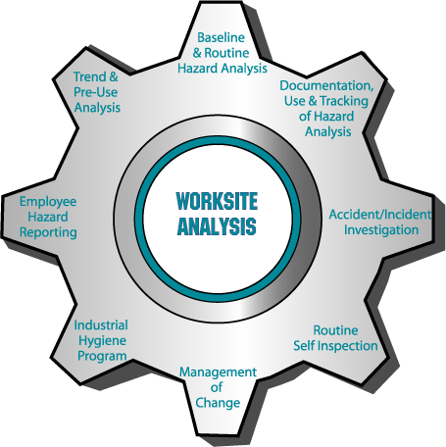
Worksite Analysis Anticipating & Detecting Hazards
Page 28
  Effective safety and health
  management must begin with a thorough understanding of all potentially hazardous situations to which employees may be exposed
  Every worksite and task needs to be reviewed to identify hazards and potential hazards to the workers. This goes far beyond a simple safety review of the work to be performed.
Notes:
Ken

Slide 83
Hazard (Definition)
Page 28
A workplace hazard is an unsafe condition or practice (or combination of the two) that could result in employee injury, illness or death.

Slide 84
Page 28
What are the four categories of hazards in the workplace?
M
aterials
E
quipment
E
nvironment
E
mployees
Notes:
Pages 73 – 76 of your workbook contains an MEEE form you can review to determine root causes of hazards, accidents and incidents.

Slide 85
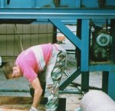
Page 28
3
Conditions account for _____ % of all workplace accidents.
Behaviors account for _____ % of all workplace accidents.
Uncontrollable acts account for ____ % of all workplace accidents.
95
2
Conclusion: The safety management system contributes to some degree to _____ % of the causes for all accidents in the workplace!
98
¹Source: SAIF Corporation Lost Control Approach, Foundation, p. 9
Notes:
¹Source: SAIF Corporation Lost Control Approach, Foundation, p. 9

Slide 86
Page 29
Types of Workplace Hazards
Acceleration.
Vibration/Noise.
Toxics.
Radiation.
Ergonomics.
Pressure.
Mechanical.
Heat/Temperature.
Flammability/Fire.
Explosives.
Electrical contact.
Chemical reactions.
Biologicals.
Workplace Violence.
Notes:
www.osha.gov OSHA's Hazard Awareness Advisor is powerful, interactive, expert software. It will help you (especially, small businesses) identify and understand common occupational safety and health hazards in your work place. It will ask you about activities, practices, materials, equipment, and policies at your work place. Then, it prepares a unique, customized report that briefly describes the likely hazards and the OSHA standards which address those hazards.

Slide 87

Page 30
Four important processes to identify hazards
1. Walkaround Inspections
How to develop an effective inspection checklist.
  Determine applicable state safety & health rules for the workplace.
  Review rules and use those you feel apply to your workplace.
  Develop applicable checklist questions that are not addressed in the rules.
Notes:
Conducting formal and informal safety inspections on a daily, weekly or monthly basis is important in making sure the workplace remains free of hazards that could cause injury or illness.
Checklists can be a god tool to make sure you look for the right things, but be aware that a checklist can also limit you from seeing hazards that are not on the checklist.

Slide 88
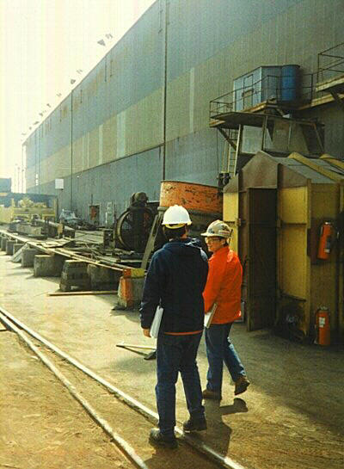
Page 30
Who should be involved in the walk-around inspection?
Everyone. Don’t rely just on the safety committee.
Actually, an effective safety committee walk-around inspection monitors the quality of the daily, weekly, monthly inspections that should be conducted by employees, supervisors and other line managers.
Notes:
Remember, OAR 437-001-0760(7) Inspections.
(a) All places of employment must be inspected by a qualified person or persons as often as the type of operation or the character of the equipment requires. Defective equipment or unsafe conditions found by these inspections must be replaced or repaired or remedied promptly.
(b) Wherever required in this safety code, a written and dated report, signed by the person or persons making the inspection, must be kept. …

Slide 89
Page 30
2. Observations (Informal and Formal)
Informal observations to detect and correct. When employees observe unsafe behaviors, they need to warn the employee. When employees spot hazardous conditions, they need to report and/or correct them. When supervisors and managers observe unsafe behaviors, they need to intervene with appropriate consequences.
Formal observation programs to gather facts. Formal observation procedures may be very helpful as a method to gather facts to help improve the safety management system. To be successful, formal observation procedures need to be carefully planned and implemented.
Notes:
While conducting inspections may be quite effective in identifying the causes for 3% of the accidents in your workplace, informal and formal observation activities are needed to address the other 95%. Don’t limit your observations to unsafe behaviors, note and acknowledge safe behaviors as well. Effective programs will note 3 to 4 times as many positives than negatives
The best observation programs are employee driven. The surest way to kill an observation process is to discipline someone who is being observed. Management run observations used for discipline will fail every time.

Slide 90
Where did these come from?
Why?
Page 31
Insurance Providers
To explain “What Happened” to cause them to cover the claim
Struck-By
Struck-Against
Contact-By
Contact-With
Caught-On
Caught-Between
Fall -To-Surface
Fall-To-Below
Over-Exertion
Bodily-Reaction
Over-Exposure
Notes:
While the terminology came from workers’ comp insurance providers, using this language to describe potential accident types will help you estimate claims costs discussed on page 13

Slide 91

Page 32
3. The Job Hazard Analysis (JHA)
The process...
  Provides the supervisor with a clear understanding of what the employee does and does not know about the task.
  Recognizes needed changes in the equipment or procedures
  Provides a way to increase employee involvement
Notes:
A Job Hazard Analysis, also called a job safety analysis. The process is an organized approach that involves the worker and supervisor observing a task, breaking it down into steps. Each step is then analyzed for safety and operational needs. Recommendations are made for procedures that will meet those needs.

Slide 92
Page 32
Notes:
The JHA lists each step (or task), determines the hazards associated with the step or task, and then lists the procedures (process, PPE, tools) to do the task safely.
Oregon OSHA Workshop Job Hazards Analysis (JHA) can help: determine which jobs need a JHA; write an effective safe job procedure; and use the JHA to improve safety programs. Conducting JHAs is required for all companies intending to achieve SHARP or VPP certification.

Slide 93
Page 32
4. Incident/Accident Analysis
All non-injury incidents and injury accidents, no matter how minor should be analyzed. Incident analysis allows you to identify and control hazards before they cause an injury. It’s always smart business to carefully analyze non-injury incidents.
What is the purpose of the incident/accident analysis?
To find and fix SHMS weaknesses…
To determine root cause(s) and prevent recurrence of accidents or incidents.
Notes:
Oregon OSHA Workshop Accident Investigation will provide detailed information on why investigations are important; and the process for conducting an accident investigation. This how-to class builds on the basic introduction in class Safety Meetings and Committees.

Slide 94
Page 33
OAR 437, Div 001, Rule 0760(3)(a) Investigation of injuries.
Each employer shall investigate or cause to be investigated every lost-time injury that workers suffer in connection with their employment, to determine the means that should be taken to prevent recurrence.
The employer shall promptly install any safeguard to take any corrective measure indicated or found advisable.
Notes:
Requirement to investigate lost-time injury accidents.
BEST PRACTICE to investigate all…
Either way, Fix any problem(s) identified!

Slide 95
Page 33
What’s a “lost time injury”?
An work-related injury that entitles the worker to compensation for time loss, disability, or death.
To fall into this category the injury or illness must be severe enough to cause:
the employee to miss one or more days from work (not counting the day of the injury/illness),
cause a work restriction, or
transfer to another job.

Slide 96
Page 33
Should we just investigate lost-time injuries? Why?
Absolutely not. Make sure to analyze all non-injury incidents as well as injury accidents.
Why are we more likely to have an accident after repeatedly being exposed to a hazard?
The longer we are exposed to a given hazard, the more comfortable we become with it. The comfortable we are with the hazard, the less we think about it. Eventually, the hazard is trivialized to the point it vanishes.
Notes:
Incident investigation gives us practice for investigating accidents while providing the opportunity to eliminate not only recurrence of the incident, but recurrence of those events that could potentially lead to injury.

Slide 97
Page 33
What are the odds, you’ll have an accident?
Source: Frank Bird 1969 Ratio Study based on 1,753,498 incidents reported by 297 companies, in 21 industry groups and 1,750,000 employees.
Notes:
HW Heinrich did a similar triangle in 1931, which postulated that for every one serious injury there were 29 minor injury and 300 no-injury mishaps (incidents).
Heinrich 100 = 88 unsafe acts: 12 unsafe conditions
DuPont 100 = 80:20, SAIF 95:5
Such studies were the basis for Behavior Based Safety, which focusses on the unsafe acts (behaviors) leading to these events.

Slide 98
What is the difference between accidents and incidents?
Page 34
Example: An employee trips in a pothole in the parking lot – Possible outcomes:
  #1: S/He catches themself and avoids injury
  #2: S/He stumbles and ends up with a sore ankle
  #3: S/He falls down and fractures their ankle
For every recordable, there are 7-9 near-misses.
We recommend: ALL accidents and incidents should be analyzed!
Notes:
*
Same employee, same parking lot, same pothole. The only difference is in the outcome!

Slide 99
Page 34
Investigation vs. Analysis What is the difference?
OR-OSHA. As stated in federal mandates and program directives, OR-OSHA conducts accident investigations primarily to:
determine what happened, and
evaluate employer performance to determine if safety rules were violated
By law, OR-OSHA investigates specifically to determine performance of the employer to establish the degree to which rules were violated. (Oregon OSHA FIRM)
Therefore, OR-OSHA investigates primarily to fix the ____________
BLAME

Slide 100
Page 34
Employer. However, according to best management practices, the employer is most effective when the accident analysis process is conducted primarily to:
analyze what happened, and
evaluate the degree to which system design and performance factors contributed to the conditions/behaviors that caused the accident
Therefore, employers should analyze primarily to fix the __________________
SYSTEM

Slide 101
WHY conduct Incident Analysis?
Page 34
Stop human suffering due to preventable injuries
Dig down to ROOT CAUSES of incidents
Discover trends
Determine corrective actions
Evaluate and implement BEST PRACTICES
Reduce POTENTIAL For Accidents
Required by OR-OSHA?
Notes:
*Go through all…
While not required by rule, Incident investigations are best practices…
It gives us practice doing the analysis, and our recommendations PREVENT that series of events from happening to cause an injury accident.

Slide 102
Incident/Accident
Analysis
Page 34
THE EVENT
SHOULD TRIGGER
Incident
Near Miss
Near Hit
Close Call
Good Catch
Accident
Injury/Illness
Analysis
Evaluation
Investigation
TO DETERMINE
Direct & Contributing Causes
  So We Can…
Eliminate Possibility of Recurrence
Notes:
The investigative (or analysis) process starts with the event. Accident events are easier to identify, because someone got hurt.
Incident events can be tougher to identify, but clarifying what we are gonna call them is a start!
The Event (whatever it is or whatever we call it) should trigger us to analyze, evaluate, or investigate the event, to we can determine the causal factors, so we can address them to eliminate it from ever happening again…

Slide 103
Page 34
Plan the work: Work the plan
  Write a clear policy statement
  Identify those authorized to notify outside agencies
  Designate those responsible to investigate
  Detail training for accident investigators
  Establish timetables for conducting the investigation and taking corrective action
  Identify those who will receive the report and take corrective action.
Why is it important to have a written incident/accident analysis plan?
Notes:
A written IA Analysis Plan is critical so that when a serious injury or fatality occurs, everyone will know what to do. People are not as likely to panic. The “blame game” is not as likely to occur when role, purpose, duties and responsibilities are clearly understood.

Slide 104
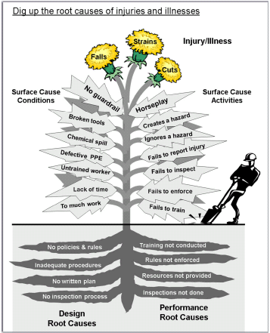
Page 35
Direct Cause
Why?
Why?
Why?
Why?
Why?
Surface
(Contributing)
Causes
Basic (Root)
Causes
Notes:
This takes us to page 35… Oregon OSHA’s Accident Weed, which illustrates direct, contributing and root causes…
Remember, on page 28 we discussed SAIF’s finding that Conditions (on the left) 3% of accidents, while Behaviors (on the right) 95% (this includes multiple accident reports, including MVA) However, management controls those factors that cause 98% of all accidents!
Please note that using the 5-Why concept can enable you to dig deep enough to find and isolate not only the direct cause, but the surface cause(s) and root cause(s) as well!

Slide 105
Accident Causation
Page 35
Direct Cause
  When a person or object receives an amount of energy or hazardous material that cannot be safely absorbed
Indirect (Surface) Causes
  Unsafe practices or conditions which allow contact with energy or hazardous material
Basic (Root) Causes
  Organizational, personal, and/or job factors that allow the unsafe practices or conditions (indirect causes) to occur
  Things like:
    Commitment, supervision, leadership, accountability, policies, procedures, enforcement, reinforcement, evaluation, involvement, maintenance, procurement, facility/job design, training, qualification…
Notes:
Notice that the ROOT causes tend to be SHMS related…
Things we have been covering today…

Slide 106
Page 35
Primary Surface Causes
Weed out the causes…
Hazardous Condition
Unsafe Behavior
Notes:
Our PRIMARY surface (indirect cause could be the final straw that broke the camel’s back, the final thing that allowed the direct cause…
Be aware, the line between conditions and behaviors can get blurry.
Being distracted could be a condition of the workplace or it could be a behavior of the individual.
Being in a hurry, if it was driven by leadership could be a condition. If it is driven by the individual, it could be a behavior.

Slide 107
Page 35
Contributing Surface Causes
Hazardous Conditions
Unsafe or Inappropriate Behaviors
Notes:
Supporting the primary surface cause, you will probably have one or more contributing surface causes.
Sometimes causes are obviously conditions or behaviors.

Slide 108
Page 35
Surface Causes of the Accident
Specific/unique hazardous conditions and/or unsafe actions
Directly produce or contribute to the accident
They may exist/occur at any time and anywhere and involve anyone.
If you're pointing at person or thing, it's probably a surface cause.

Slide 109
Page 35
Root Causes
Performance
Design
Notes:
LTA production expectations could be attributed as a performance root cause to cases where the surface cause was ‘in a hurry’ due to production demands.
LTA layout could be attributed as a design root cause to cases where the surface cause was ‘in a hurry’ due to bottlenecked workflow.
To clarify…

Slide 110
Page 35
Root Causes of the Accident
Performance weaknesses - General failure to effectively carry out safety policies, programs, plans, processes, procedures, practices
Program design weaknesses - Failure to effectively develop safety policies, programs, plans, processes, procedures, practices
Result in common or repeated hazardous conditions and unsafe/inappropriate performance
If you're pointing a group or a written plan, policy, procedure, it's probably a root cause.
Notes:
LTA = weakness!

Slide 111

Page 36
The six-step accident analysis process
3 Primary Tasks
6 Basic Steps
Gather Information
Analyze the Facts
Implement Solutions
Secure the Accident Scene
Collect the Facts
Develop the Sequence of Events
Determine the Causes
Recommend Improvements
Write the Report
Notes:
Oregon OSHA has long promoted a six-step process that fits in three- primary tasks:
Important to NOT determine cause(s) until after you have developed the sequence of events!
For more information on this topic take the Accident and Incident Investigation Workshop. It will take you into far greater detail.

Slide 112
Page 36
Three phases of analysis
  Injury analysis
              Identify direct cause
  Event analysis
              Identify indirect or surface cause(s)
              Conditions or behaviors
  Systems analysis
              Identify root cause(s)
              SHMS weaknesses
                Policies, procedures, plans, processes, programs, practices
Why?
Notes:
When analyzing accidents (and incidents) we need to focus on 3 things during that analysis, the injury (or potential), the event, and finally the system that allowed it.
Be sure to determine each cause

Slide 113
Page 37
ELEMENT 4 –
HAZARD PREVENTION AND CONTROL
Controlling the Hazards You Identify
437-001-0760(6) Extraordinary Hazards. When conditions arise that cause unusual or extraordinary hazards to workers, additional means and precautions shall be taken to protect workers or to control hazardous exposure. If the operation cannot be made reasonably safe, regular work shall be discontinued while such abnormal conditions exist, or until adequate safety of workers is ensured.
Notes:
Again, Oregon Administrative Rule, extraordinary hazards… Just because a specific rule doesn’t address a hazard, it still needs addressed.
Unseen or unusual, it doesn’t matter, the employer needs to use additional means or precautions.
COVID-19?

Slide 114
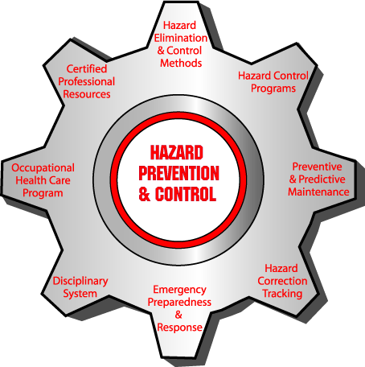
Hazard Prevention and Control
Page 37
  Once the hazards have been identified and analyzed, they must be prevented or controlled.
  The safety of the employee must be protected by eliminating the hazards or providing effective engineering and/or administrative controls.
Notes:
Ken

Slide 115
Pages 37 - 39
1. Engineering Controls
2. Administrative Controls
3. Personal Protective Equipment
4. Interim Measures
Notes:
If we cannot control something immediately and permanently, we need to put in interim measures until we can get it controlled.
While your book focusses on engineering controls, management controls and PPE controls, the HIERARCHY of controls is the best way to control hazards…

Slide 116
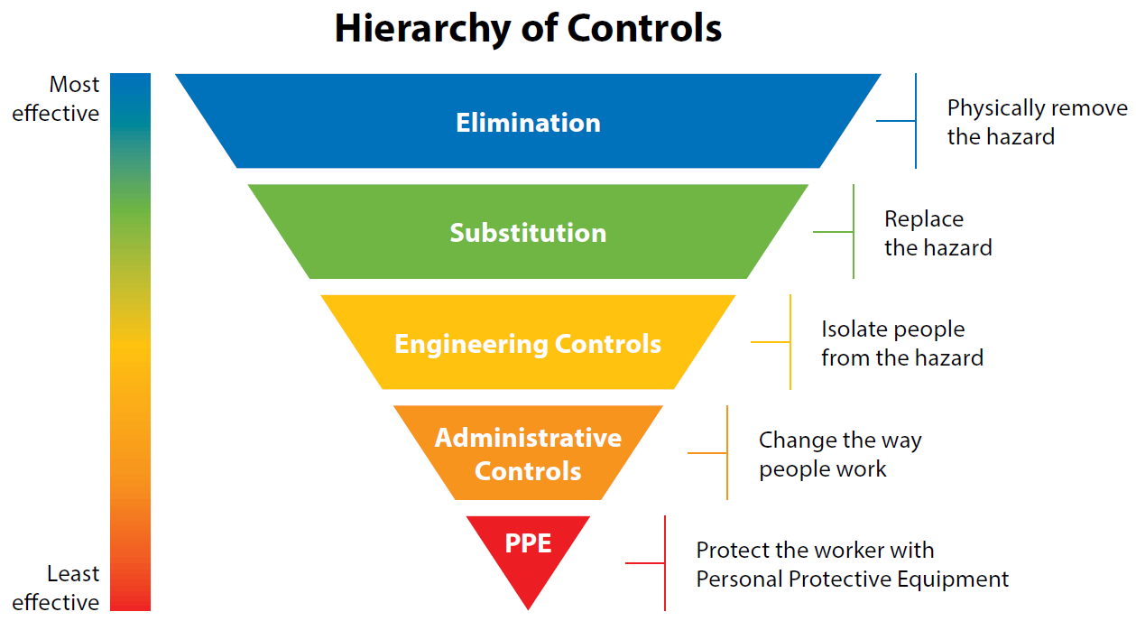
Pages 37 - 39
NIOSH
Notes:
If we can eliminate a hazard, it is gone. Substituting a less hazardous hazard when we can is also an accepted method.
Your workbook includes examples of Engineering controls, Management controls, PPE, and Interim measures.

Slide 117
Hazard Control (Effectiveness Ranking)
Pages 37 - 39
Eliminate / Substitute
  Removes the Hazard
Engineering Controls
  Address Hazards
    Design (redesign to eliminate, enclose, guard, barrier)
Administrative Controls (Safe Work Practices)
  Address Exposures
    Enforced/reinforced work rules/SOPs/training/maintenance
    Personnel scheduling (duration/frequency/severity)
Personal Protective Equipment
  Hazards and Exposures are still there
    Barrier(s) between worker & hazard
Notes:
Another way of looking at it is by effectiveness…
Often times, the cost of the control is looked at in the short-term, but not the long term. It may be cheaper to go with respirators instead of a spray booth in the short-term, but when we figure the cost over the years to include fit tests, medical exams, cartridge replacements, supervision costs, etc. within a few years, we could have paid for the spray booth.
Remember, Human error plays in to which control we use.

Slide 118
Page 40
ELEMENT 5 -
EDUCATION AND TRAINING
Notes:
Education is continual. Life is a school.
Training has a beginning and an end. Briefly cover the concepts on this page.

Slide 119
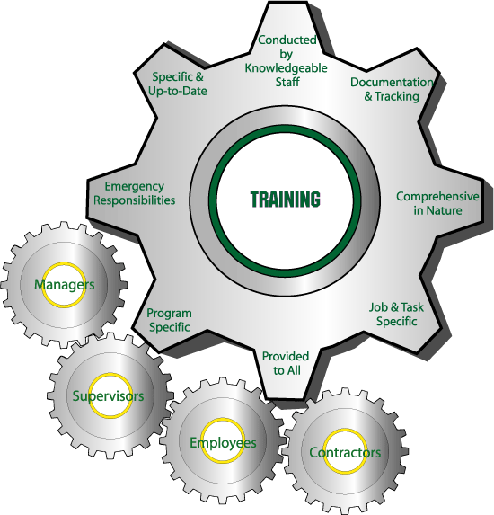
Safety and Health Training
Page 40
The appropriate level of training should be provided to every employee.
The type of training will depend on the nature of the employee’s job and the hazards encountered in the workplace
Notes:
Ken

Slide 120
Page 40
Education tells Why
Training shows How
Experience may improve skills
Consequences may sustain behavior
Culture matters
Notes:
Education transfers general knowledge and more specifically explains natural and system consequences.
Safety training helps employees perform safe procedures and practices.
Experience within a supportive safety culture will help to further increase knowledge, skills and attitudes about safety in the workplace. It’s important to understand how important the safety culture is to safe performance.
When employees understand the natural consequences (hurt or health) of their actions, they’re more likely to use safe procedures and practices. Employees are also more likely to comply when they understand that system consequences (discipline, recognition) will be administered.

Slide 121
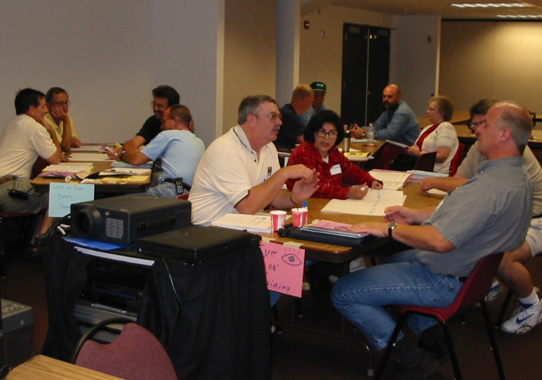
Page 40
How do you know safety training is effective?
Why are improved skills and sustained behavior not guaranteed by effective safety training?
People know what to do and how to do something, and they CAN do it to standard when they finish training. Remember, behavior is the most direct effect indicating the success of training.
If the corporate culture does not support safety training, it is ultimately doomed to failure. If supervisors don’t insist on safe behavior after training. Behaviors will change.

Slide 122
Page 41
Two Types of Safety Education
Type One: General Safety Instruction
General/Specific information and instruction
Knowledge and skills are not measured at the end of training
Trainers write goals for students. Instructional objectives are not required
All you have to do is attend to get a certificate
Measurement focuses on student's reaction to the training session rather than learning
Measurement tools include - "smile sheet" evaluation forms
Notes:
Instruction occurs at orientation, tailgate meetings, etc.
Instruction is NOT Training

Slide 123
Page 41
Type Two: Technical Safety Training
Describes general/specific policies, procedures, practices
Trainers write goals and operational objectives for students.
Knowledge and skills are measured immediately after training in the learning environment.
You have to "pass the test" in class to get a certificate.
Measurement tools - oral/written exam, skill demonstration.
This level is required for most safety training!
Notes:
Emphasize testing and demonstration. Most safety training also requires certification of adequate knowledge and skills.

Slide 124
Page 42
The 7 basic steps in OJT
Step 1. Introduction
  Explain subject, emphasize natural and system consequences
Step 2. Trainer show and tell
  Trainer EXPLAINS a step then PERFORMS a step.
  Learner OBSERVES each step and QUESTIONS the trainer.
Step 3. Trainer ask and show
  Learner EXPLAINS each step and RESPONDS to questions,
  Trainer PERFORMS each step and QUESTIONS the trainee.
Step 4. Trainee tell and show
  Learner EXPLAINS, gets PERMISSION and then PERFORMS each step.
  Trainer gives PERMISSION, OBSERVES each step and QUESTIONS trainee
Notes:
Students use this process later while presenting their OJT. What’s neat about this procedure is that education and training is occurring, and measurement of knowledge and skills is occurring in steps 3-5. Emphasize step four to protect the worker. In OJT that does not involve hazards, step four could be eliminated.

Slide 125
Pages 42 - 43
The 7 basic steps in OJT
Step 5. Conclusion
  Recognize, reemphasize, tie training to accountability
Step 6. Document
  Include trainer and trainee names, subject or procedure, signature, dates.
  Certify that knowledge and skills were achieved
Step 7. Validate
  After session, observe and question trainee to validate training was successful.
Notes:
Step 6. Strong documentation is critical. If it isn’t in writing it didn’t get done. An attendance roster, by itself, merely certifies attendance...not adequate..
Strong documentation is vital, not only to protect the employee, but to protect the employer against claims of negligence.

Slide 126
Page 44
ELEMENT 6 -
PROGRAM EVALUATION AND IMPROVEMENT
OAR 437-001-0765(6)(d) Program Evaluation. The safety committee shall assist the employer in evaluating the employer's accident and illness prevention program, and shall make written recommendations to improve the program where applicable…
What is the purpose of writing recommendations?
To persuade the employer to make improvement in PROGRAMS, POLICIES, and PROCEDURES
A work order is not a recommendation.
Good consultants fix the system!

Slide 127
Page 44
Critically evaluate the effectiveness of your SHMS at least annually. Program evaluation gives you the ability to achieve a long term focus on continuous improvement. Your self-evaluation process should include:
a review of your programs,
a walk-through of your facility, and
interviews with employees.
Purpose:
Identify and correct deficiencies or shortcomings and identify additional improvement opportunities.
Ask Yourself:
Is it comprehensive?
Is it effective and meeting established goals?
What improvements can be made to make it even more effective?
What goal modifications should be made for next year?

Slide 128
Key to evaluating and improving
Page 44
When evaluation your written programs, ask yourself:
  Do we do what it says, and does it say what we do?
  If not, WHY not?
    Change one or the other so that they line up
Don’t forget to look at your leading indicators!

Slide 129

Help is available…
Page 44
Leading indicators are proactive and preventative measures that can help determine whether your safety and health activities are effective at preventing incidents or whether there are potential problems with your safety and health program. Leading indicators play an important role in preventing worker fatalities, injuries and illnesses, and strengthening other safety and health outcomes in the workplace.
Leading indicators include things like: worker participation levels, # of safety suggestions, # of near misses reported, # and frequency of inspections, # and severity of hazards identified, # of routine IH exposure assessments, timely completion of corrective actions, # of workers completing training, # and completion rate of PM activities, # of positive observations, # of negative observations, climate surveys, etc.
https://www.osha.gov/leadingindicators/docs/OSHA_Leading_Indicators.pdf
Notes:
Leading indicators are proactive, preventive, and predictive measures that provide information about the effective performance of your safety and health activities. They measure events leading up to injuries, illnesses, and other incidents and reveal potential problems in your safety and health program.
In contrast, lagging indicators measure the occurrence and frequency of events that occurred in the past, such as the number or rate of injuries, illnesses, and fatalities.

Slide 130
Page 45
Successful change requires effective design and implementation
Identify
Analyze
Evaluate
Problem Solve
Recommend
Carry out
Test
Perform
Train
Implement
Check
Monitor
Measure
Analyze
Compare
Adjust
Implement
Standardize
Document
Evaluate
Notes:
Later in W. Edwards Deming’s career he modified to Plan-Do-Study-Act (PDSA) ecause he felt “check” emphasized inspection over analysis.

Slide 131
Page 46
ELEMENT 7 -
COMMUNICATION AND COORDINATION for host employers, contractors, and staffing agencies

Slide 132
Page 46
OAR 437, Div 1, Rule 7650 (1) (d) Every employer must inform the employees regarding the known health hazards to which they are exposed, the measures which have been taken for the prevention and control of such hazards, and the proper methods for utilizing such control measures.
What is the purpose of Communication and Coordination?
Communication to ensure ALL workers are aware of the type of hazards that may be present and the measures needed to avoid or control exposure to them. Coordination to work out conflicts or concerns that could impact safety or health
Notes:
Communication (informing) is built in to the rule for a reason.

Slide 133
How do we communicate/coordinate?
Page 46
Internally
  Shifts
  Departments
  Crews
Externally
  Temporary workers
  Contractors and contract workers
  Staffing Agencies
To ensure ALL workers on site understand and can participate in preventing injuries and illnesses
  The types of hazards present
  Means and methods to avoid or control exposure to the hazards
  How to report injuries, illnesses, incidents, and concerns and who to report them to
Notes:
We can enhance safety in our workplaces if we establish methods to coordinate our efforts and communicate effectively to afford all workers equal protection against hazards.
These mechanisms include measures to ensure that all workers on site (and their representatives) can participate in preventing injuries and illnesses. Failure to take these steps could seriously undermine safety programs.
For example, if the different departments/employers have inconsistent policies for when and where to wear PPE, workers may mistakenly believe that the equipment is not needed, leading to injury. Inconsistencies in safety policies may also cause workers to question the credibility of safety and health programs, resulting in less meaningful employee engagement and participation.

Slide 134
Pages 47 - 48
That's it!
Before you run, time to review!

Slide 135
Page 47
All systems have S _____________, I ________________, P ______________, and
O ________________.
2. Conditions cause around _________ % of the accidents in the workplace, while behaviors account for about _________ % ?
3. According to the text, a safety management system should include all of the following positions, Except:
  a. Safety engineer
  b. Safety manager
  c. Human resource coordinator
  d. Quality control coordinator
4. Engineering controls reduce or eliminate ________________ and management controls help to reduce or eliminate ______________.
  a. exposure, hazards
  b. hazards, exposure
  c. hazards, non-compliance
  d. exposure, non-compliance
Structure
Inputs
Processes
Outputs
3
95
hazards
exposures

Slide 136
Pages 47 - 48
5. According to the text, effective recognition should be:
  a. simple, certain, single, sincere, formal
  b. soon, policy-driven, justified, significant
  c. soon, sure, significant, simple, sincere
  d. simple, sincere, policy-driven, personal
6. The condition of accountability exists when:
  a. Performance + Evaluation -> Results
  b. Results + Consequences -> Evaluation
  c. Behavior + Evaluation -> Consequences
  d. Results + Evaluation -> Consequences
7. Which of the following would be a surface cause of an accident?
  a. A staff member fails to replace a guard after servicing equipment
  b. No lockout/tagout procedures in place
  c. The training plan does not include supervisor safety training
  d. Some supervisors are ignoring safety rules

Slide 137
Page 48
8. Which of the following describes a root cause for an accident?
  a. An unguarded saw.
  b. A missing MSDS.
  c. PPE training plan does not include practice of spill procedures.
  d. A maintenance worker fails to wear eye protection.
9. When it comes to discipline, the accident is an important consideration:
  a. True, it should always be considered
  b. False, it’s irrelevant
10. The most effective accident investigations analyze __________________ to determine _____________________.
  a. the accident, fault
  b. employee performance, surface causes
  c. the accident, root causes
  d. quickly, blame

Slide 138
Reference Material & Resources
Pages 47 - 89
50-51: Hazard Analysis Worksheet
52: Sample PPE Certification
53-54: Risk = Exposure x Probability x Severity
55-56: Determining Cost
57-58: Determining Benefits
59-61: Writing Recommendations
62-66: Sample S&H Training Plan
67: Sample Training Program Evaluation Form
68-69: Sample Safety Training Certificate
70-72: ‘Fix the System’ IA Analysis Plan
73-76 SHMS IA Analysis Checklists (MEEE)
77-84: Attributes of Excellence for a SHMS
85-85: Div. 7 S&H Program
88: Safety Pays OSHA Advisor
89-91: Policy Statement Worksheet

Slide 139
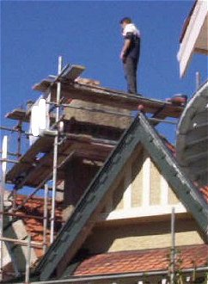
Thanks for coming and be careful!

