Slide 1
The Powered Industrial Truck

Slide 2
Oregon OSHA Public Education Mission:
Consultative Services
Enforcement
Public Education and Conferences
Standards and Technical Resources
We provide knowledge and tools to advance self-sufficiency in workplace safety and health.

Slide 3
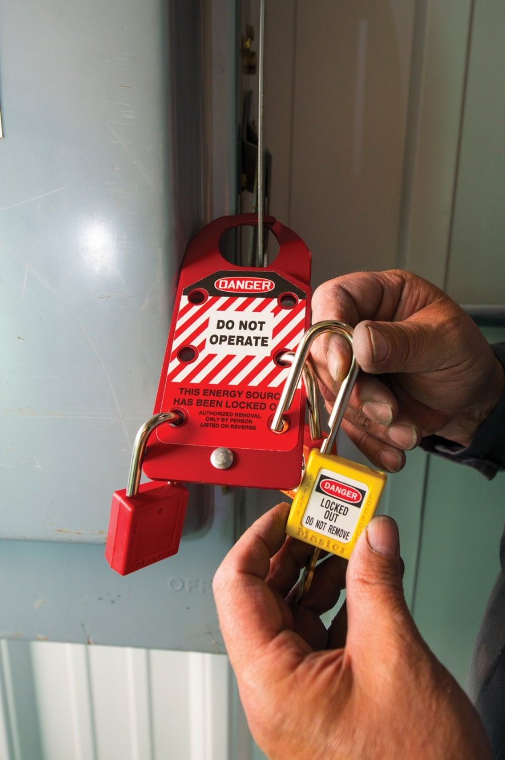
Contact us
Field Offices:
Portland 503-229-5910
Salem 503-378-3274
Eugene 541-686-7562
Medford 541-776-6030
Bend 541-388-6066
Pendleton 541-276-2353
Salem Central:
Toll Free English: 800-922-2689
Toll Free Spanish: 800-843-8086
Website: osha.oregon.gov

Slide 4
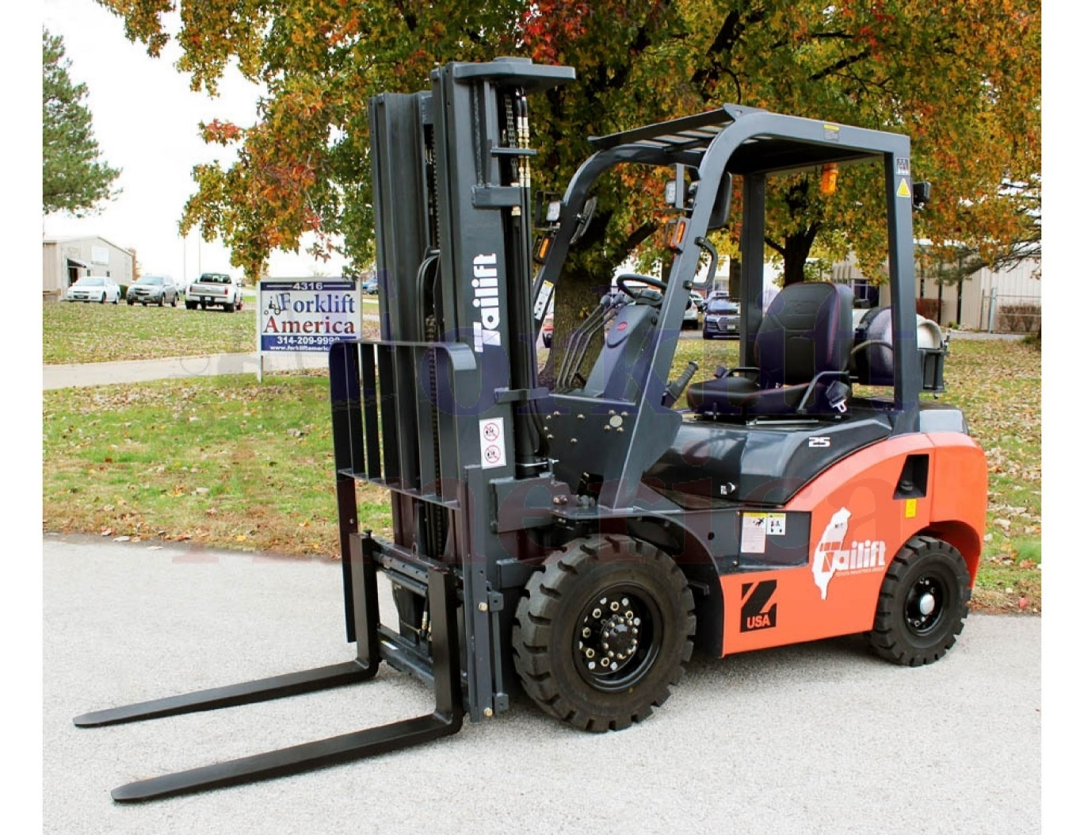
Powered industrial truck
Mobile, power-driven vehicle used to carry, push, pull, lift, stack, or tier material.

Slide 5
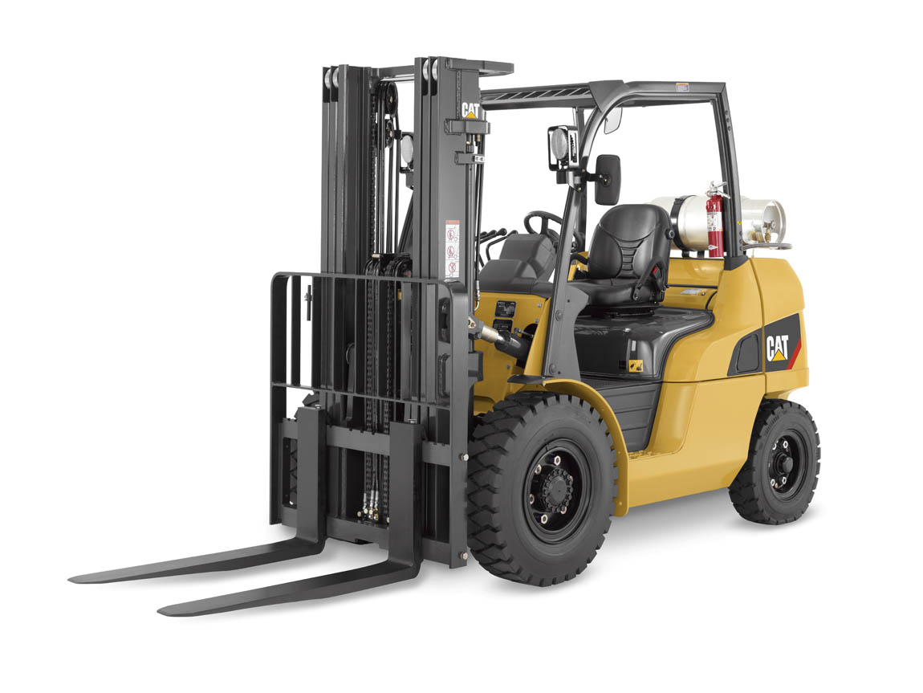
General requirements
Design and construction of powered industrial trucks must be in compliance with the current revision of ANSI B56.1. ASME B56.1-1993, Safety Standard for Low Lift and High Lift Trucks, is the latest revision.

Slide 6
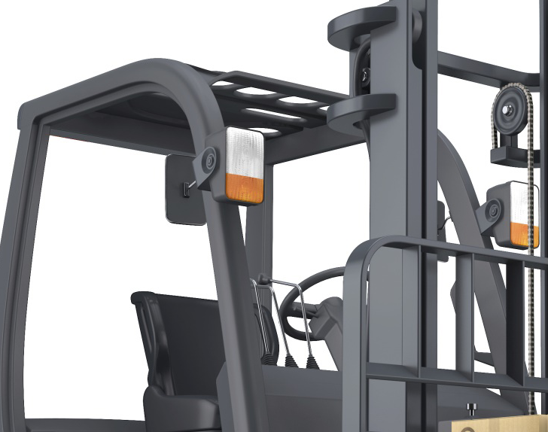
FOPS
Most vertical mast forklifts are equipped with FOPS
(Falling Object Protective Structure).

Slide 7
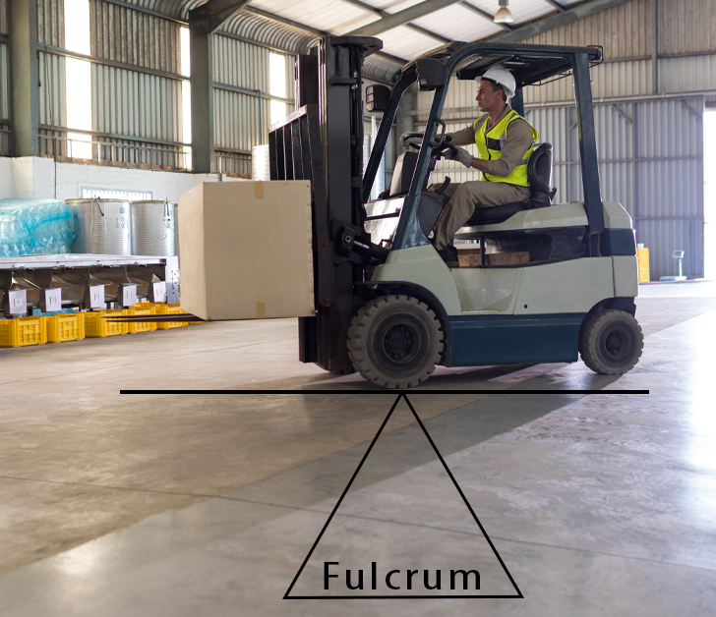
Fulcrum point
The lift truck is based on the principle of two weights balanced on opposite sides of a pivot (fulcrum point).
The forward wheels are the fulcrum.
This is the same principle used for a teeter-totter.

Slide 8
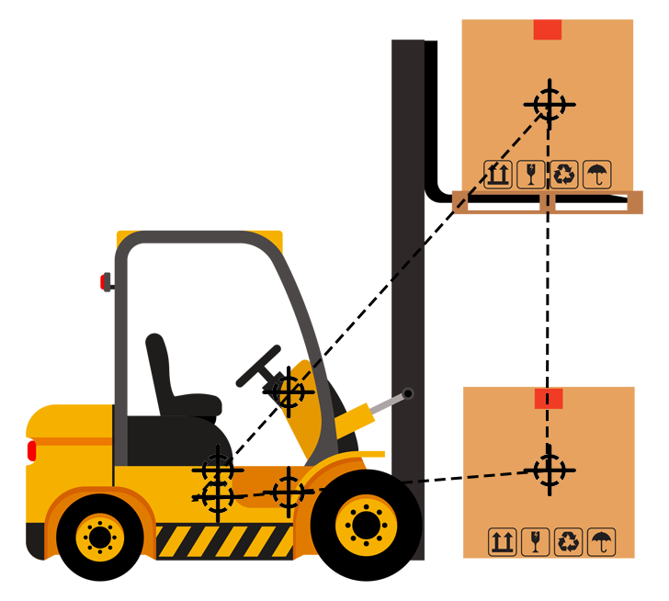
Center of Gravity (CG)
When the lift truck picks up a load, the truck and load have a new combined CG.
The stability of the lift truck is determined by the location of its CG, or if the truck is loaded, the combined CG.

Slide 9
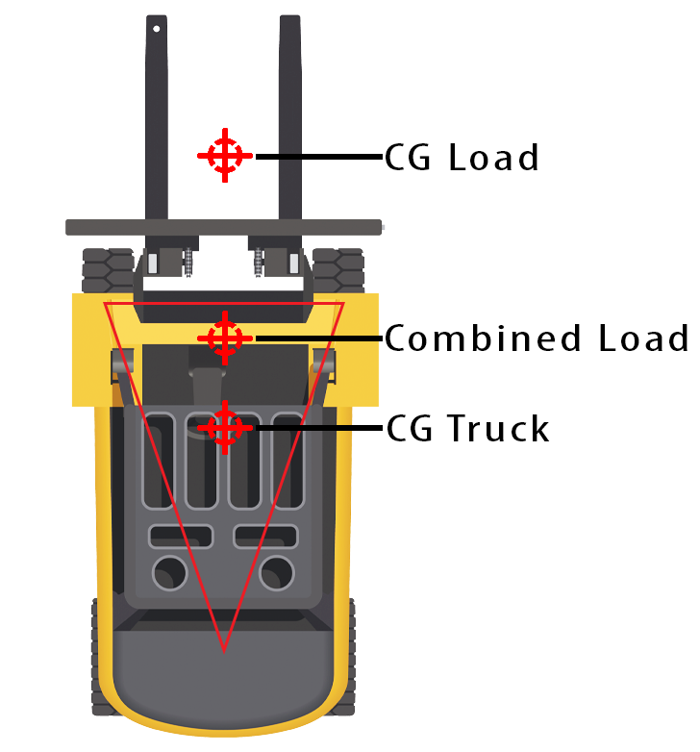
Triangle on wheels
When the lift truck picks up a load, the truck and load have a new combined CG.
The stability of the lift truck is determined by the location of its CG, or if the truck is loaded, the combined CG.

Slide 10
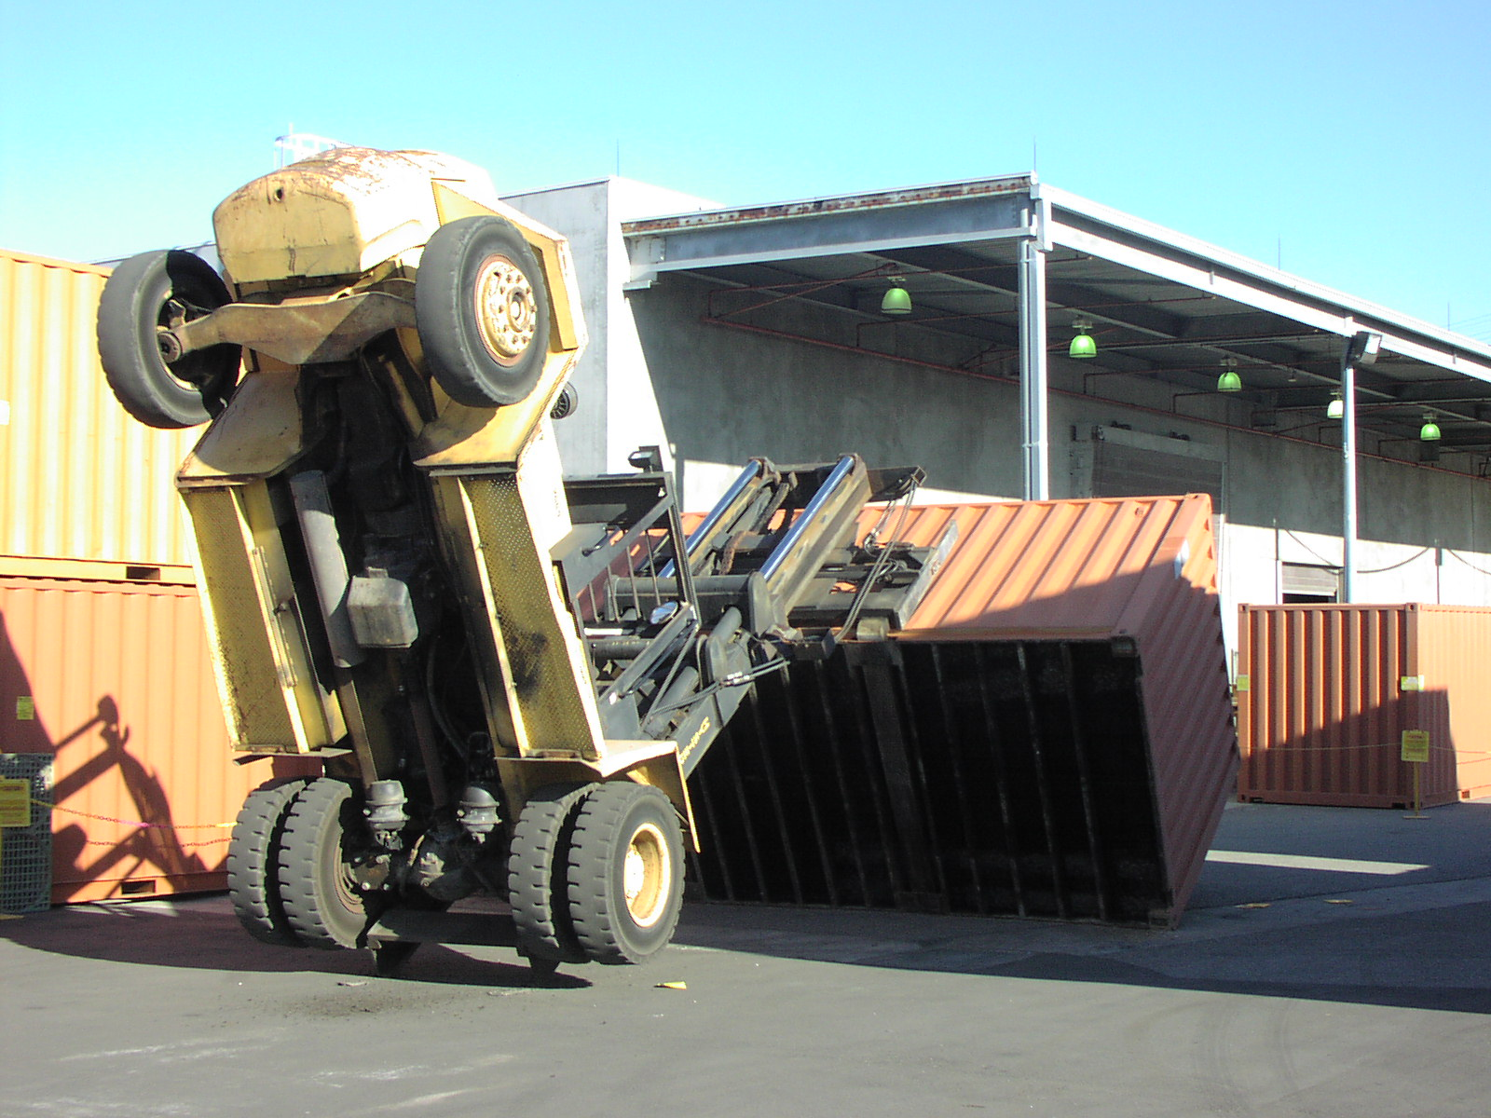
Stability
What factors have caused trucks to tip forward?

Slide 11
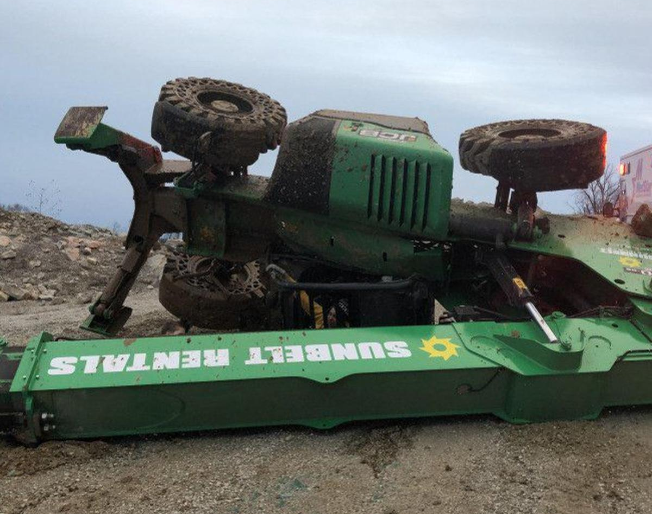
Stability
What factors have caused trucks to tip over on their side?

Slide 12
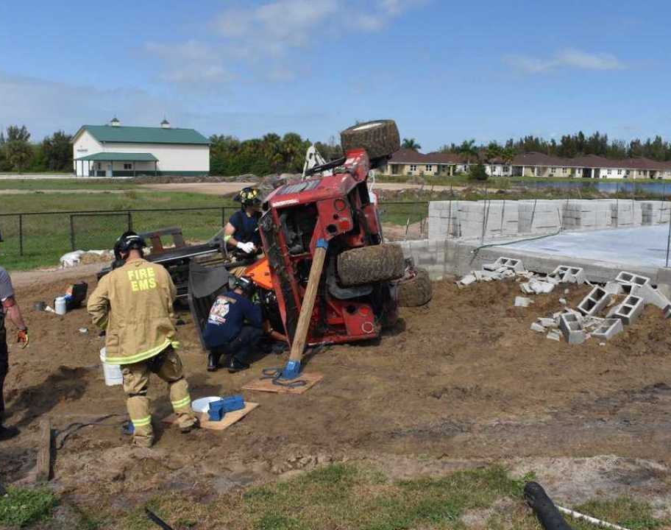
Seat restraints
The leading cause of death to forklift operators is overturn.

Slide 13
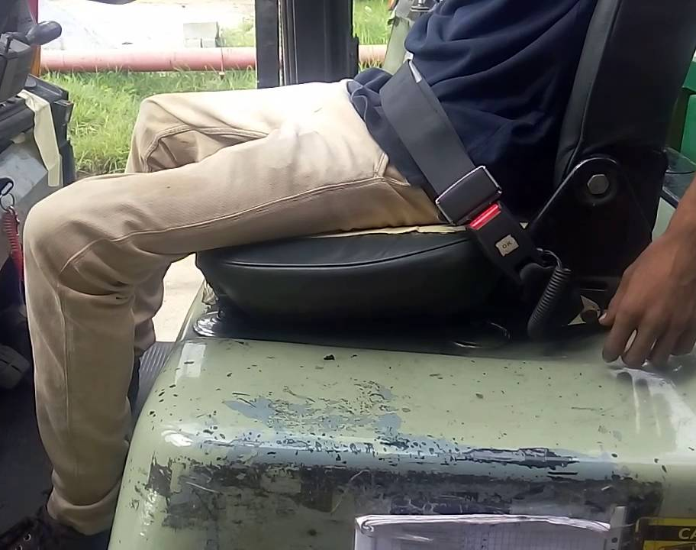
Operator seat restraints
Employees must use them when exposed to an overturn hazard or traveling in areas where an operator can be thrown from the operator’s compartment.
Employees must use them when required by the manufacturer, AND when exposed to an overturn hazard.

Slide 14
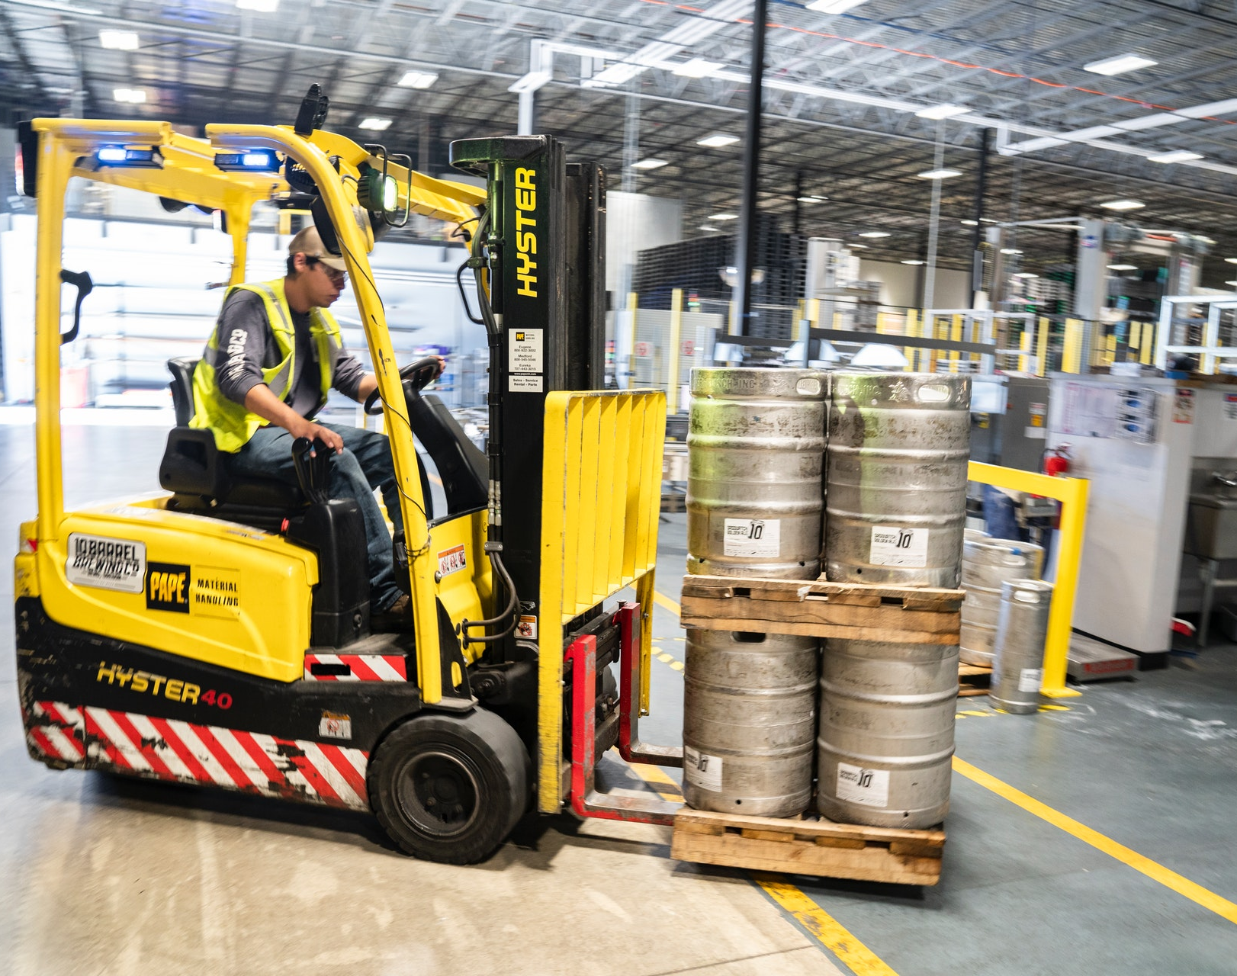
Picking up a load
Load does not exceed the forklift’s capacity
Forks are positioned properly
Load is balanced and secure
Bottom of the load is raised to the proper traveling height
Drive as far into the load as possible
Slightly tilt back and lift
Back, stop, and lower load 2-6 inches from the floor
Before backing up, check behind and on both sides for pedestrians or other traffic

Slide 15
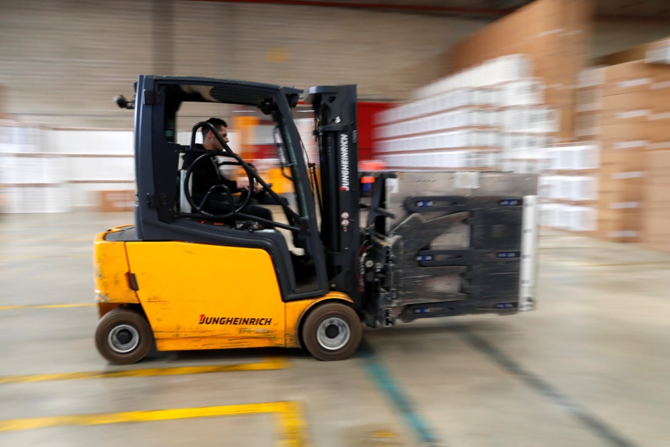
Traveling with a load
The operator and pedestrians must communicate
No riders/passengers
Travel at walking speed
All traffic regulations must be met, including plant speed limits (if established)
Maintain at least 3 truck lengths
Be aware of the traveling surface
Keep the load slightly off grade
Avoid sudden braking
Turn in a sweeping motion
Keep the load slightly tilted back
Sound horn when approaching corners and blind areas
Lift and lower the load only when stopped

Slide 16
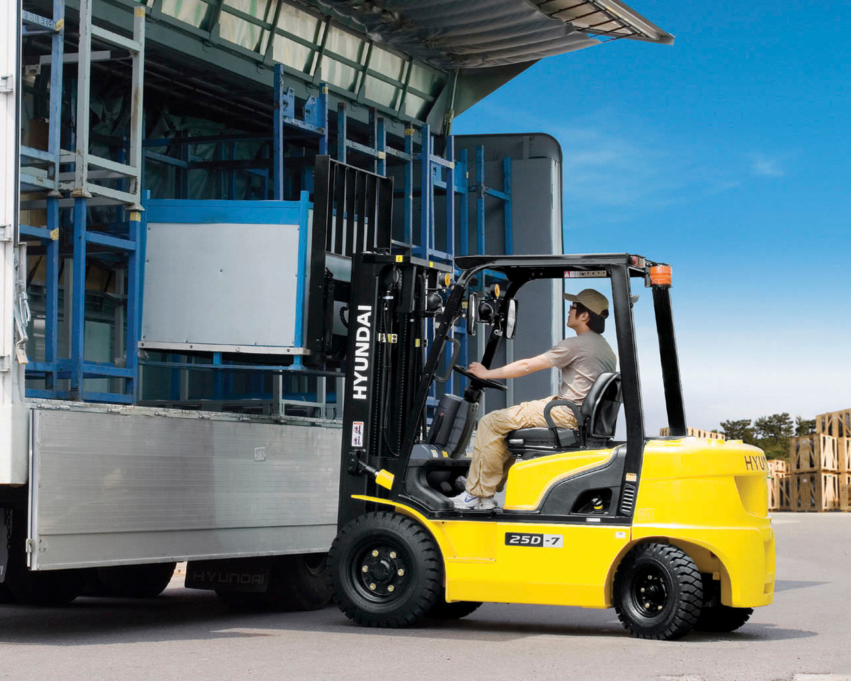
Placing and stacking a load
Completely stop before raising a load
Never walk, stand, or allow anyone to pass under a raised load
Move slowly after raising the load
Tilt forward, level only when over a stack or rack
Make sure forks have cleared the pallet when backing out & before turning or changing height
Before backing up, check behind and on both sides for pedestrians or other traffic
Caution must be exercised when handling unusually shaped and off center loads

Slide 17
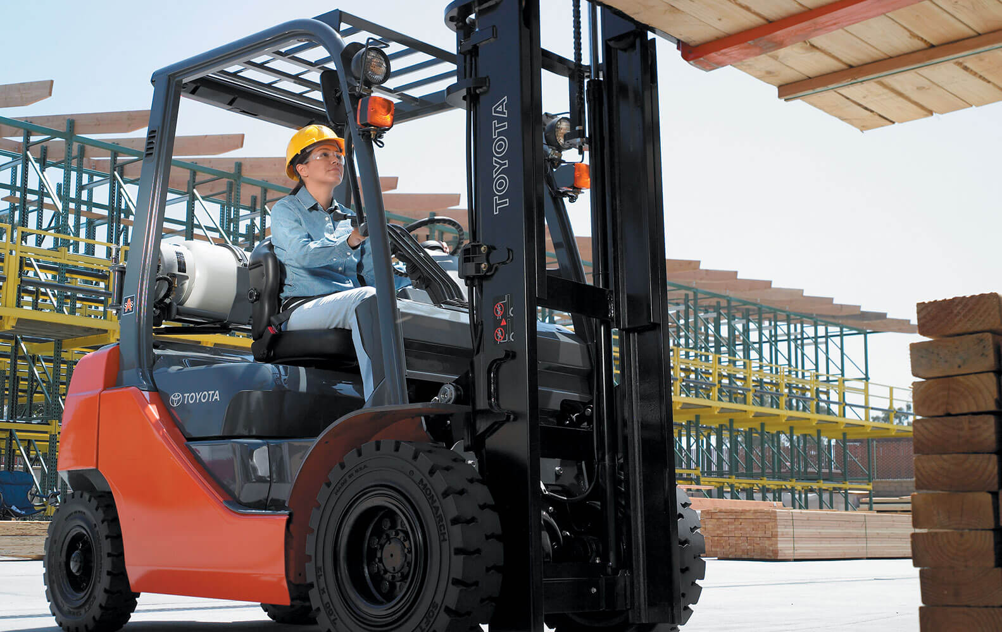
More safe operations
Only loads within the rated capacity must be handled
Trucks equipped with attachments must be operated as partially loaded trucks even when unloaded
Avoid running over loose objects

Slide 18
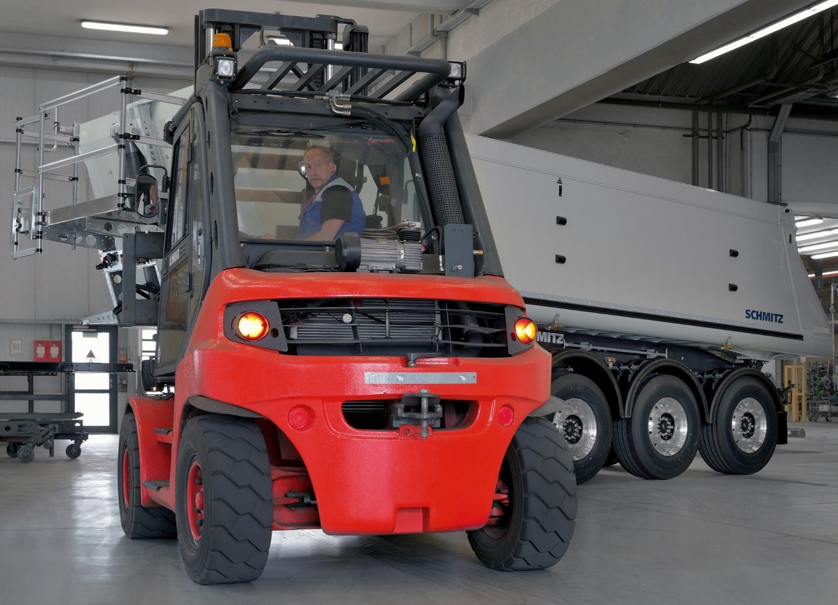
More safe operations
Under all travel conditions, the truck must be operated at a speed that will permit it to be brought to a stop in a safe manner
No horseplay or stunts
If the load is high obstructing forward view drive in reverse

Slide 19
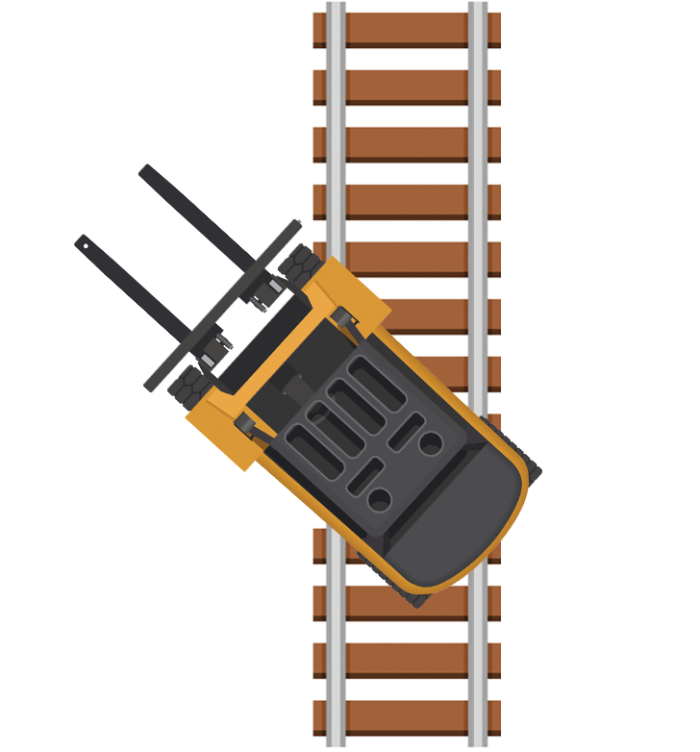
More safe operations
Cross railroad tracks diagonally
Never park closer than eight feet from tracks
Right of way must be given to emergency vehicles
Keep arms & legs from the mast and within the running lines of the truck

Slide 20
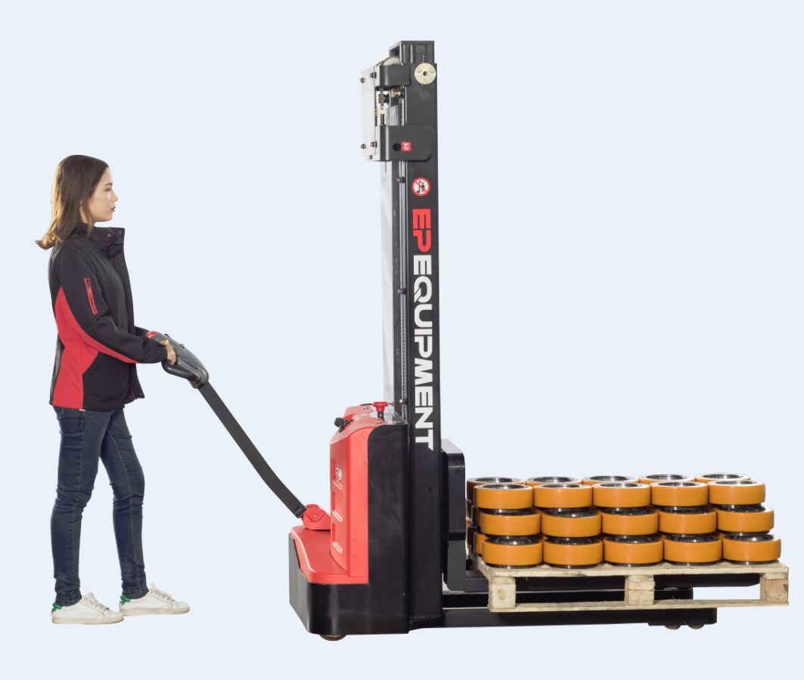
More safe operations
Never drive up to someone standing next to a fixed object
Powered hand trucks must enter enclosed areas load end forward

Slide 21
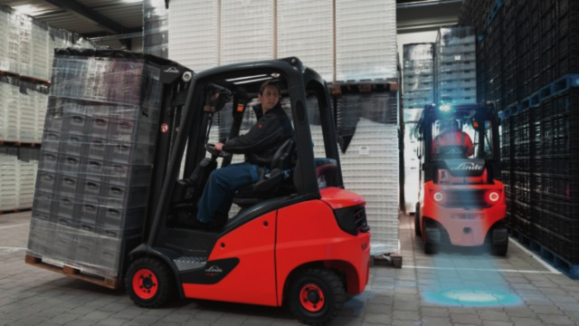
More safe operations
Never pass another truck traveling in the same direction at:
Blind corners
Intersections
Other dangerous areas

Slide 22
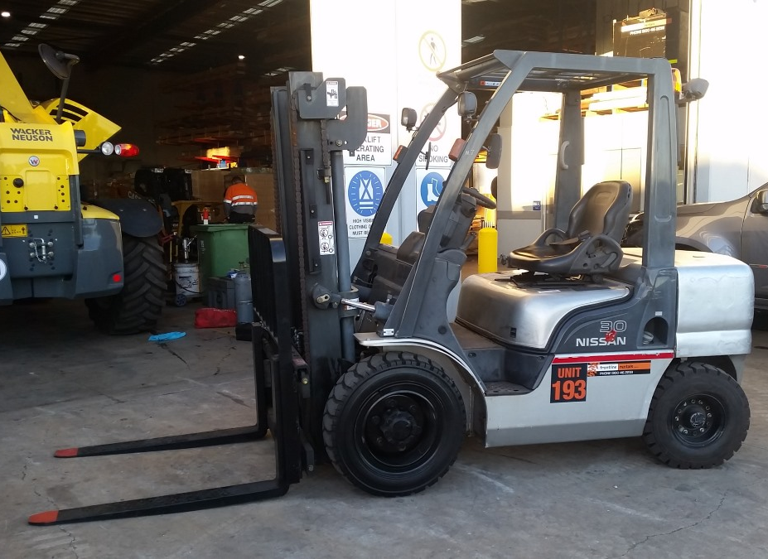
When truck is left unattended:
Lower forks
Neutralize controls
Shut off
Set brakes

Slide 23
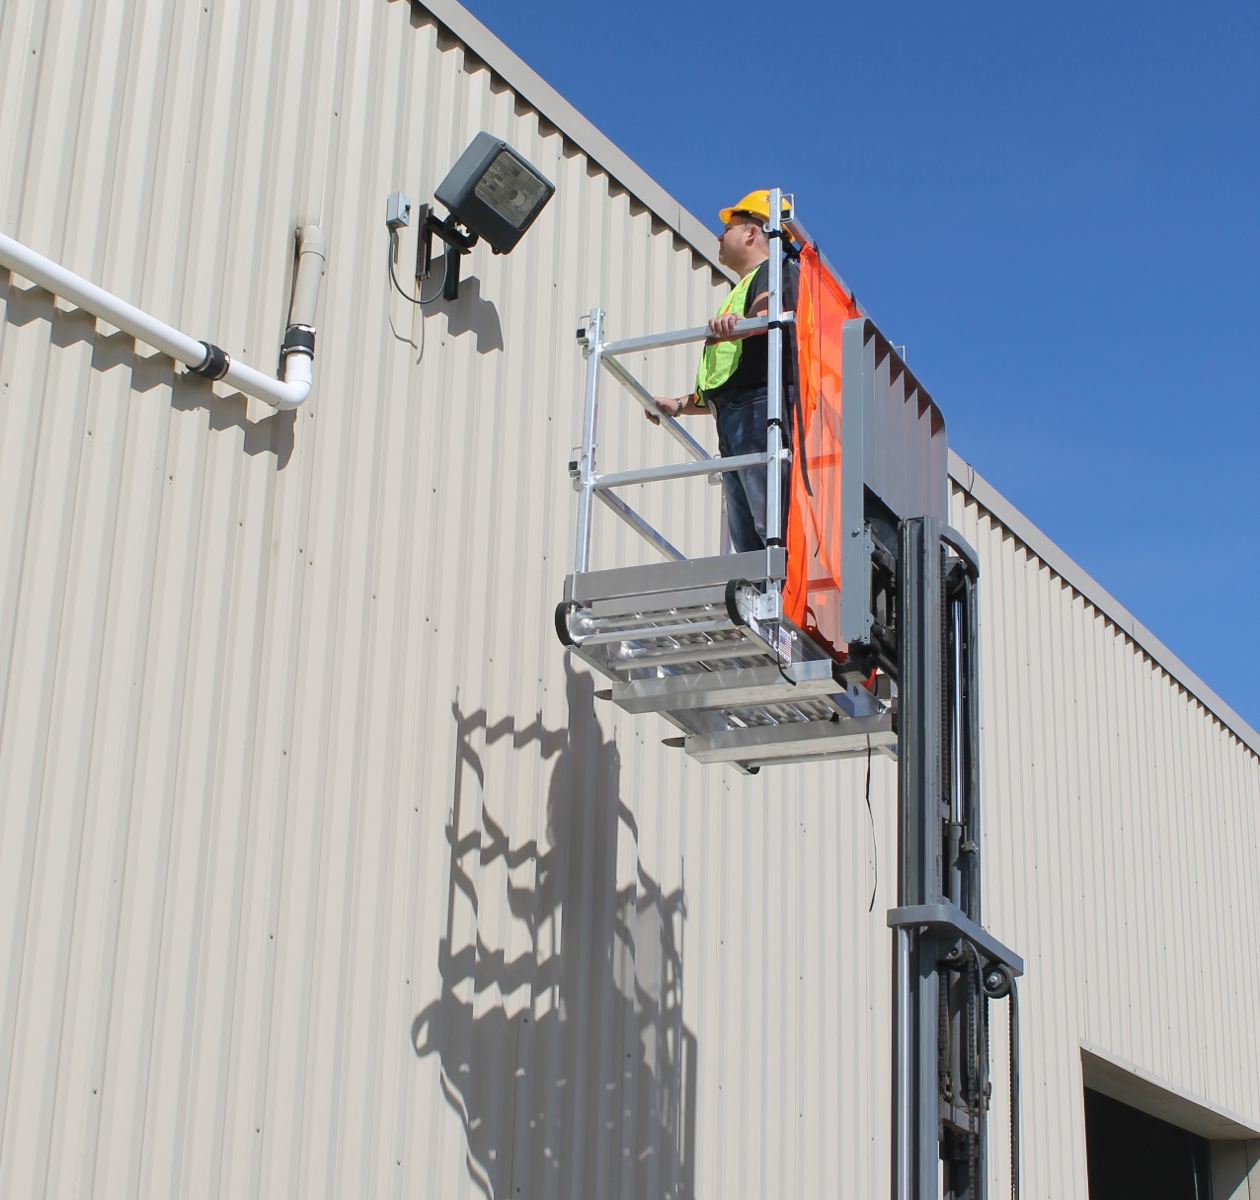
Lifting people
Work platform
Falling objects
Operator musts
Guards

Slide 24
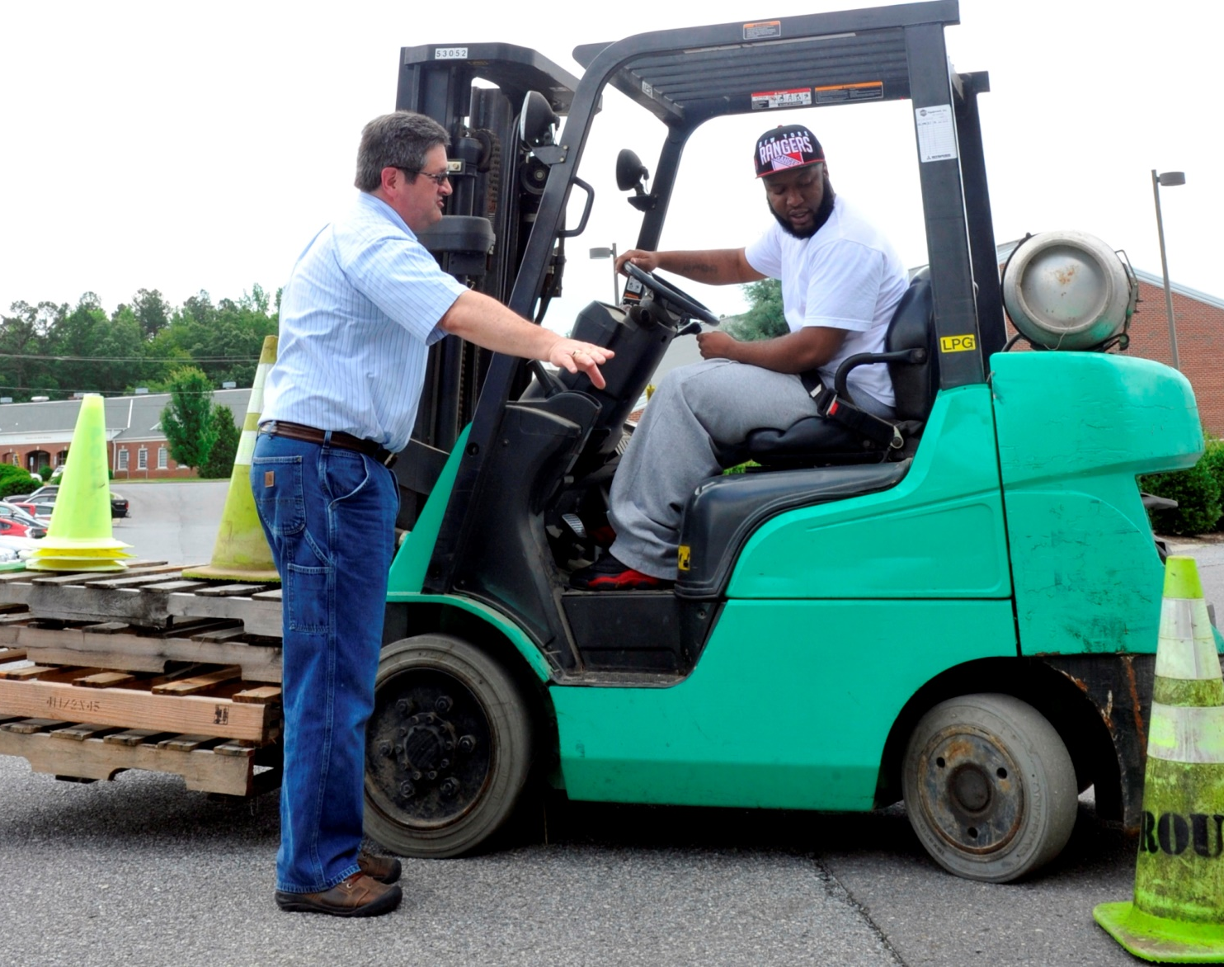
Training
Each powered industrial truck operator must be competent to operate a powered industrial truck safely.
What is your definition of competent?

Slide 25
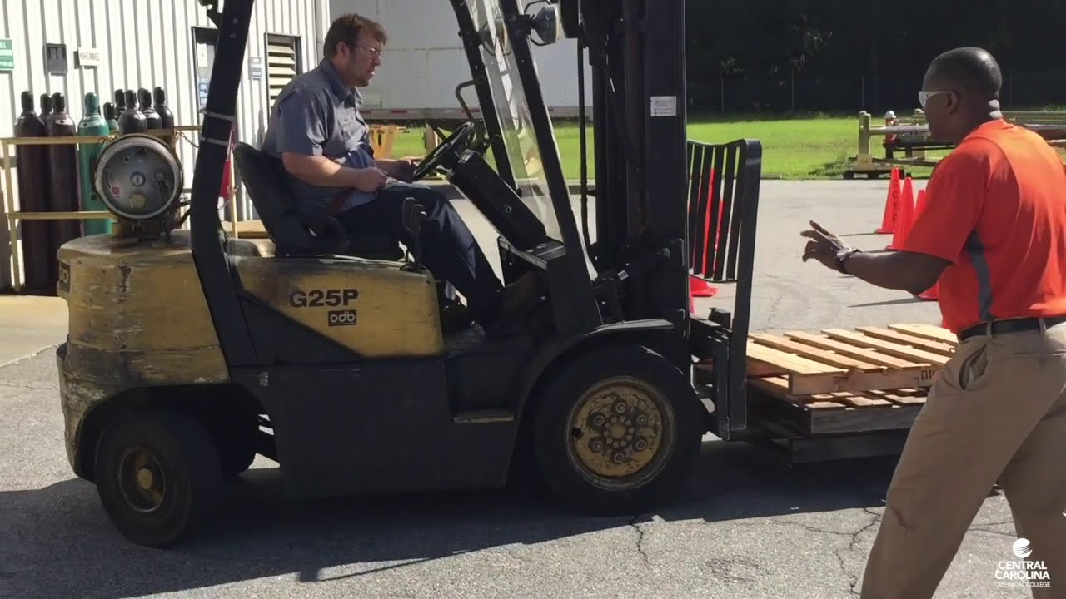
Training
Trainees may operate a powered industrial truck only under the direct supervision of persons who have the knowledge, training, and experience to train operators and evaluate their competence.

Slide 26
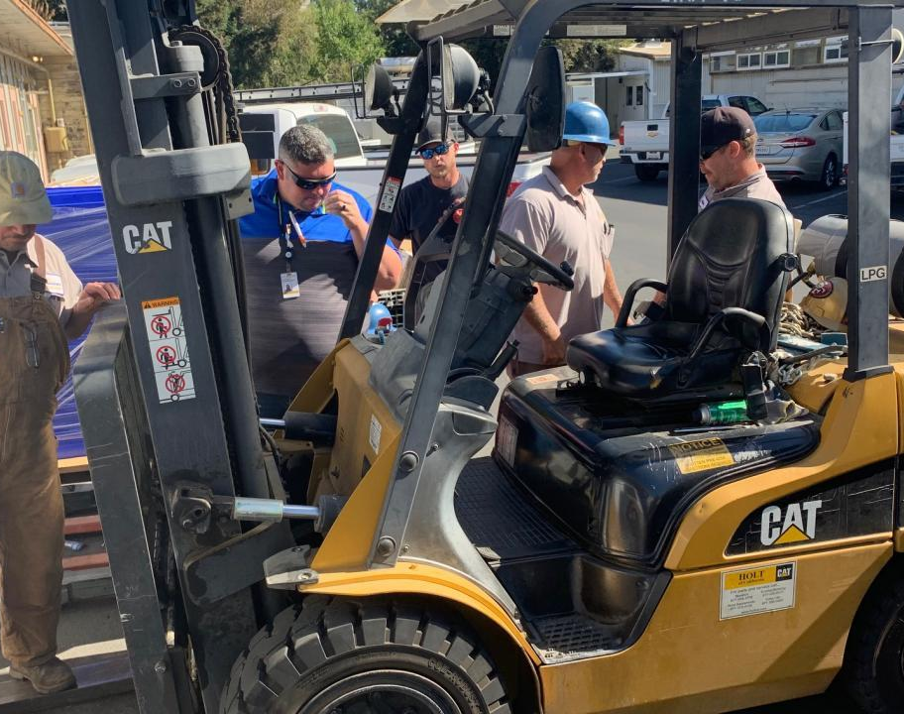
Operator training:
Formal
Practical
Evaluation of performance in the workplace

Slide 27
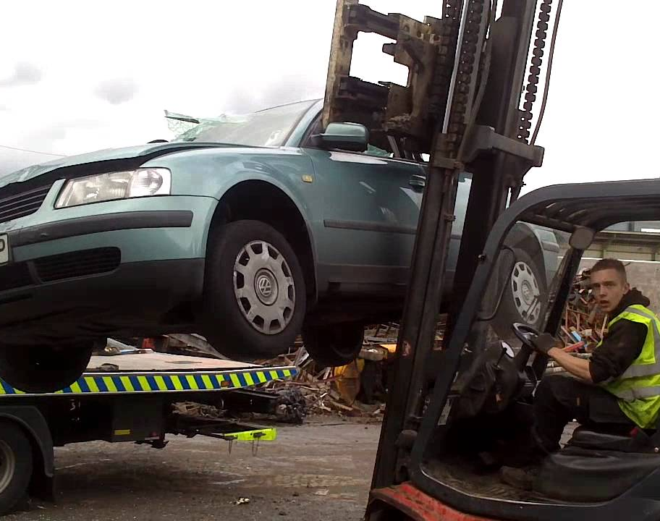
Retrain operator when:
Observed operating the vehicle unsafely
Involved in an accident or near – miss
Received a poor evaluation
Assigned to different type of truck
Work place changes that could affect safe operation

Slide 28
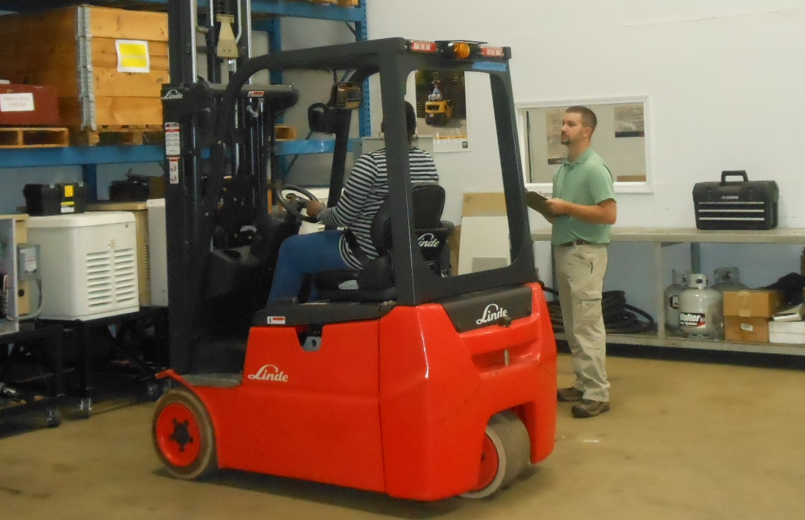
Truck related topics
Operating instructions, warnings, and precautions
Truck vs. automobile
Controls and instrumentation
Engine or motor operation
Steering and maneuvering
Visibility (restrictions)
Fork and attachments
Vehicle capacity
Vehicle stability
Inspection/Maintenance
Refueling
Operating instructions

Slide 29
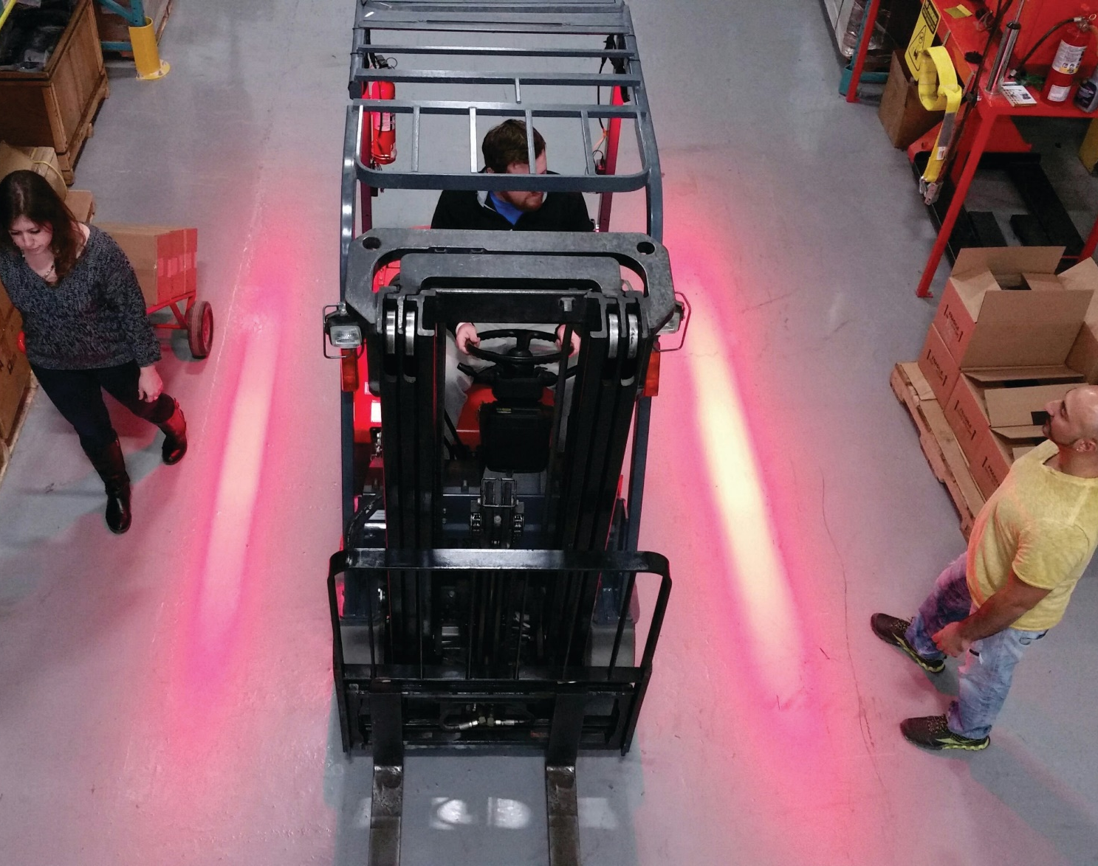
Workplace – related topics:
Pedestrian traffic
Restricted places
Hazardous locations
Areas accumulating exhaust
Sloped surfaces
Hazardous environmental conditions

Slide 30
Previously Received Training
If an operator has previously received training in a topic specified under the training program content criteria, and such training is appropriate to the truck and working conditions encountered, is additional training in that topic required if the operator has been evaluated and found competent to operate the truck safely?

Slide 31
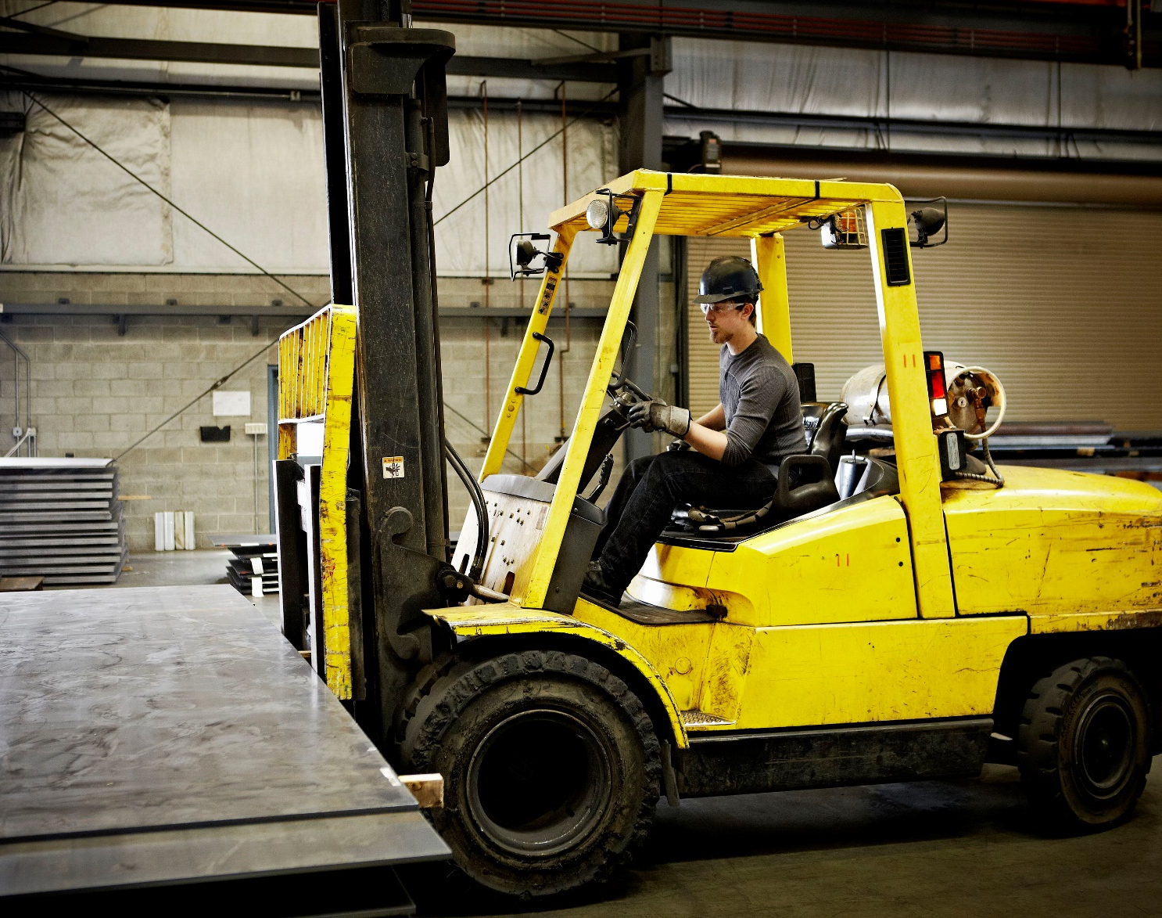
Evaluation
Must be conducted at least once every 3 years.

Slide 32
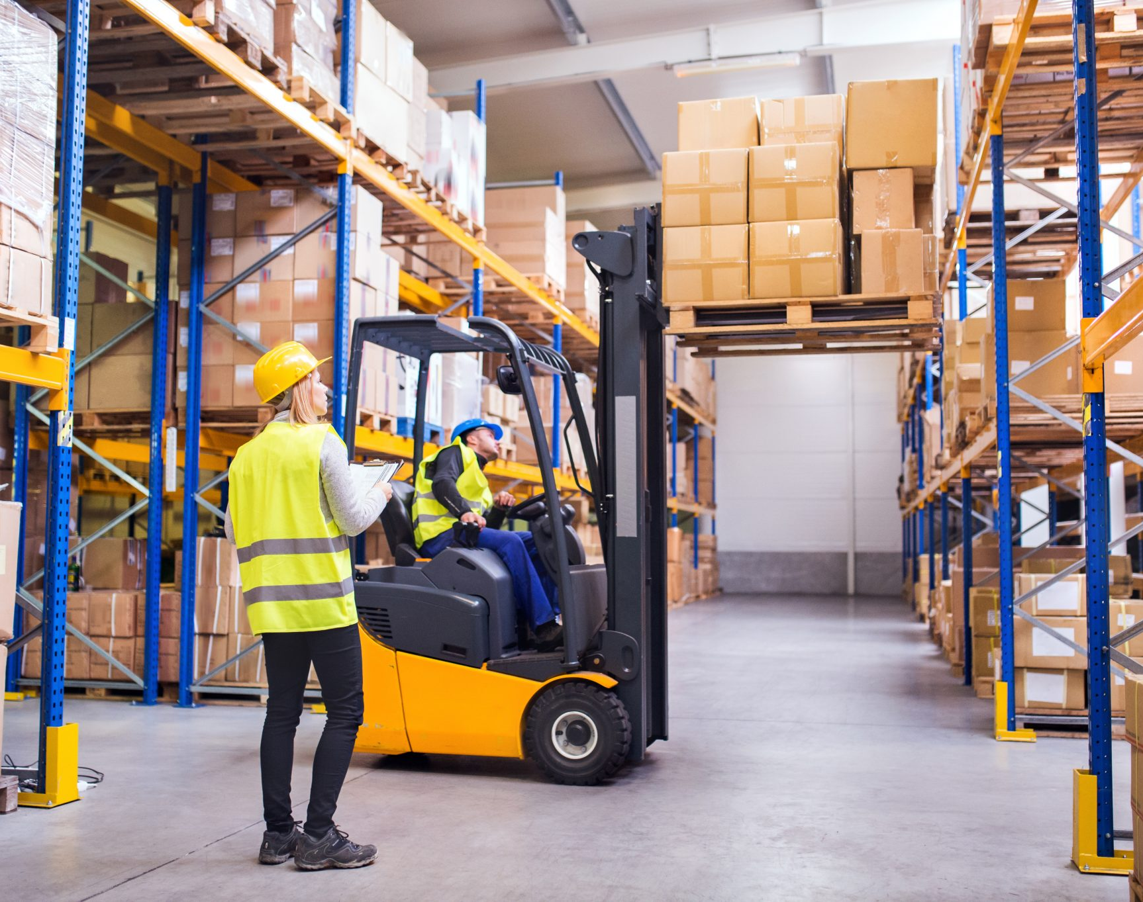
Observe/audit performance
Loading
Stacking
Fueling
Parking
Etc.

Slide 33
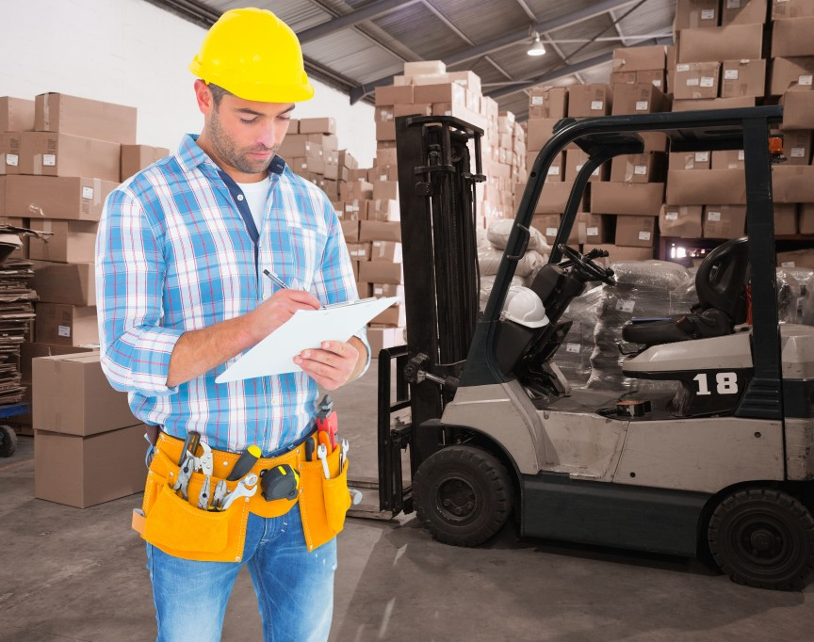
Training effectiveness
An evaluation of the effectiveness of the training must be done.

Slide 34
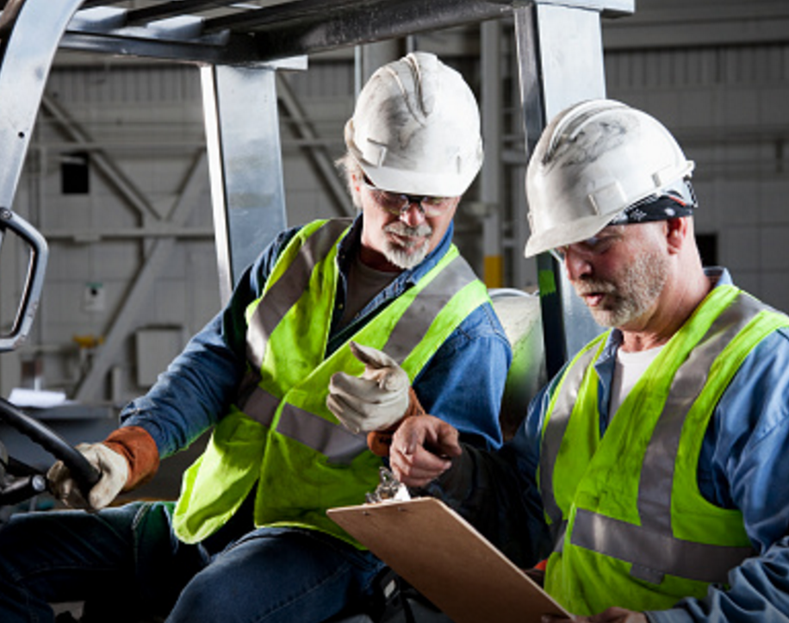
Training documentation
Name of operator
Date(s) of the training
Date(s) of the evaluation
Name of the person(s) performing the training/evaluation

Slide 35
Additional Educational Resources
Oregon OSHA’s YouTube Channel
A-Z Topic Index – Forklifts (Powered industrial trucks)
PESO – English to Español

Slide 36
Thank You!

