Slide 1


Hazard Identification and Control
Presented by Oregon OSHA Public Education

Slide 2


Oregon OSHA Public Education Mission:
Oregon OSHA Services
Consultation Services
Enforcement
Appeals
Public Education and Conferences
Standards and Technical Resources
We provide knowledge and tools to advance self-sufficiency
in workplace safety and health.

Slide 3
Contact us
Field Offices:
Portland 503-229-6193
Salem 503-373-7819
Eugene 541-686-7913
Medford 541-776-6016
Bend 541-388-6068
Pendleton 541-276-2353
Salem Central
Toll Free English:
800-922-2689
Toll Free Spanish:
800-843-8086
Website: osha.oregon.gov

Slide 4
Workshop goals
Provide basic knowledge and skills necessary to identify, assess, control, and prevent workplace hazards, as they relate to your industry and work environment.
Learn to use the hierarchy of controls, which provides a systematic approach for determining the best methods for controlling hazards found in a work environment.

Slide 5

What is a hazard?
A hazard is an unsafe condition or practice –
or a combination of the two – that could cause
an injury, illness, or death.

Slide 6

Common workplace hazards
Fall hazards
Mechanical hazards
Toxic hazards
Extreme temperature hazards
Flammability and fire hazards
Explosion hazards
Pressure hazards
Electrical hazards
Ergonomic hazards
Biohazardous material hazards
Workplace violence

Slide 7
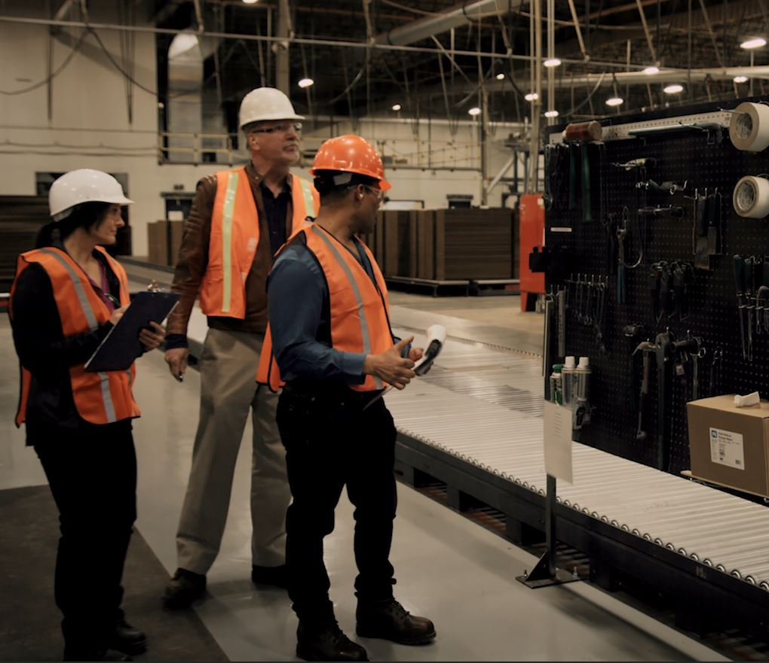
Three strategies to identify and assess hazards
Perform regular safety and health inspections.
Investigate incidents and near misses to determine root causes.
Do a job hazard analysis (JHA).

Slide 8
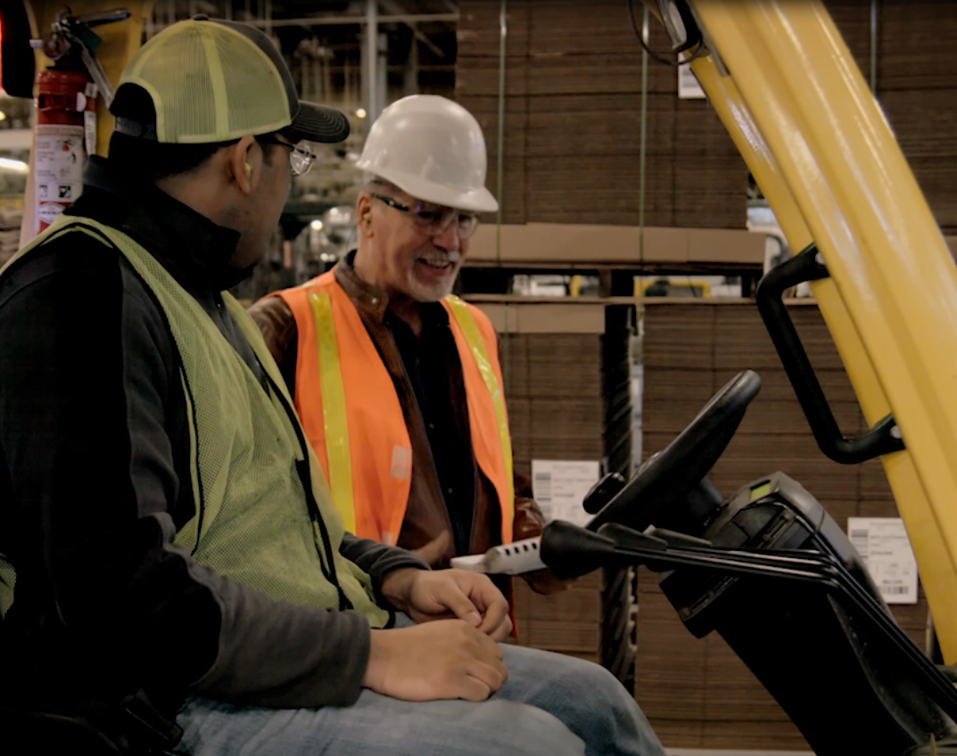

Safety inspection
Who is involved?
Major weakness?
How can we overcome this weakness?
The Safety Inspection - Video

Slide 9

Job hazard analysis (JHA)
Why is it important to involve the employees in the JHA process?
Introduction to the Job Hazard Analysis - Video

Slide 10
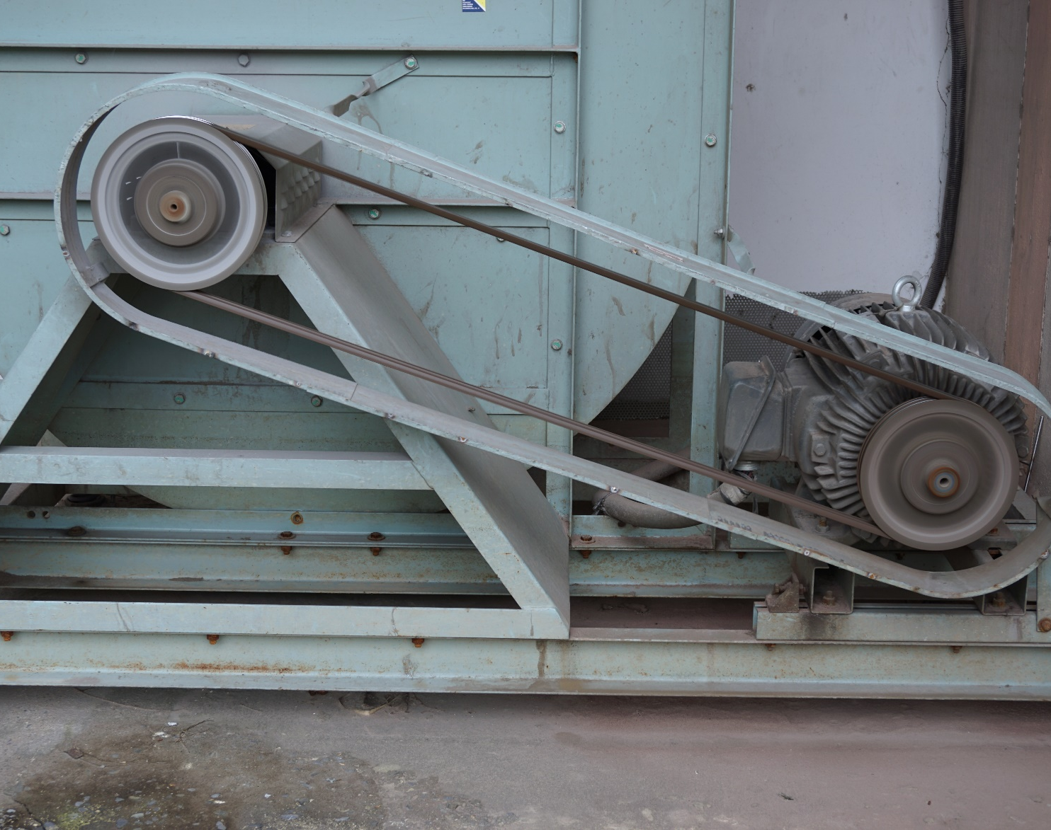
Identifying and assessing hazards: Exercise 1
Look at the photo and discuss the hazards you see.
What kind of accident might occur?

Slide 11

Identifying and assessing hazards: Exercise 2
Look at the photo and discuss the hazards you see.
What kind of accident might occur?

Slide 12

Identifying and assessing hazards: Exercise 3
Look at the photo and discuss the hazards you see.
What kind of accident might occur?

Slide 13
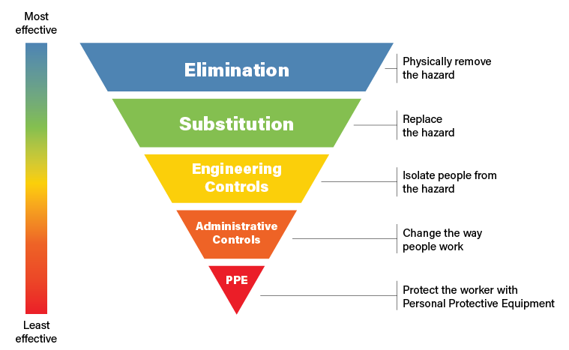
Controlling and preventing hazards
The Hierarchy of Controls
The Hierarchy of Controls is a method of identifying and ranking safeguards to protect workers from hazards. The Hierarchy of Controls consists of five elements, ranging from most effective to least effective:
Elimination
Substitution
Engineering controls
Administrative controls
Personal protective equipment (PPE)

Slide 14
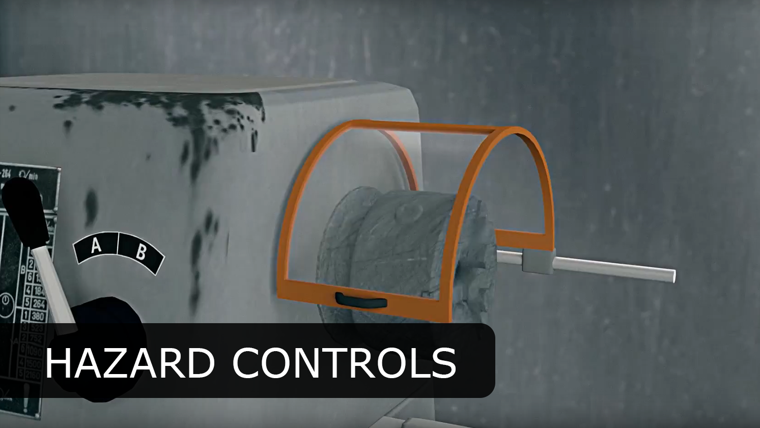

Controlling and preventing hazards (continued)
How to use The Hierarchy of Controls
Identify the hazards you are trying to control.
Think about how you can block the path between the worker and the hazard.
Brainstorm ways the hazard can be eliminated, substituted, engineered out, administratively controlled, or what PPE can be used with other controls.
Decide if the controls are feasible.
Choose controls that are highest on the hierarchy.
Understanding Hazard Controls Example - Video

Slide 15
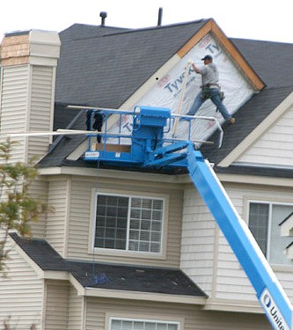
Identifying, preventing, and controlling hazards: Exercise 1
Look at the photo and discuss:
Hazards
Unsafe behavior
Ways to eliminate or control the hazard
Photo 1

Slide 16
Identifying, preventing, and controlling hazards: Exercise 2
Look at the photo and discuss:
Hazards
Unsafe behavior
Ways to eliminate or control the hazard
Photo 2

Slide 17
Identifying, preventing, and controlling hazards: Exercise 3
Look at the photo and discuss:
Hazards
Unsafe behavior
Ways to eliminate or control the hazard
Photo 3

Slide 18
Identifying, preventing, and controlling hazards: Exercise 4
Look at the photo and discuss:
Hazards
Unsafe behavior
Ways to eliminate or control the hazard
Photo 4

Slide 19

Let’s review!
Answer 10 quiz questions to test what you have learned.

Slide 20
Additional Educational Resources
Oregon OSHA’s YouTube Channel
A-Z Topic Index
Oregon OSHA Online Training Courses
PESO – English to Español
Other Safety and Health Training Resources

Slide 21
Need more information? Call your nearest Oregon OSHA Office
Salem Central Office
350 Winter St. NE
Salem, OR 97301-3882
Phone: 503-378-3272
Toll-Free: 800-922-2689
Fax: 503-947-7461
en Español: 800-843-8086
Website: osha.oregon.gov
Eugene
1500 Valley River Drive, Suite 150
Eugene, OR 97401-4643
541-686-7562
Consultation: 541-686-7913
Medford
1840 Barnett Road, Suite D
Medford, OR 97504-8293
541-776-6030
Consultation: 541-776-6016
Pendleton
200 SE Hailey Ave.
Pendleton, OR 97801-3072
541-276-9175
Consultation: 541-276-2353
Portland
Durham Plaza
16760 SW Upper Boones
Ferry Road, Suite 200
Tigard, OR 97224-7696
503-229-5910
Consultation: 503-229-6193
Salem
1340 Tandem Ave. NE, Suite 160
Salem, OR 97301-8080
503-378-3274
Consultation: 503-373-7819
Bend
Red Oaks Square
1230 NE Third St., Suite A-115
Bend, OR 97701-4374
541-388-6066
Consultation: 541-388-6068

Slide 22
Thank you!

