Slide 1


Job Hazard Analysis (JHA)
Presented by Oregon OSHA Public Education

Slide 2


Oregon OSHA Public Education Mission:
Oregon OSHA Services
Consultation Services
Enforcement
Appeals
Public Education and Conferences
Standards and Technical Resources
We provide knowledge and tools to advance self-sufficiency
in workplace safety and health.

Slide 3
Contact us
Field Offices:
Portland 503-229-6193
Salem 503-373-7819
Eugene 541-686-7913
Medford 541-776-6016
Bend 541-388-6068
Pendleton 541-276-2353
Salem Central
Toll Free English:
800-922-2689
Toll Free Spanish:
800-843-8086
Website: osha.oregon.gov

Slide 4
Goals
Explain why JHAs are important
Describe the five-step JHA procedure
Conduct a JHA for a hazardous task

Slide 5
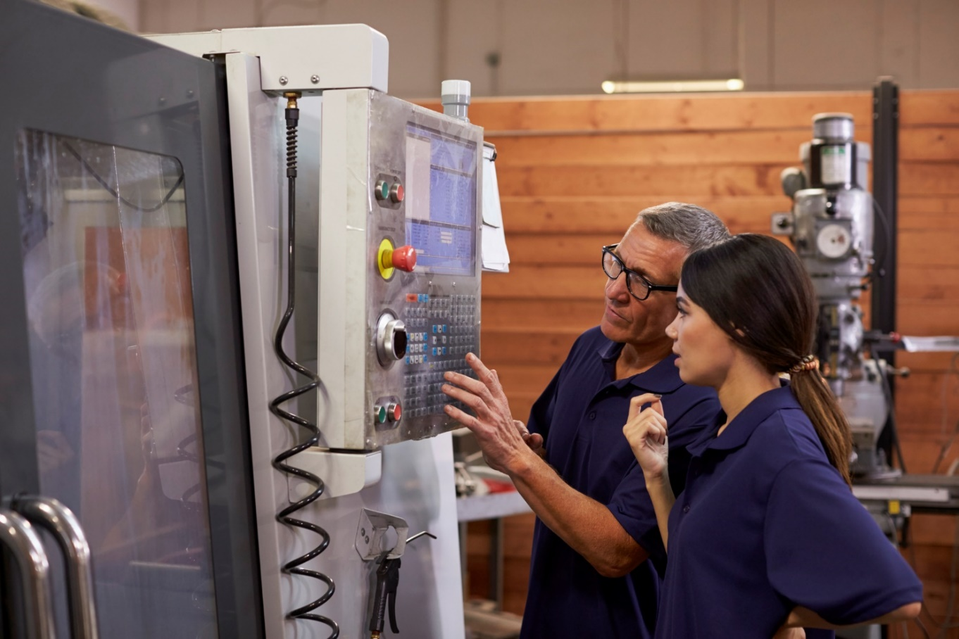
What is a job hazard analysis (JHA)
The JHA is an analysis and improvement process that can literally transform workplace safety.
The JHA is a structured process that can discover the causes for the vast majority of workplace injuries and illnesses.

Slide 6
Is the employer required to conduct a job hazard analysis?
Most Oregon OSHA standards do not specifically require the employer to conduct a JHA.
Employer is required to take the necessary steps to furnish employment (jobs, tasks, procedures) that is safe and healthful.
The JHA helps fulfill this requirement.

Slide 7

Why is a job hazard analysis important?
Workers are injured and killed at the workplace every day in the United States.
Safety and health can add value to your business, your job, and your life.
One of the best ways to ensure safe work procedures is to conduct a JHA.

Slide 8

What is a “job”?
It's important to understand that a “job” in this procedure does not refer to the employee's job title or occupation such as forklift operator or roofer.
Actually, we’re analyzing a "task" that is composed of a series of steps.

Slide 9

Conducting the JHA Step 1 - Prepare to conduct the JHA
Conduct an initial job review.
Review your accident history.
What records and reports will you review?
Involve your employees.
What are some reasons to involve employees in the JHA?

Slide 10
List hazardous jobs
Ask each supervisor and employee to identify the various jobs that will require an evaluation in each department.
Discuss the various jobs where you work.

Slide 11

Conduct a risk analysis
Factors that increase risk include:
Number of employees exposed
Frequency of each exposure
Duration of each exposure
Proximity of employees to the point of danger
Unreasonable workload
Working under stress (hurry, fatigue, illness, personal problems)
Environment (noise, light, wind, rain)

Slide 12
Prioritize hazardous jobs
Analyze the “worst first"
Another way to prioritize jobs
Use the risk matrix

Slide 13

Conducting the JHA Step 2 – Observe the job and list the steps
What are some ways to observe and record job steps?
What is a "step"?

Slide 14
Tips on conducting the JHA
Be sure to record enough information to describe each job action without getting overly detailed.
Avoid long, overly detailed breakdown of steps.
Do not combine steps (look for "and" in the step).
Get input from other workers who have performed the same job.

Slide 15
Tips on conducting the JHA Continued
Review the steps with workers to make sure you have not omitted something.
Point out that you are evaluating the task, not the worker’s job performance.
Include the employee in all phases of the analysis, from reviewing the job steps and procedures to discussing uncontrolled hazards and recommended solutions.
It may be helpful to photograph or videotape the worker performing the job.

Slide 16
Using the worksheet, discuss and write a brief description of each step for any of the following common jobs:
Filling a lawn mower with gasoline
Changing a ceiling light bulb
Cleaning out a rain gutter
Cutting a piece of wood with a handsaw
Mixing a pesticide/herbicide in a portable sprayer
Moving a box
Choose another common task at work or home

Slide 17

Conducting the JHA Step 3 – Describe the hazards in each step
Hazards and Exposure
A hazard is an unsafe _______ that could cause injury or illness to an employee.
Exposure usually refers to an employee's placement relative to the hazard’s ________ ________ .

Slide 18

Don't forget to look for potential hazards
To ensure that all hazards associated with a step are identified, analyze each step to identify potential as well as actual hazards produced by both work environment and the activity being performed.

Slide 19
Types of hazards in the workplace
Falls
Impact
Mechanical
Vibration and noise
Toxics
Health and temperature
Flammability/fire
Explosives
Pressure hazards
Electrical contact
Ergonomics
Biohazards

Slide 20
Activity (page 19)
Use the worksheet to list the steps that have hazards.
Describe the hazards and the type of injury/accident that could result.
Note: Not all steps will have hazards.

Slide 21

Conducting the JHA Step 4 – Develop preventive measures
How do I correct or prevent hazards?

Slide 22
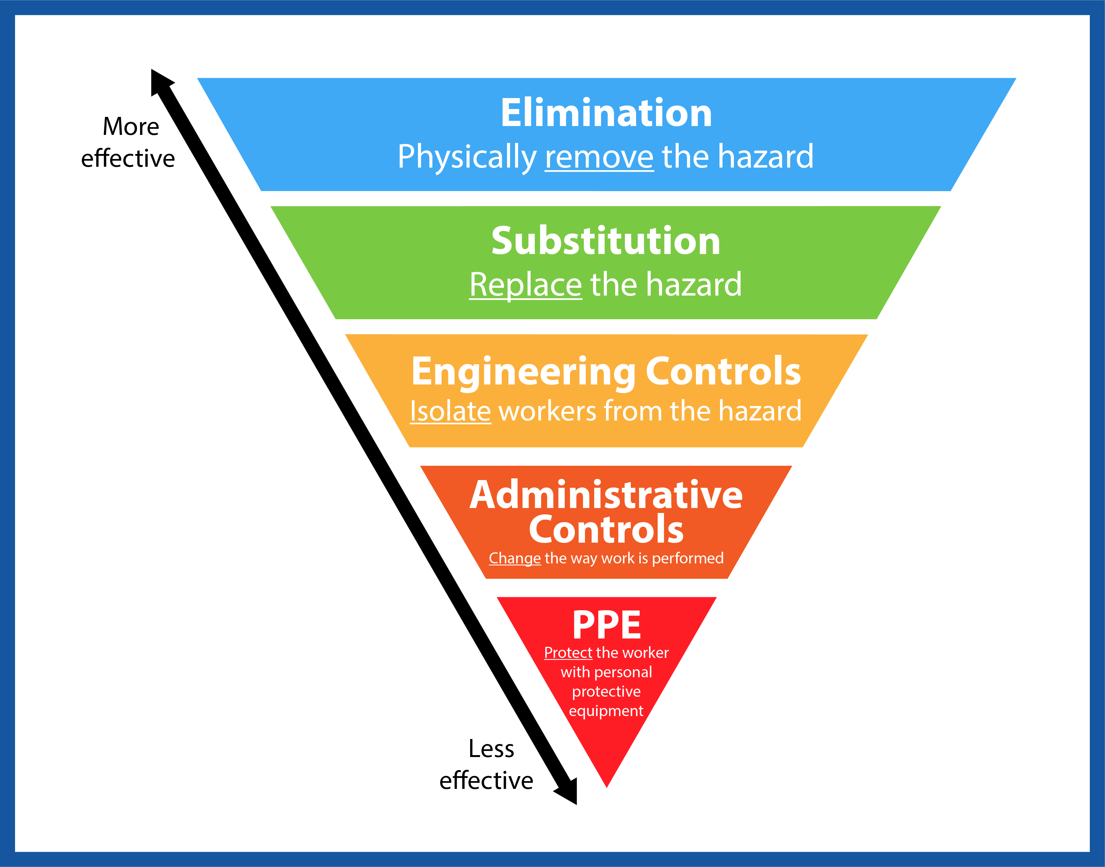
Hazard control strategies
Elimination
Substitution
Engineering controls
Administrative controls
PPE

Slide 23
Activity (page 21)
Use the worksheet to identify and list preventive measures in each step of the task your team has developed.

Slide 24
Conducting the JHA Step 5 – Write the safe job procedure (SJP)
Criteria for an effective safe job procedure.
Write in a step-by-step format. Usually this means writing a number of paragraphs.
If no hazard or possible unsafe behavior exists in a step, just state the action.
If a hazard does exist in a step, state the action and identify:
1) the hazard
2) the possible injury it could cause, and
3) safety measures to prevent the injury.

Slide 25
Conducting the JHA Step 5 – Write the safe job procedure (SJP) continued…
Try to paint a word picture - concrete vs. abstract.
Write in the active voice – “take,” not “should be taken.”
Write as clearly as possible using simple words – “use,” not “utilize.”
Keep sentences short. Use no more than 7-15 words.
Try to write in a less technical, more conversational style.

Slide 26
Activity (page 23)
Using the worksheet, write a safe job procedure for your team’s job.
Evaluate the SJP using the criteria discussed on the previous page.
Be prepared to analyze and evaluate SJPs developed by other groups.
Team leader: Assign different members of the team to make sure hazards, injuries, and safety measures are included in each step.

Slide 27

Reviewing the JHA
It is particularly important to review your job hazard analysis if an illness or injury occurs on a specific job. Based on the circumstances, you may determine that you need to change the job procedure to prevent similar incidents in the future.
Any time you revise a job hazard analysis, it is important to train all employees affected by the changes in the new job methods, procedures, or protective measures adopted.

Slide 28
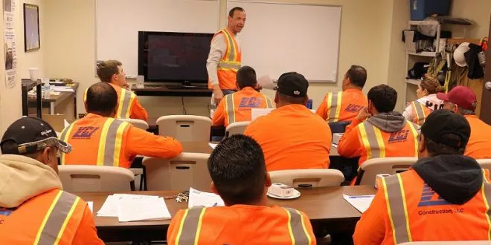
Use the JHA as a lesson plan
To get more value out of the JHA program, consider using the completed JHA as a lesson plan when training new employees.
Incorporate the SJP into the organization's safety training plan. Doing so helps guarantee safe job procedures are taught from the start.

Slide 29
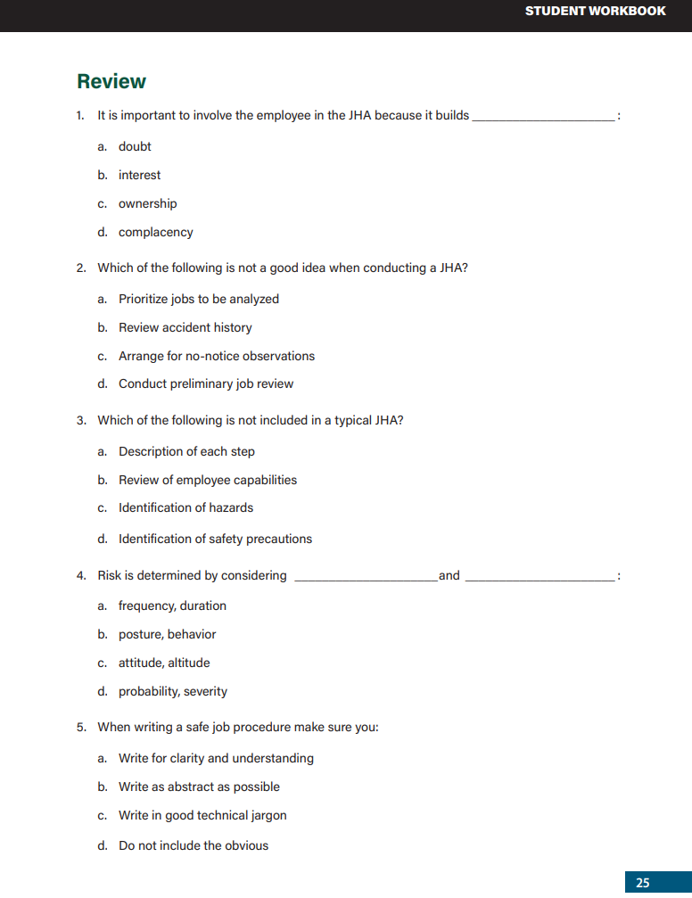
Knowledge Check

Slide 30
Videos
Oregon OSHA - Overview of JHA
Oregon OSHA – Writing a Job Procedure
Oregon OSHA - Job Steps and Tasks
Oregon OSHA - Identifying Hazards
Oregon OSHA – Hierarchy of Controls
Oregon OSHA – Planning a Safety Inspection
Oregon OSHA – Safety Inspection

Slide 31
Additional Educational Resources
Oregon OSHA’s YouTube Channel
A-Z Topic Index
Oregon OSHA Online Training Courses
PESO – English to Español
Other Safety and Health Training Resources

Slide 32
Need more information? Call your nearest Oregon OSHA Office
Salem Central Office
350 Winter St. NE
Salem, OR 97301-3882
Phone: 503-378-3272
Toll-Free: 800-922-2689
Fax: 503-947-7461
en Español: 800-843-8086
Website: osha.oregon.gov
Eugene
1500 Valley River Drive, Suite 150
Eugene, OR 97401-4643
541-686-7562
Consultation: 541-686-7913
Medford
1840 Barnett Road, Suite D
Medford, OR 97504-8293
541-776-6030
Consultation: 541-776-6016
Pendleton
200 SE Hailey Ave.
Pendleton, OR 97801-3072
541-276-9175
Consultation: 541-276-2353
Portland
Durham Plaza
16760 SW Upper Boones
Ferry Road, Suite 200
Tigard, OR 97224-7696
503-229-5910
Consultation: 503-229-6193
Salem
1340 Tandem Ave. NE, Suite 160
Salem, OR 97301-8080
503-378-3274
Consultation: 503-373-7819
Bend
Red Oaks Square
1230 NE Third St., Suite A-115
Bend, OR 97701-4374
541-388-6066
Consultation: 541-388-6068

Slide 33
Thank you!

