Slide 1
Lockout/Tagout and Machine Safeguarding

Slide 2
Oregon OSHA Public Education Mission:
Consultative Services
Enforcement
Public Education and Conferences
Standards and Technical Resources
We provide knowledge and tools to advance self-sufficiency in workplace safety and health.

Slide 3
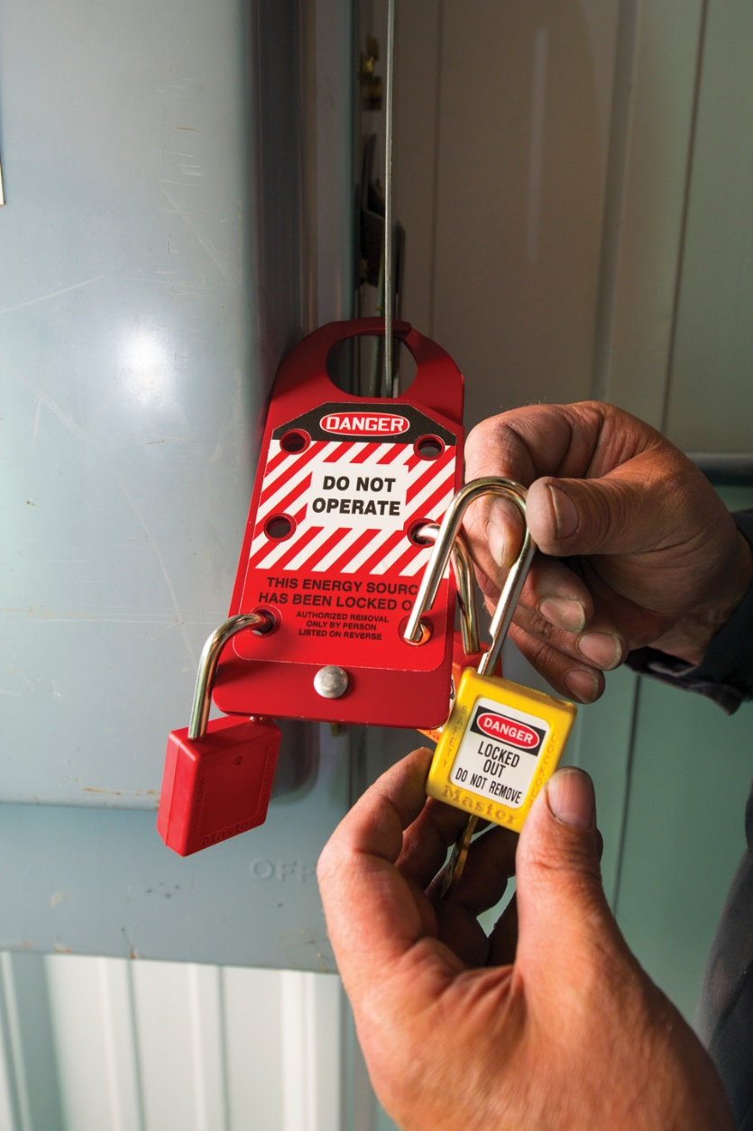
Contact us
Field Offices:
Portland 503-229-5910
Salem 503-378-3274
Eugene 541-686-7562
Medford 541-776-6030
Bend 541-388-6066
Pendleton 541-276-2353
Salem Central:
Toll Free English: 800-922-2689
Toll Free Spanish: 800-843-8086
Website: osha.oregon.gov

Slide 4
Lockout/Tagout

Slide 5

Introduction
The key is that the equipment or machines are returned to a ZERO energy state before work begins.

Slide 6

3 key elements of an energy control program
Energy control procedures
Employee training
Periodic inspection

Slide 7
The lockout/tagout rule covers the following employees:
Authorized Employee
Affected Employee
Other Employee
The person who services or performs maintenance on machines and equipment.
The person who operates or uses a machine or piece of equipment which is being serviced.
The person who works in an area where lockout procedures are being used.

Slide 8
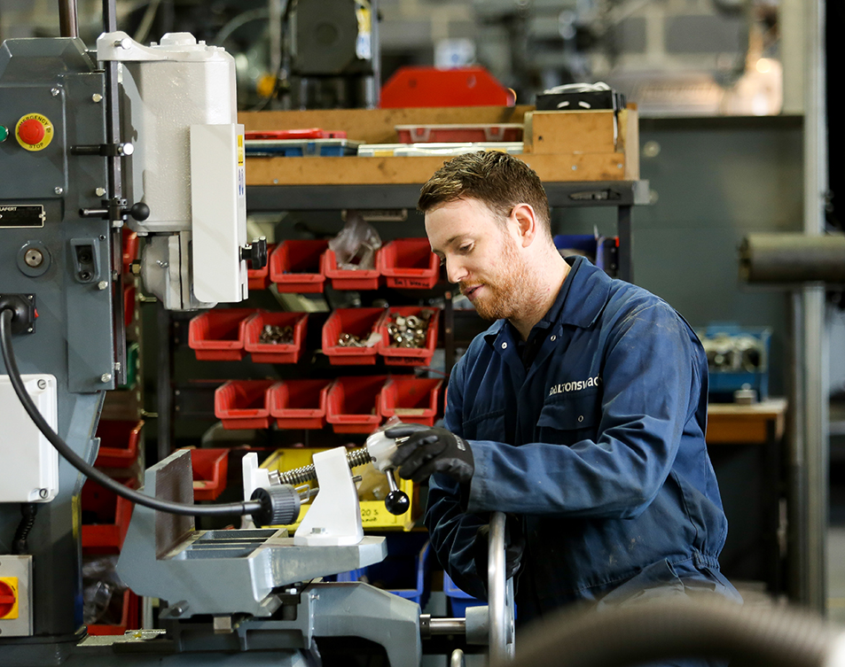
Servicing/Maintenance
Adjusting
Inspection
Modifying
Constructing
Re-tooling
Lubricating
Installing
Setting-up
Removing jams
Cleaning

Slide 9

Sources of energy capable of causing serious injury
Electrical
Pneumatic
Gravity
Hydraulic
Radiation
Kinetic

Slide 10
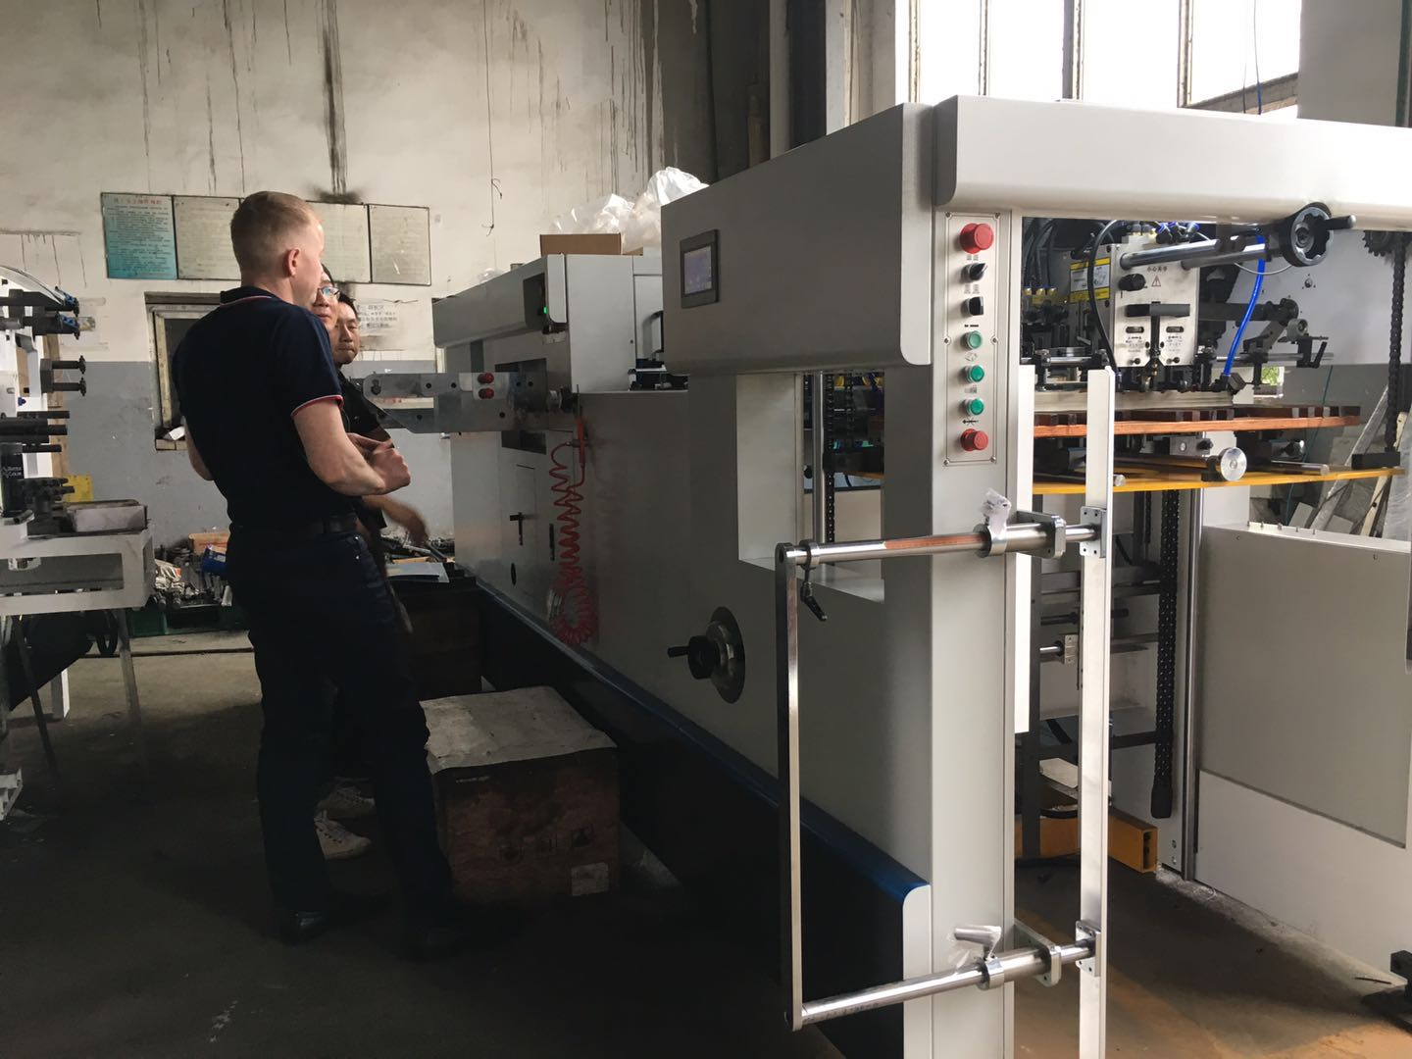
Energy control plan
Intended Use
Procedures to shut down
Lockout/tagout devices
Machinery tests

Slide 11

Develop a program
List all equipment or machines that need servicing or maintenance;
Identify those machines which could unexpectedly start up or release stored energy while being serviced or maintained;
Determine the steps in the maintenance or servicing task; and
Review each step for the potential of a hazard from all energy sources.

Slide 12
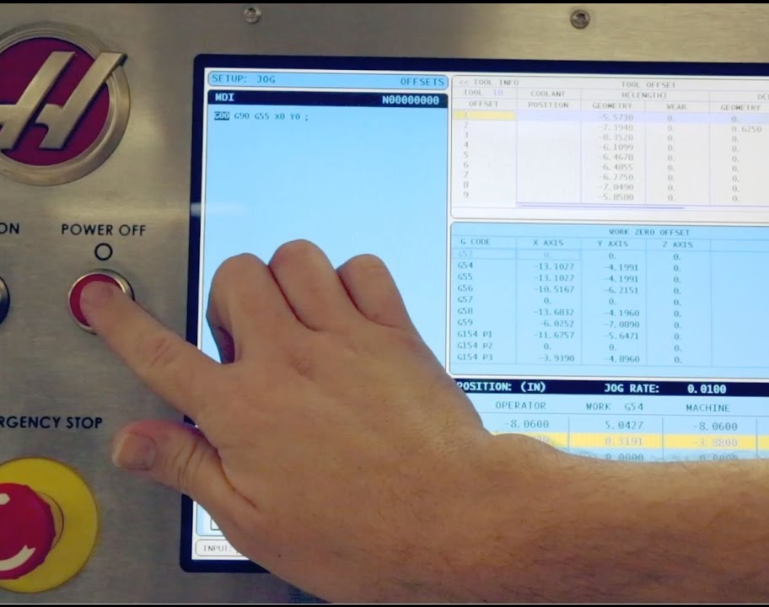
Lockout/Tagout procedures
Prepare for lockout
Shutdown
Energy isolation
Lockout or tagout application
Controlling stored energy
Verify

Slide 13

1) Prepare for lockout
Types and magnitudes of energy
Hazards posed by that energy
Methods to effectively control the energy

Slide 14

2) Shut down
Machinery and equipment must be turned off or shut down using the procedures you’ve established for the machine or equipment.

Slide 15
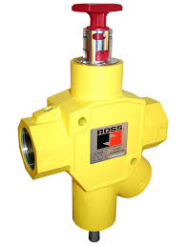
3) Energy isolation
All energy isolating devices must be located and operated to completely de-energize and isolate the equipment.

Slide 16

4) Lockout or Tagout application
Lockout vs. Tagout
Lockout devices
Tagout devices

Slide 17
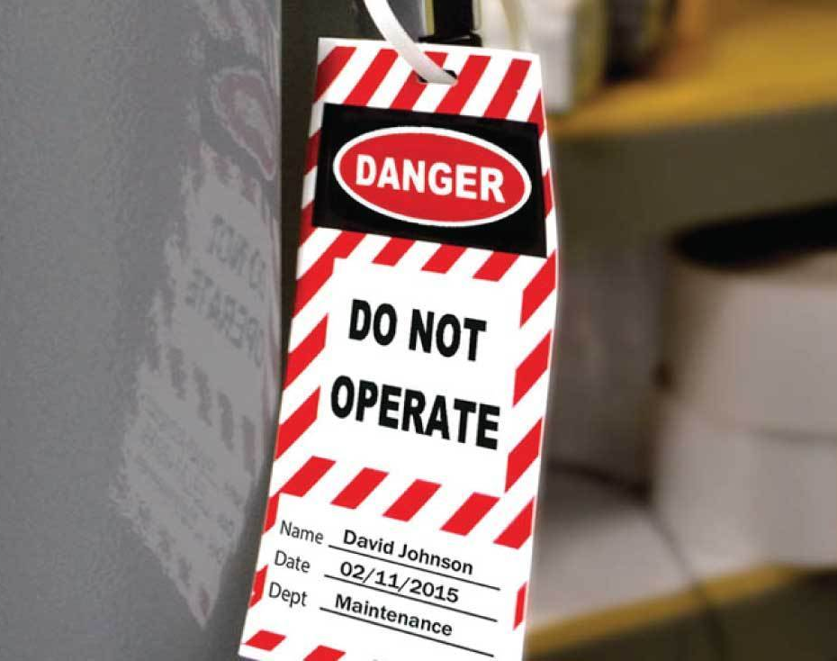
When can an employer use a tagout system?
When an energy isolating device is not capable of being locked out, or
When the employer can demonstrate (prove) that using a tagout system will provide full employee protection.

Slide 18
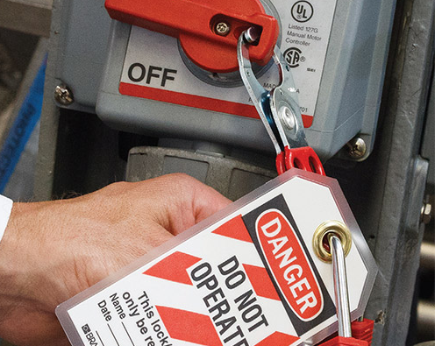
5) Controlling stored energy
Immediately after applying lockout or tagout devices, the authorized employee must ensure all potentially hazardous stored or residual energy is:
relieved
disconnected
restrained

Slide 19

6) Verify
Before starting work on a machine or piece of equipment that has been locked or tagged out, the authorized employee must verify that the machine or piece of equipment has been isolated and de-energized.

Slide 20
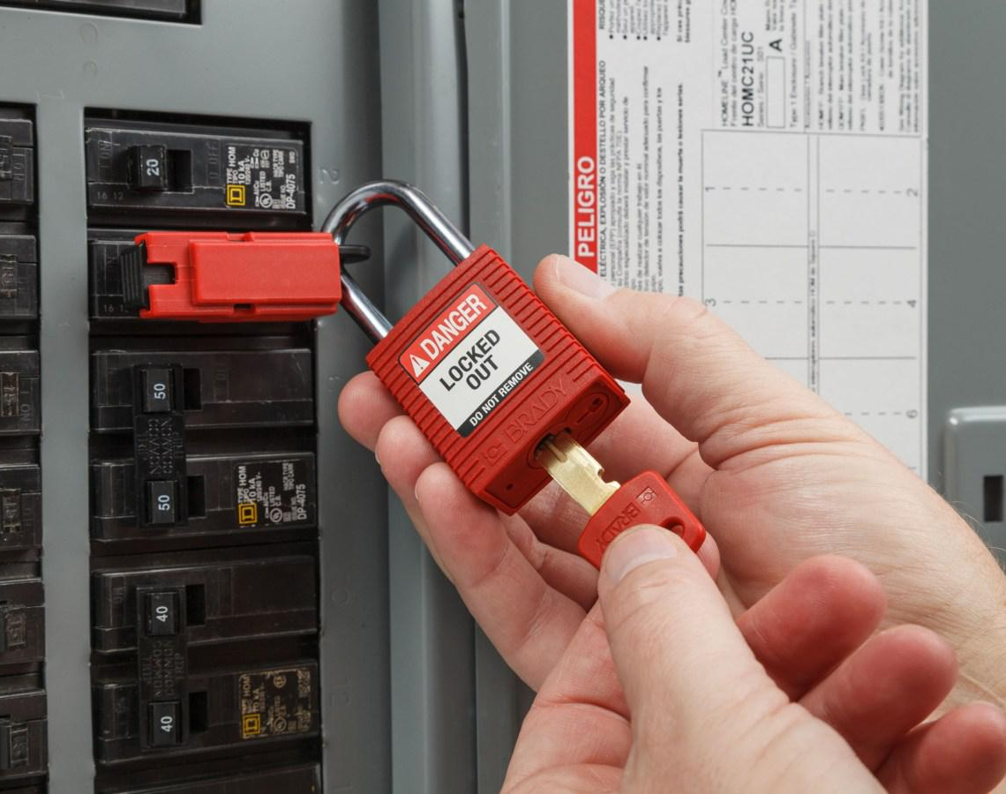
Release from lockout or tagout
Equipment
Employees
Removing lockout/tagout devices

Slide 21

Testing/positioning machines or equipment
Clear the machine or equipment of tools and materials
Remove employees from the machine or equipment area
Remove the lockout or tagout devices
Energize and proceed with testing or positioning
De-energize all systems and reapply energy control measures

Slide 22
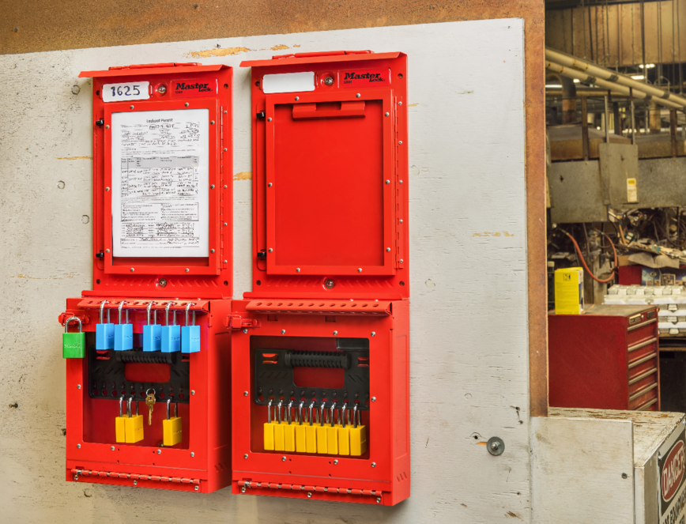
Group lockout/tagout
Primary responsibility
Monitor the exposure status
Coordinate all affected groups
Personal lockout or tagout

Slide 23
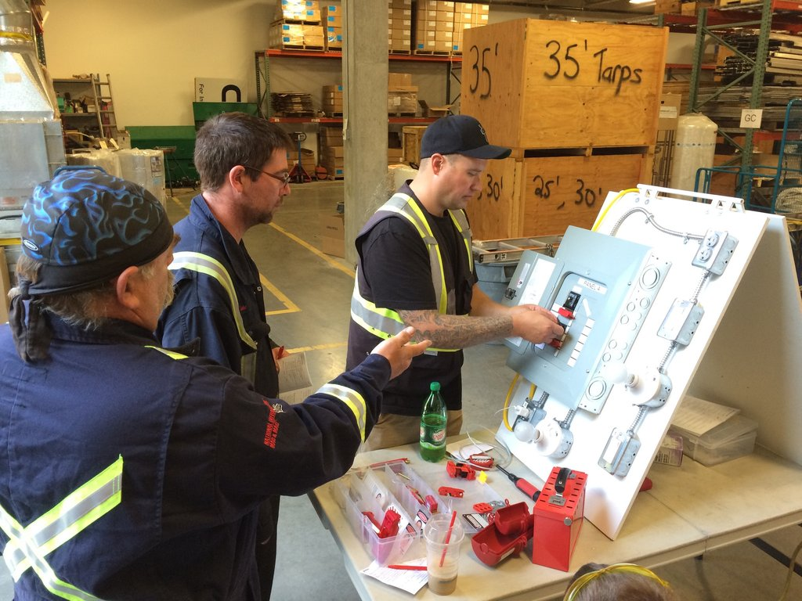
Training
Authorized employees
Affected employees
Other employees

Slide 24

Training on tagout devices
Tags are warning devices
Tags must not be removed without the authorized employee’s approval
Tags must be understandable
Tags must be able to withstand the environment
Tags may give employees a false sense of security
Tags must be securely attached

Slide 25
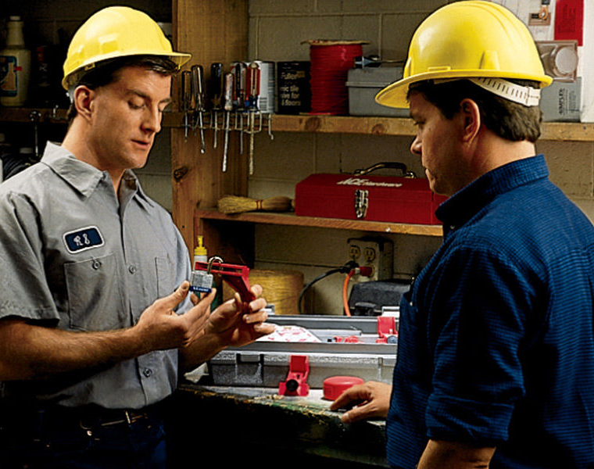
When should employees be retrained?
Whenever there is a change in their job activities
Whenever there is a change in machine, equipment, or process that present a new hazard
Whenever there is a change in your energy control procedures
Whenever there are deviations from or inadequacies in the employee’s knowledge or use of the energy control procedures

Slide 26

Training documentation
A training certification must contain:
Each employee’s name and date(s) of training
The topics that were covered
Who conducted the training
How the training was done
Pass or fail

Slide 27
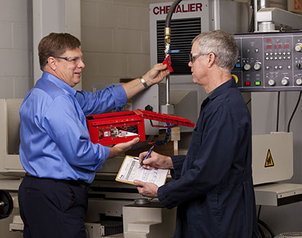
Inspections
An inspection of each energy control procedure must be conducted at least annually.
These inspections must at least include a demonstration of the procedures (steps) and may be implemented through random audits and/or planned visual observations.

Slide 28
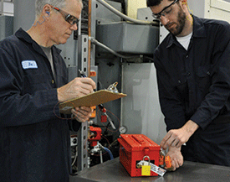
Inspection documentation
The equipment or machine being serviced
The date(s) of inspection
The employees included in the inspection
The authorized employee performing the inspection

Slide 29
Principles of Machine Safeguarding

Slide 30
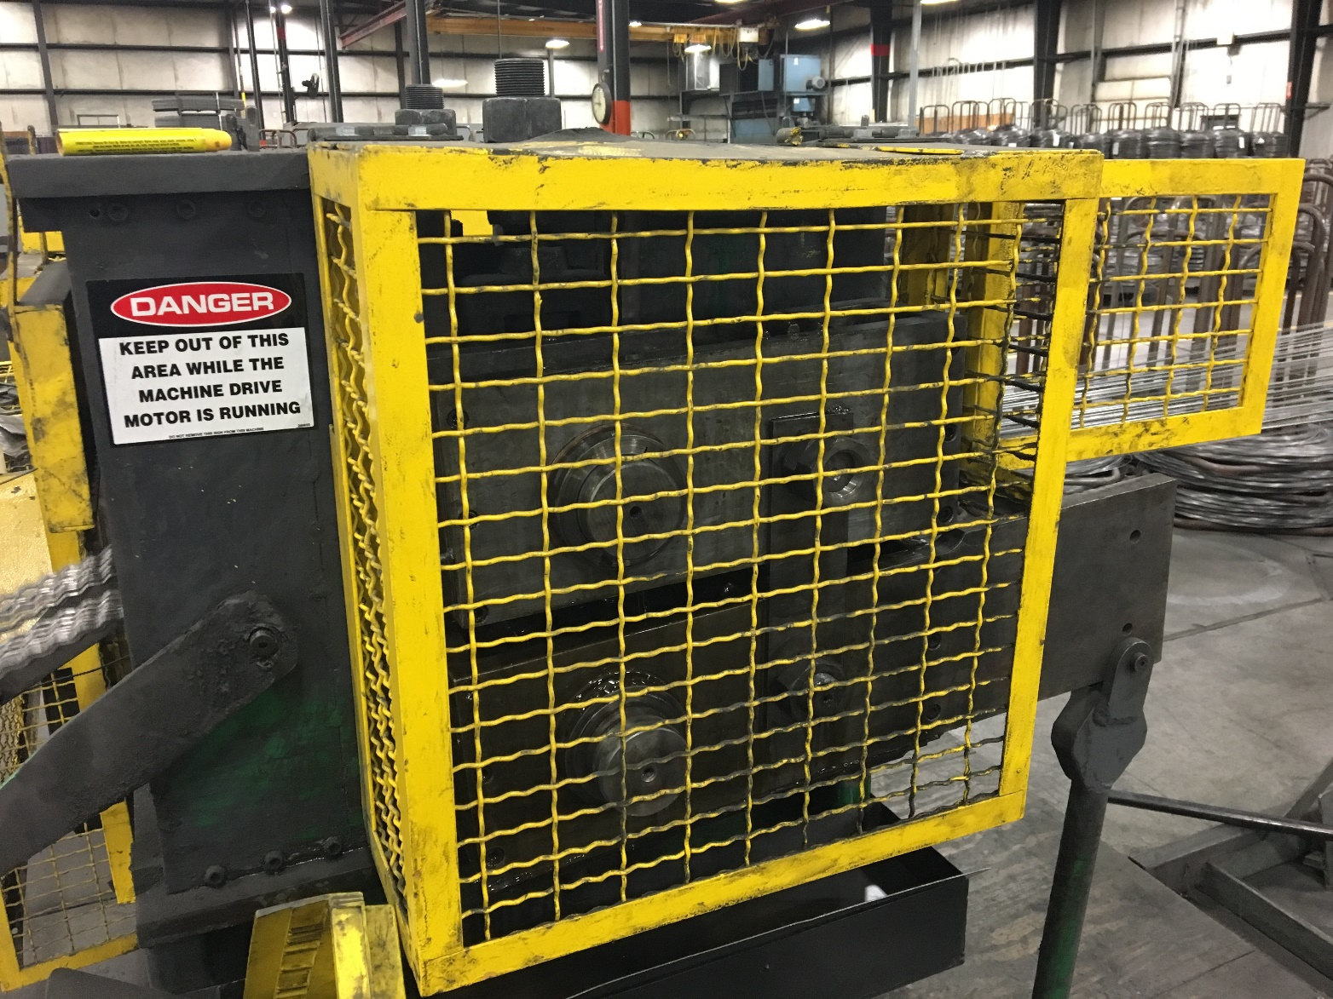
Goals
Describe the basic hazards involving machinery
Introduce control measures

Slide 31
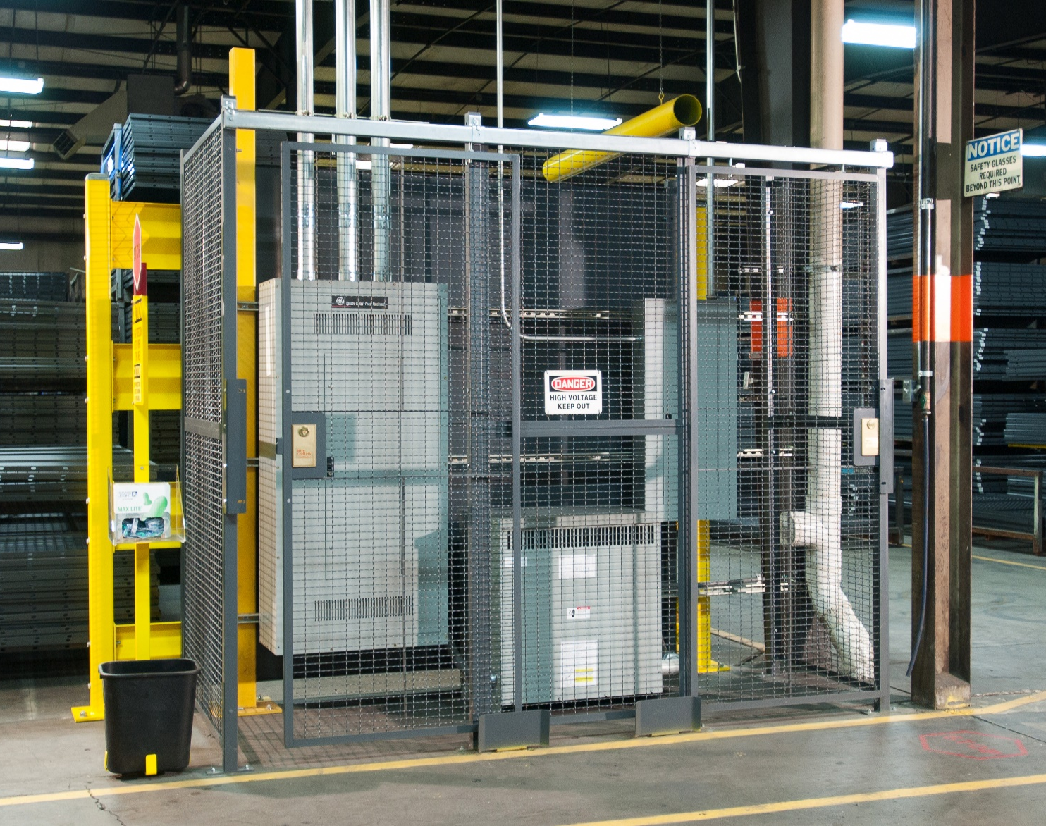
Purpose
The purpose of machine guarding is to protect against and prevent injury from point of operation, in-running nip points, rotating parts, flying chips, and sparks.

Slide 32
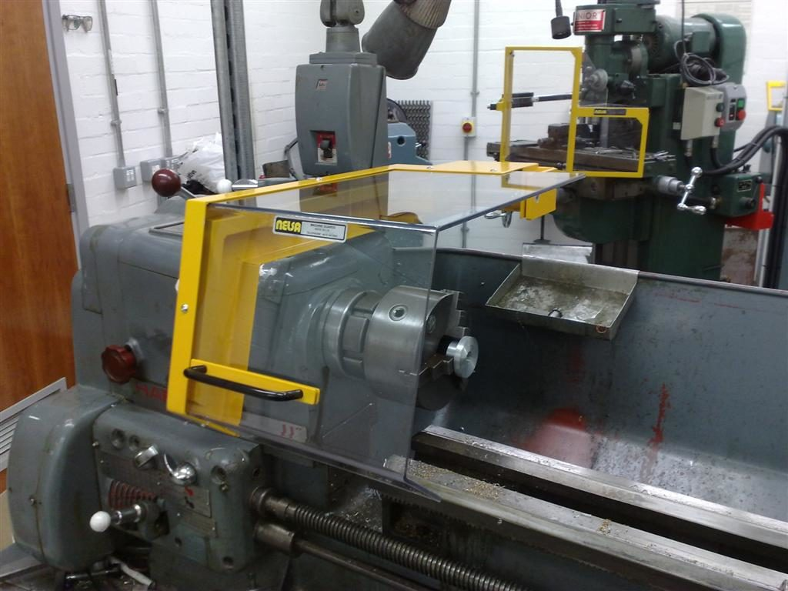
3 Basic areas
The point of operation
Power transmission apparatus
Other moving parts

Slide 33






Hazardous mechanical motions
Rotating
In-running nip point hazards
Reciprocating
Transverse

Slide 34
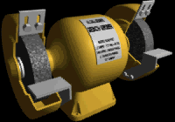


Nip points between rotating elements and parts with longitudinal motions

Slide 35

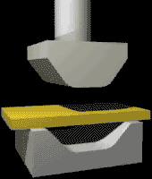
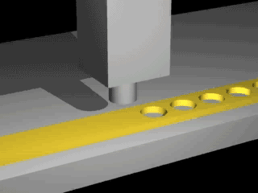

Hazardous mechanical actions
Cutting
Shearing
Bending
Punching

Slide 36
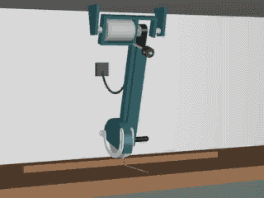
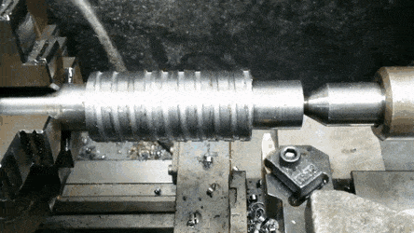
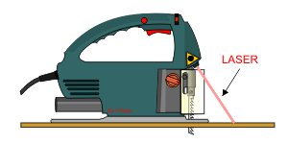
More cutting action examples

Slide 37
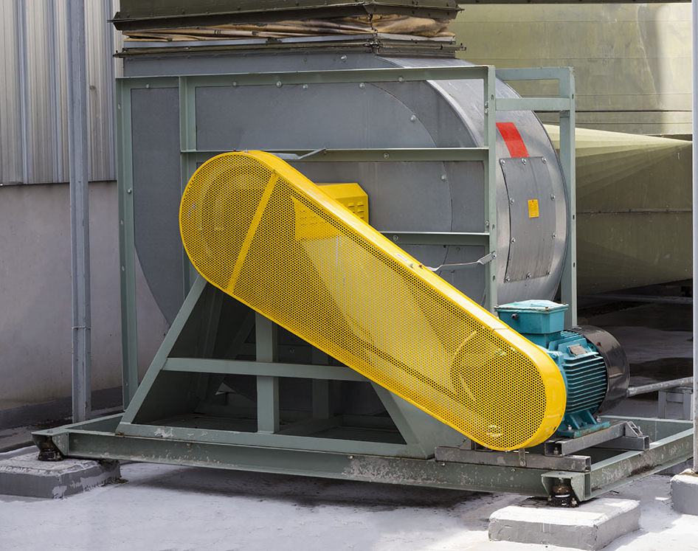
Safeguarding strategies
Guards
Devices
Location and/or distance
Feeding/ejection methods

Slide 38
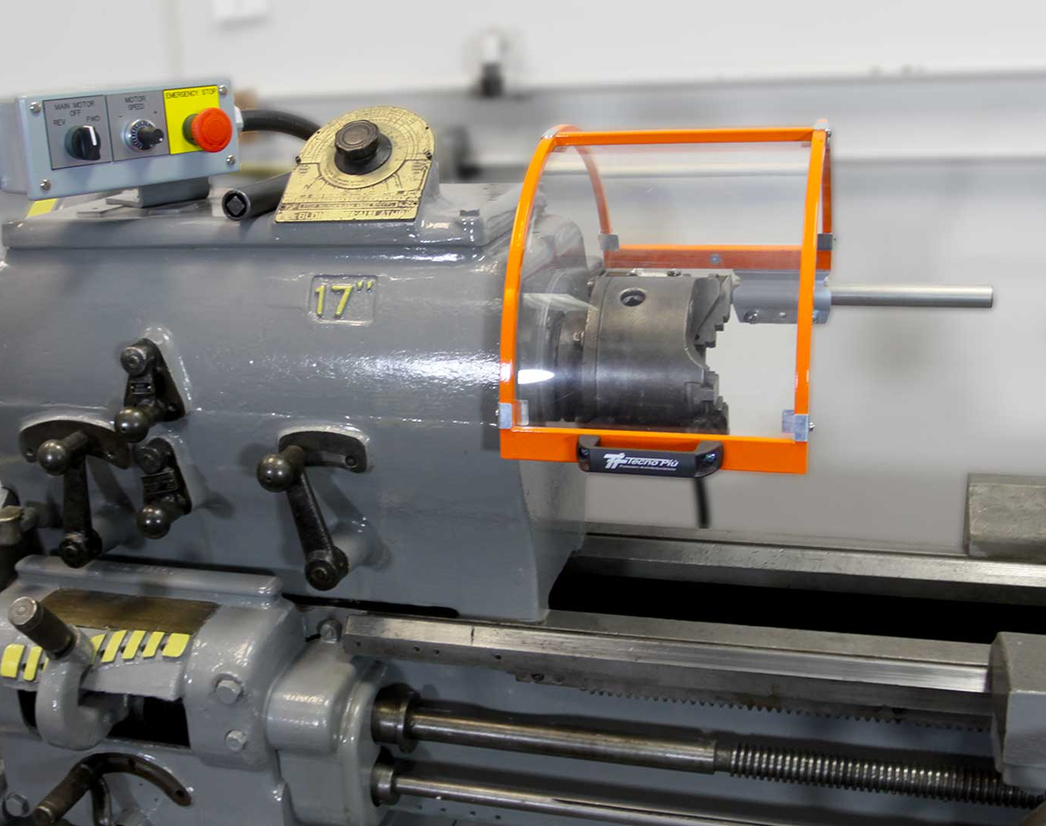
Miscellaneous aids
Awareness barriers
Protective shields
Hand-feeding/holding tools
Anti-restart devices

Slide 39
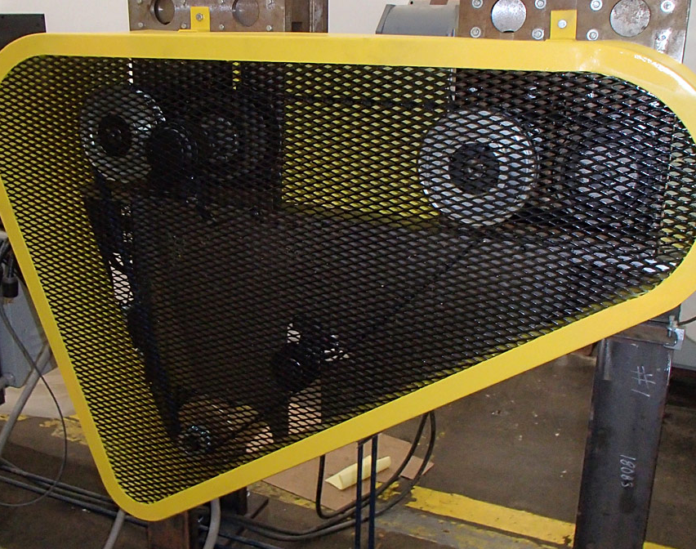
What makes a guard effective?
Prevent contact
Not a hazard itself
Doesn’t allow objects to fall into moving parts
Safe maintenance
Secure
Conforms with standards

Slide 40
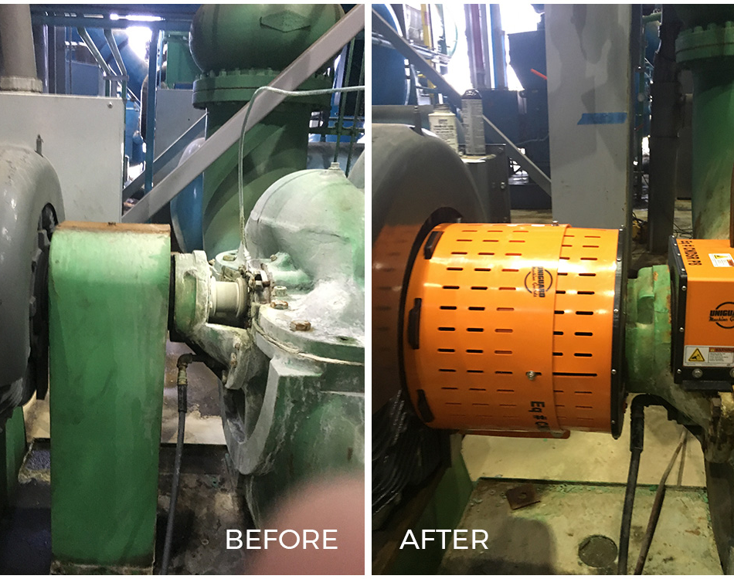
Guards
Fixed
Interlocked
Adjustable
Self-adjusting

Slide 41
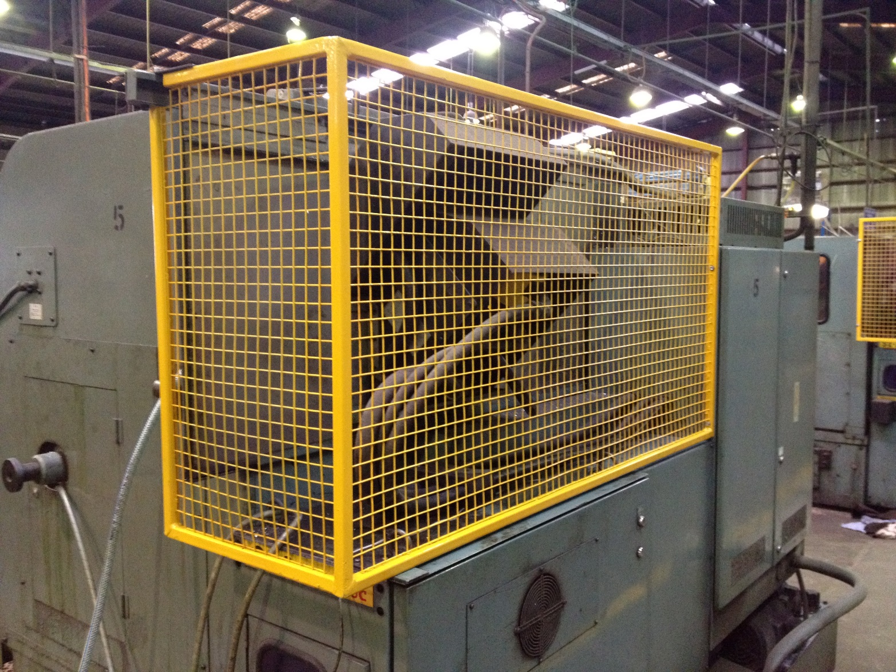
Fixed
Permanent part of the machine
Not dependent upon moving parts to perform its intended function
Constructed of sheet metal, screen, wire cloth, bars, plastic, or other substantial material
Usually preferable to all other types because of its relative simplicity and permanence

Slide 42
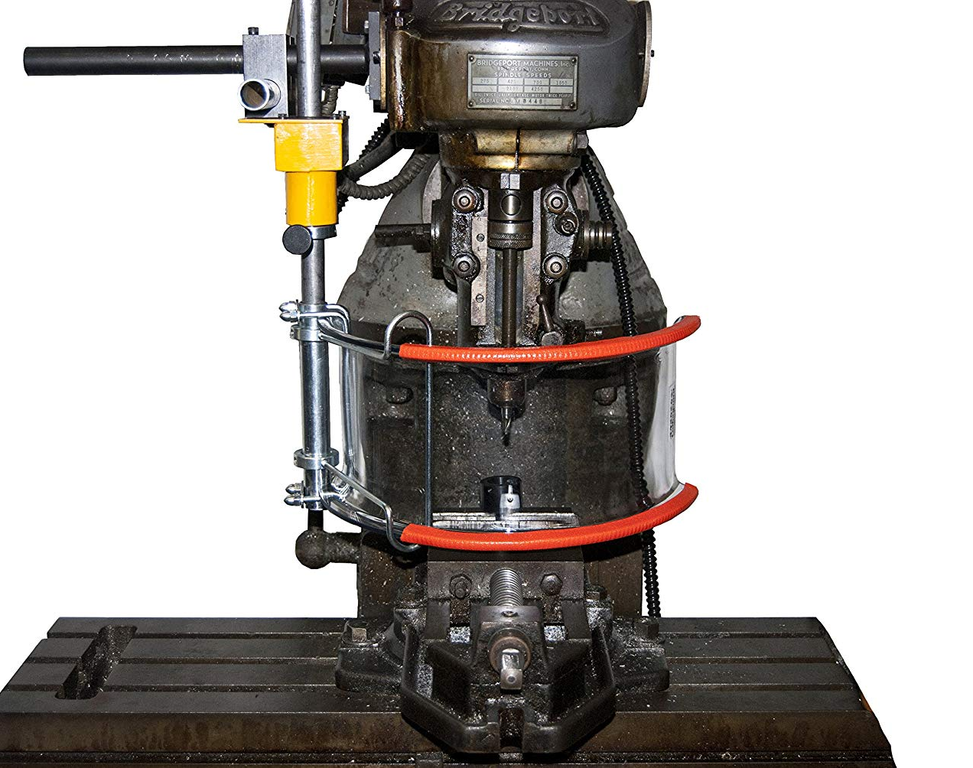
Interlocked
When opened or removed, the tripping mechanism and/or power automatically shuts off or disengages
Machine cannot cycle or be started until the guard is back in place
Electrical, mechanical, hydraulic, or pneumatic power
Replacing the guard should not automatically restart the machine

Slide 43
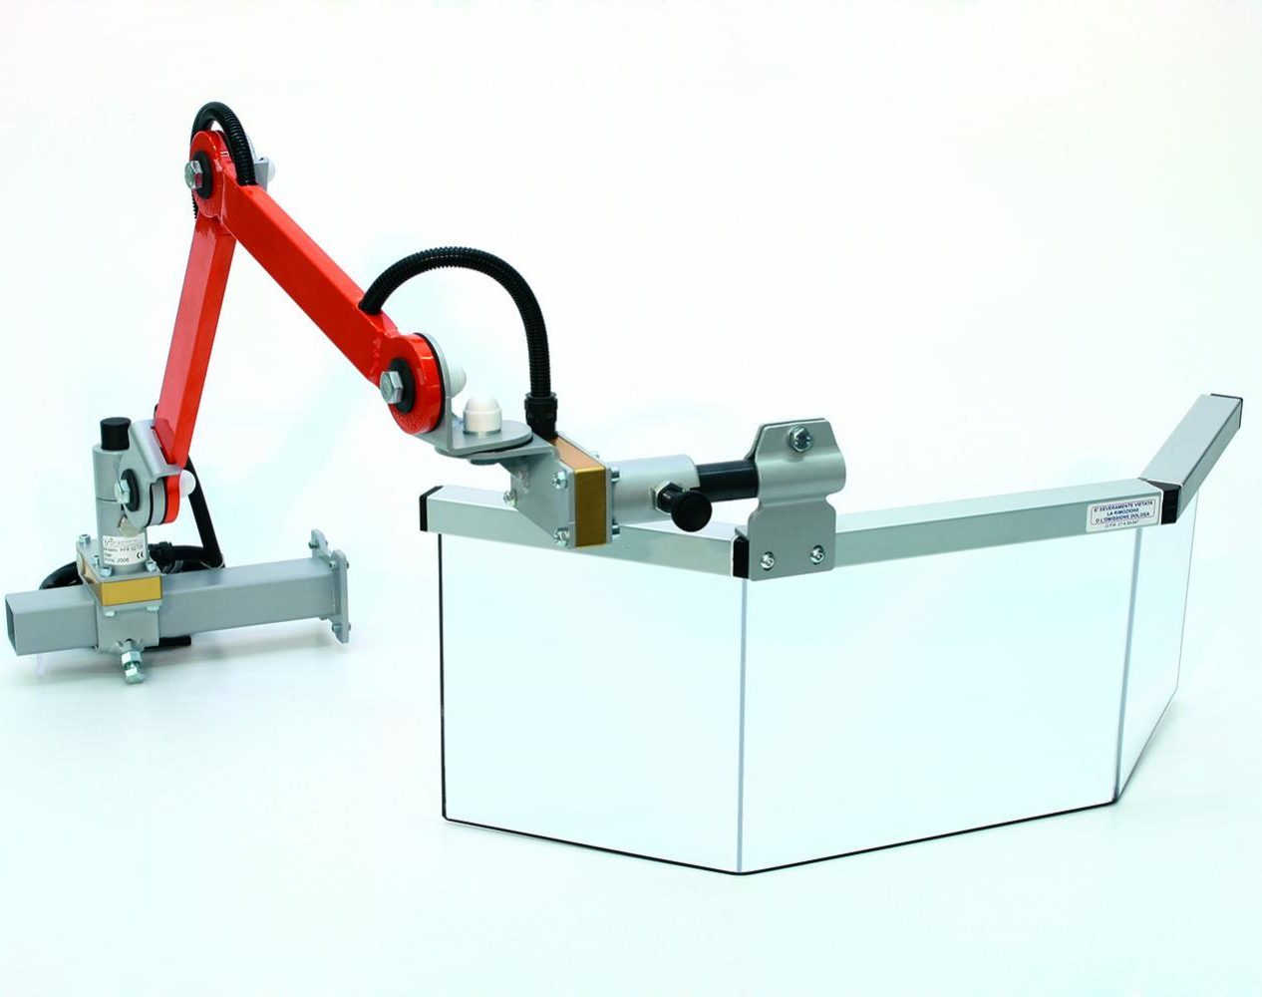
Adjustable
Allow flexibility in accommodating various sizes of stock

Slide 44

Self - adjusting
Openings are determined by the movement of stock

Slide 45
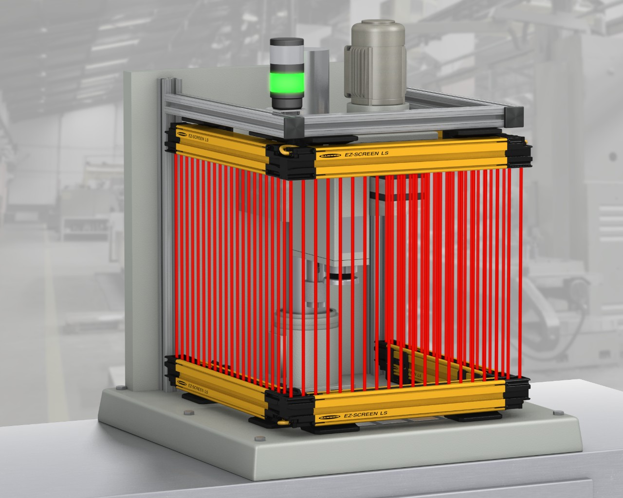
Devices
Presence-Sensing Devices
Photoelectric
Radiofrequency
Electromechanical
Pullback
Restraint
Safety trip controls
Two-hand controls
Two-hand trip
Gate

Slide 46
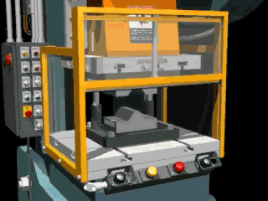
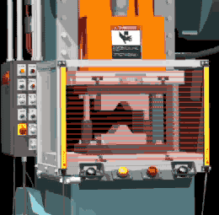
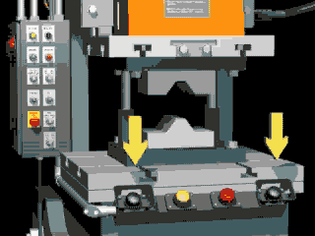
Some examples of devices
Type A Gate
Presence Sensing
2 Hand Controls

Slide 47
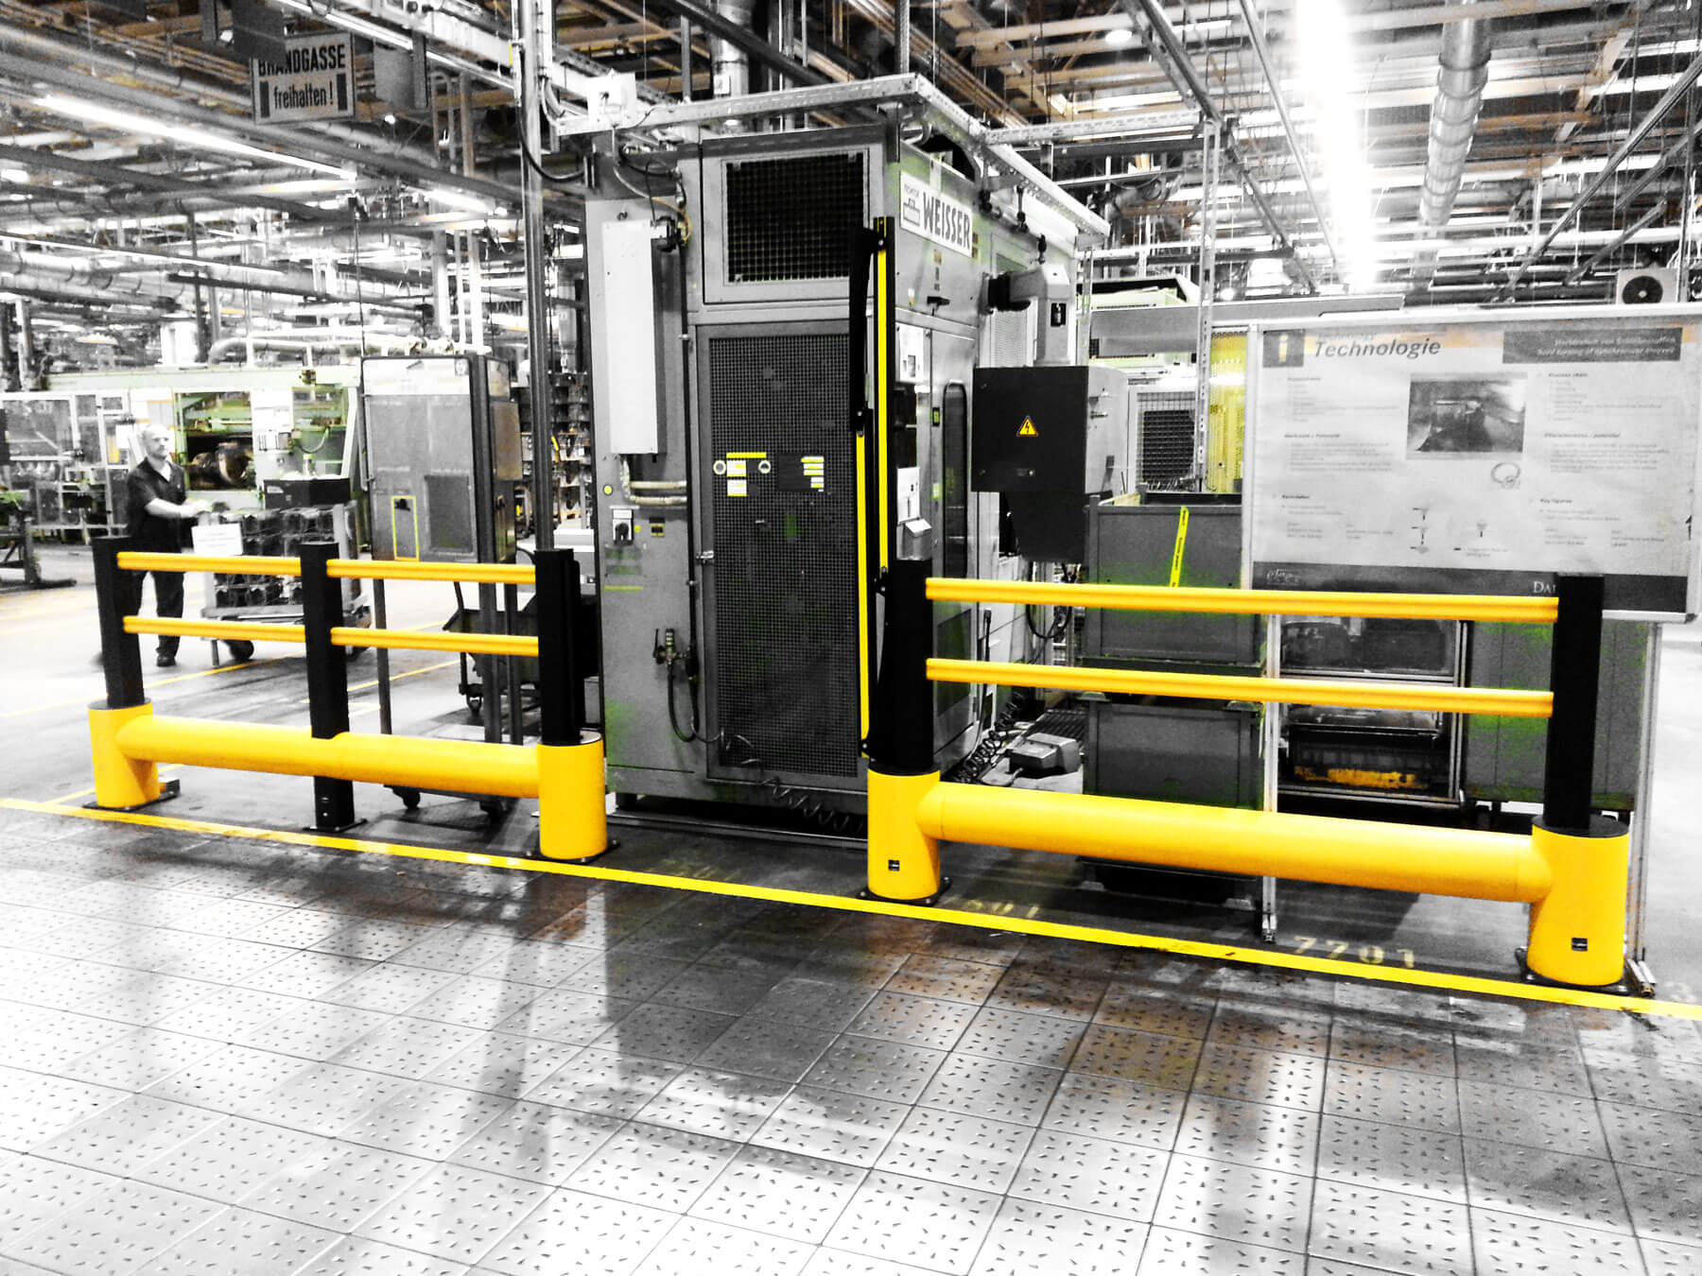
Location & distance
Walls
Barriers/Fences
Height above worker
Size of stock (single end feed, punching)
Controls (positioned at a safe distance)

Slide 48
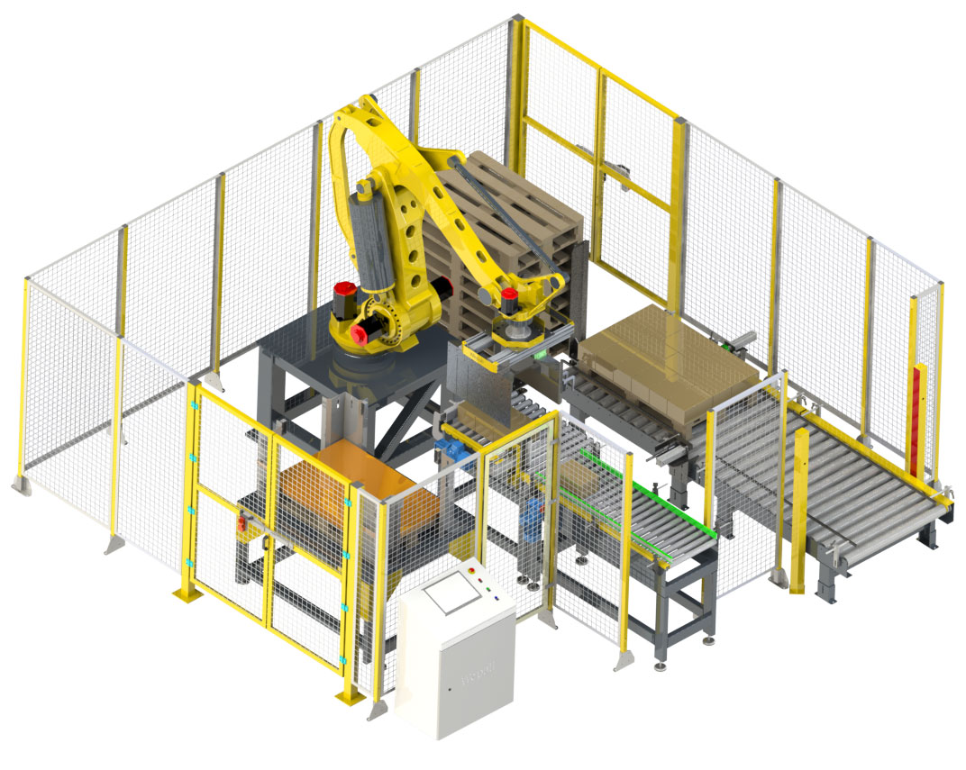
Feeding & ejection
Automatic
Semi-automatic
Robots

Slide 49
Additional Educational Resources
Oregon OSHA’s YouTube Channel
A-Z Topic Index – Control of hazardous energy
PESO – English to Español

Slide 50
Thank You!

