Slide 1
Safety Meetings and Committees

Slide 2
Oregon OSHA Public Education Mission:
Consultative Services
Enforcement
Public Education and Conferences
Standards and Technical Resources
We provide knowledge and tools to advance self-sufficiency in workplace safety and health.

Slide 3
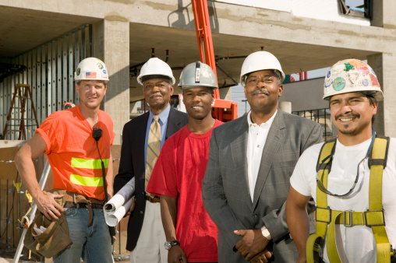
Contact us
Field Offices:
Portland 503-229-5910
Salem 503-378-3274
Eugene 541-686-7562
Medford 541-776-6030
Bend 541-388-6066
Pendleton 541-276-2353
Salem Central:
Toll Free English: 800-922-2689
Toll Free Spanish: 800-843-8086
Website: osha.oregon.gov

Slide 4

Purpose
The purpose of safety committees and safety meetings is to bring workers and management together in a non-adversarial, cooperative effort to promote safety and health.
Safety committees and safety meetings will assist you in making continuous improvement to your safety and health programs

Slide 5
Introduction

Slide 6

Your business must have either:
Safety committee
or
Safety meetings
The only exception is if you’re the sole owner and the only employee of a business.

Slide 7
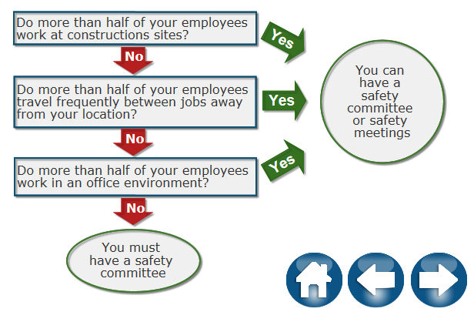
Safety committee or safety meetings?
If your business has more than 10 employees:

Slide 8
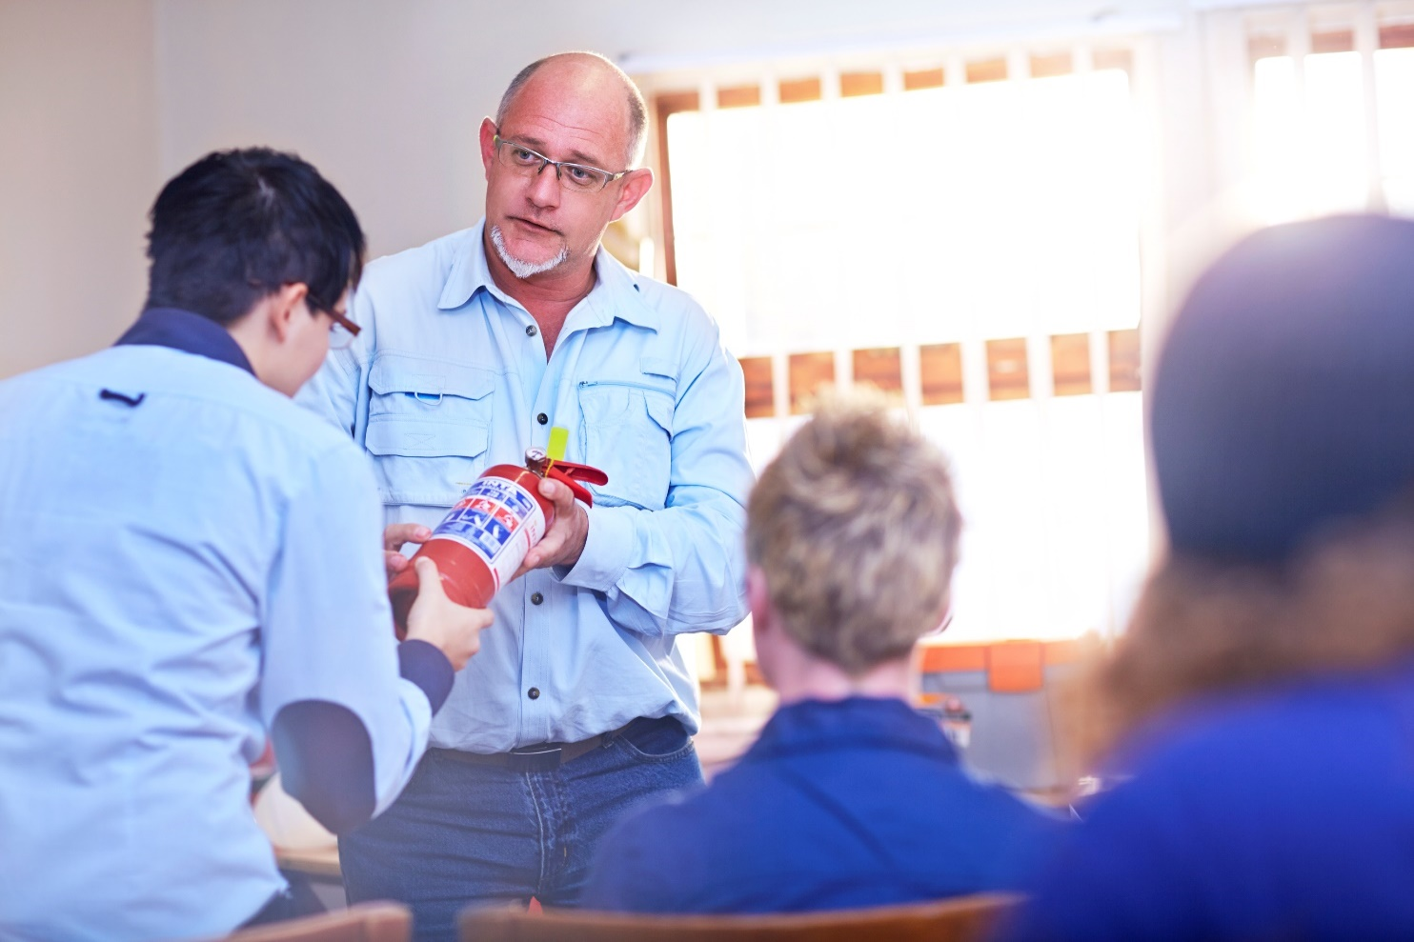
Multi-location employers
Centralized safety committees follow the same requirements and represent the safety and health concerns of employees at all of the locations.

Slide 9
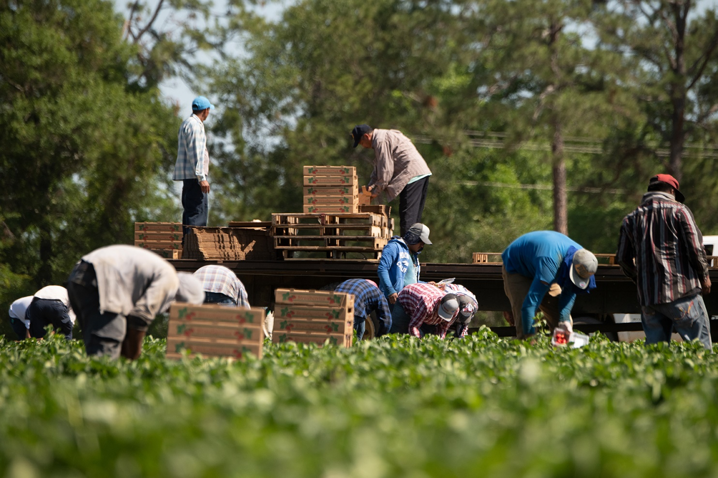
Agricultural employers
Main differences:
Certain seasonal workers aren’t included in employee count
Those that have centralized committees aren’t required to have a written safety and health policy
All ag employers must keep records of safety committees or safety meetings; minimal records are still allowed if all employees attend a safety meeting

Slide 10
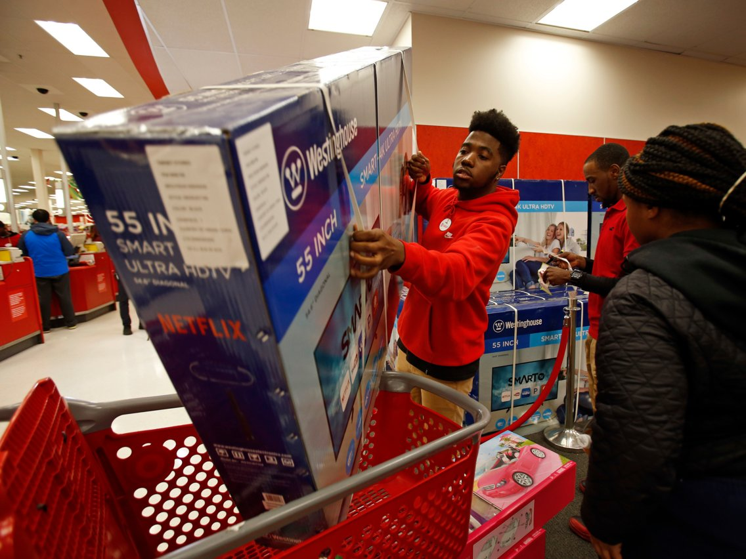
Seasonal workers
They need to be told about:
Safety and health rules of their work
How to contact supervisor in case of accident, illness, or safety or health problems
What to do if workers are injured or sick and get emergency assistance
Location of posted safety and health information

Slide 11
Safety Meetings

Slide 12
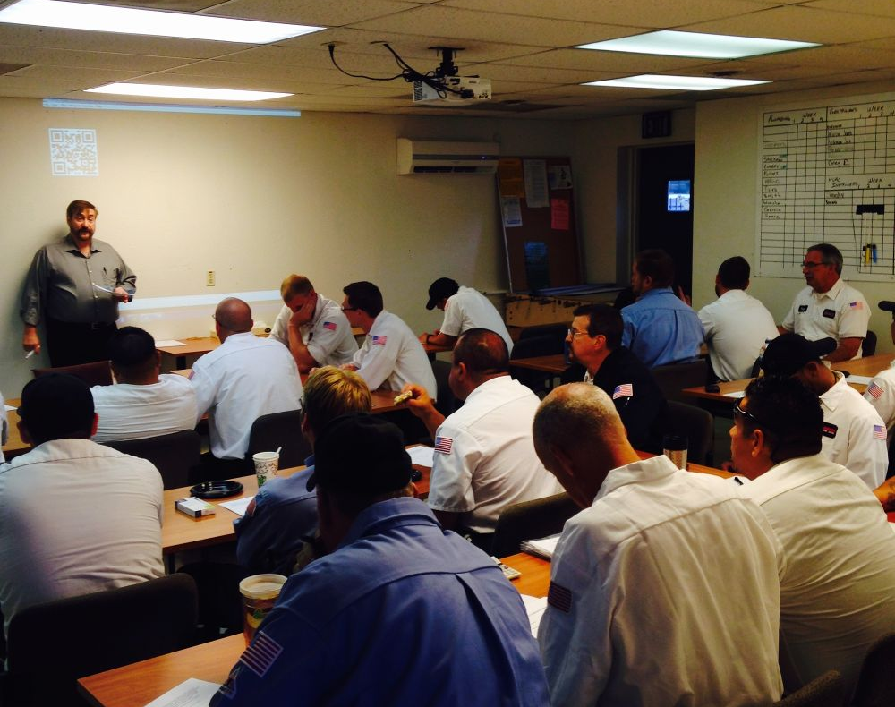
Who needs to attend?
All available employees
At least one person needs to have management authority
Must be held on company time and employees are paid at regular rate

Slide 13
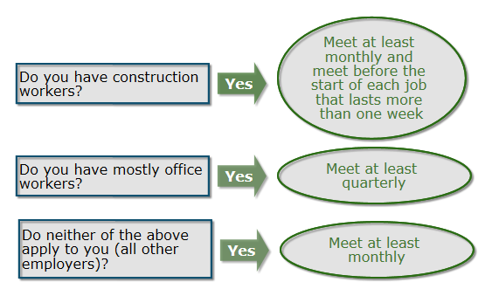
How often do we meet?
Monthly or quarterly depending on what your business does.

Slide 14
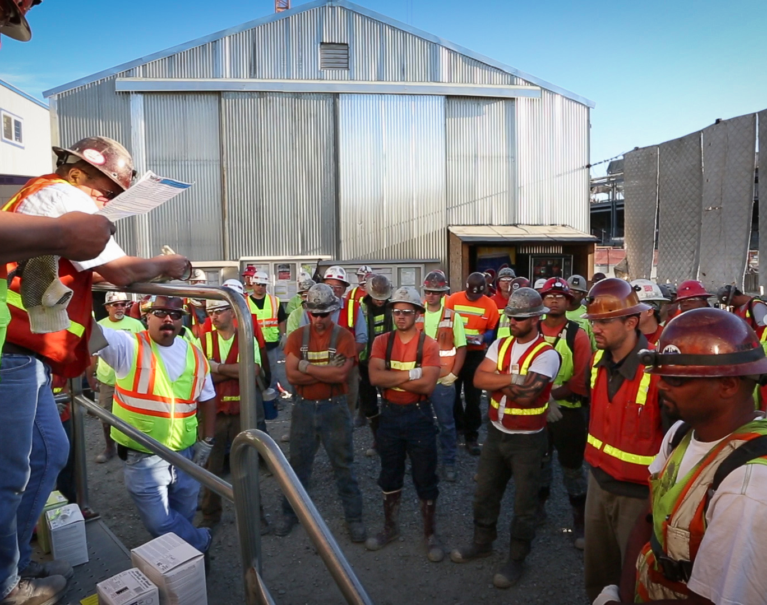
Safety meeting discussions
Employees’ concerns about:
Workplace safety
Workplace health conditions
Accident investigations and near misses, and:
The causes
The suggested corrective measures

Slide 15
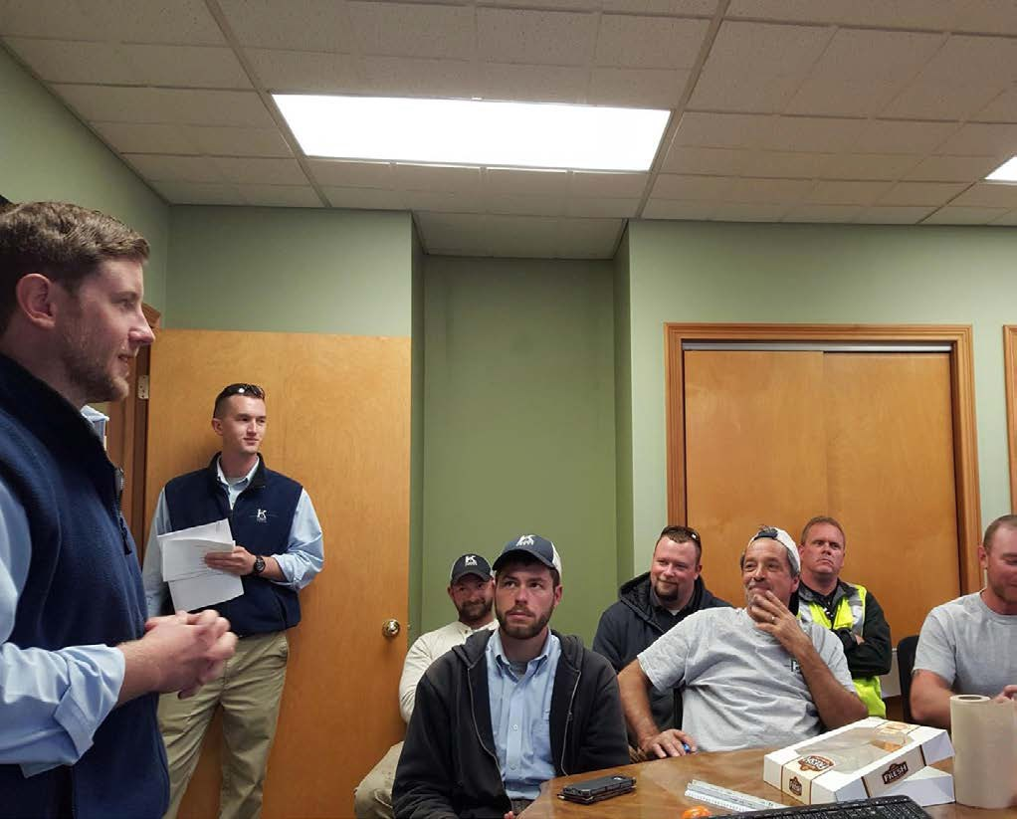
Meeting minutes
If your employees do construction, utility work, manufacturing:
Keep minutes of all safety meetings for 3 years
All other employers
Don’t have to keep minutes, unless some one is absent

Slide 16
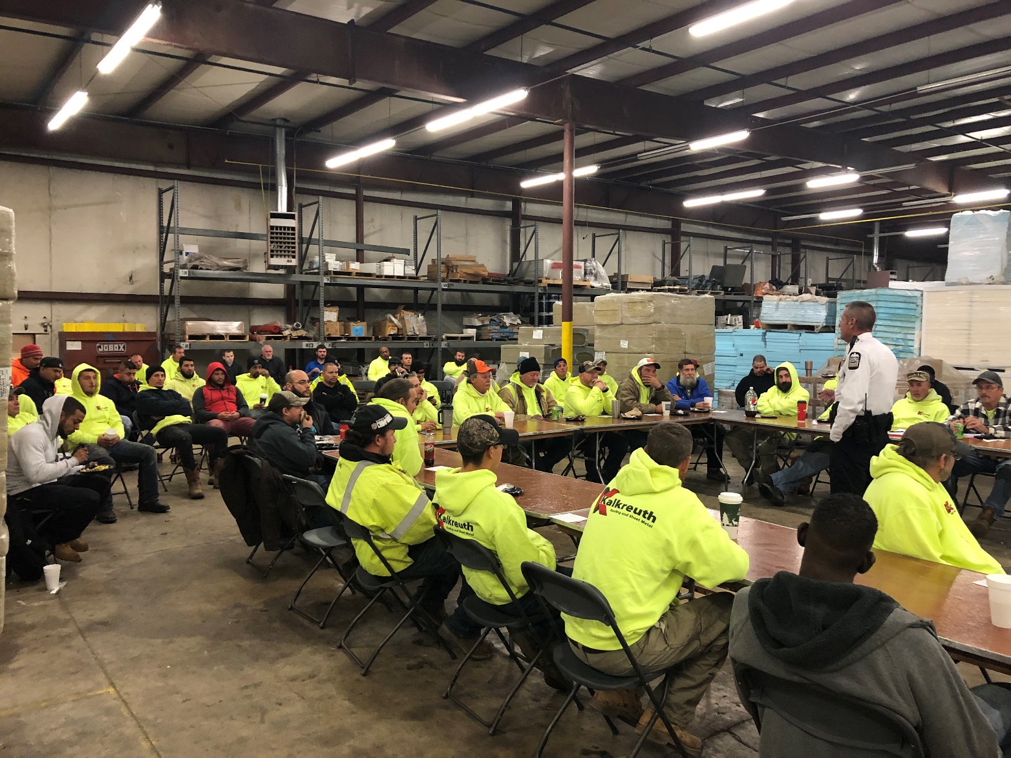
What information to keep?
Date
Attendees’ names
All safety and health issues discussed during the meeting

Slide 17
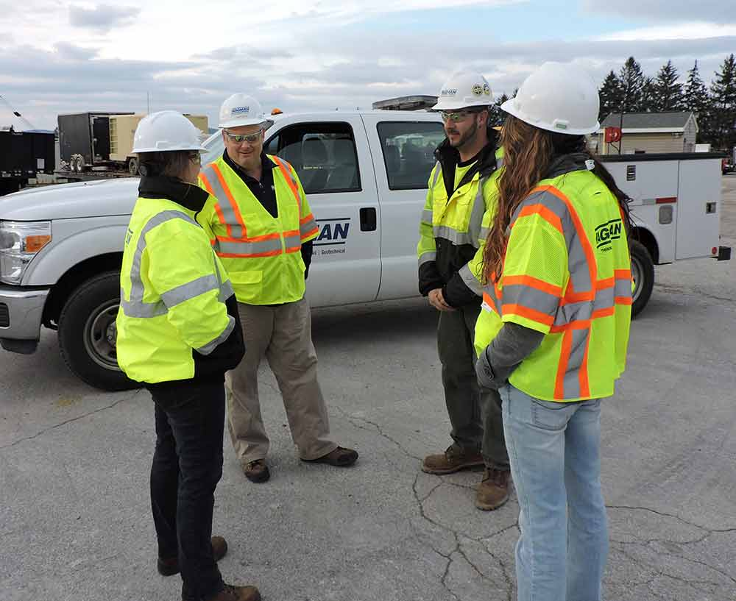
Multi-employer worksites
If your employees attend the main contractor’s safety meetings, you do not need to have separate safety meetings for your employees
Keep the minutes from the prime contractor’s safety meetings for 3 years as part of your records
You still need to meet with employees to discuss any incidents involving them

Slide 18
Safety Committees

Slide 19
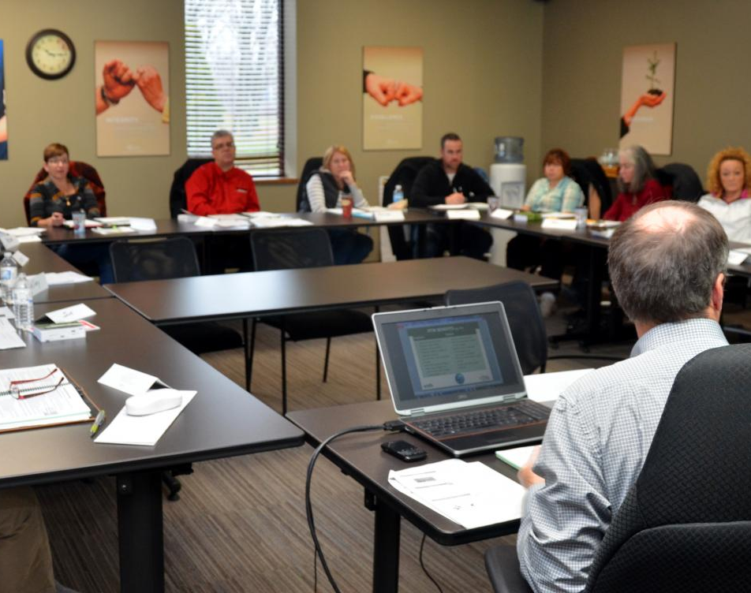
Members
Equal number of:
Employer selected
Employee elected/volunteer
*Must not have majority of employer selected members

Slide 20
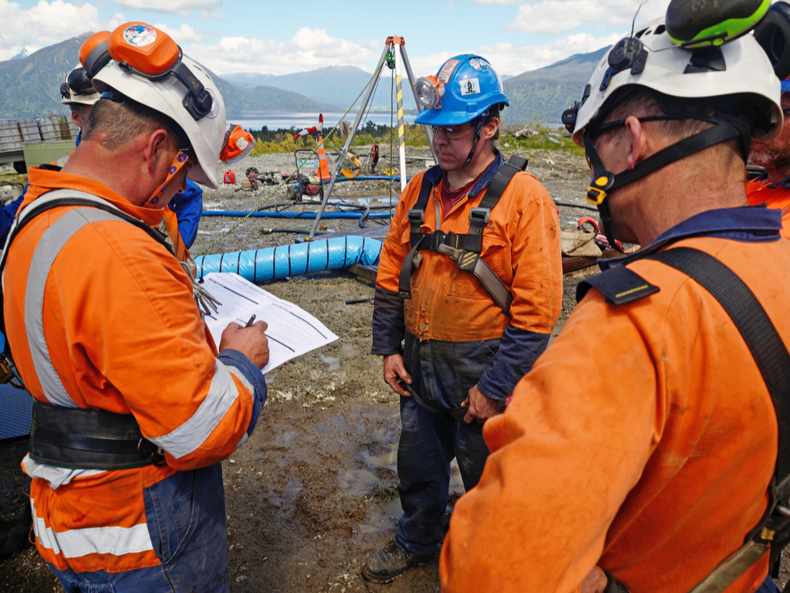
Employer selected
Manager
Supervisor
Or any other employee management chooses to serve on the committee as its representative

Slide 21

Employee selected
Elect another employee
Elect a supervisor to represent them
Allow a volunteer to serve

Slide 22
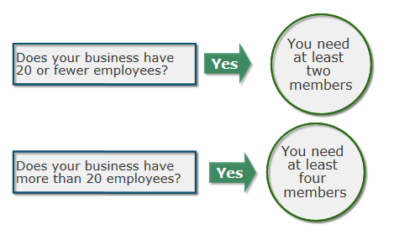
How many members?
The size of your safety committee is determined by how many employees your business has.

Slide 23
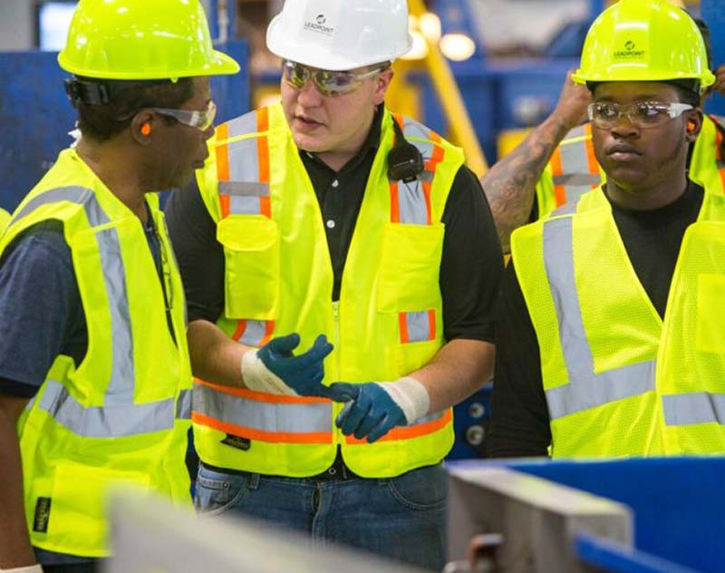
Member requirements
Agree on a chairperson
Serve a minimum of one year, when possible
Trained in accident investigation principles and know how to apply them
Trained in hazard identification
Receive safety committee meeting minutes
Represent the major activities of the company
Be compensated at their regular pay rates

Slide 24
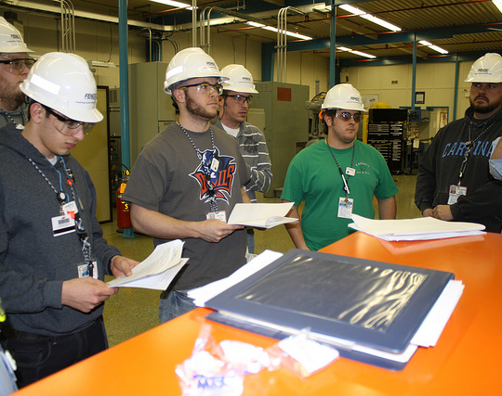
4 Committee requirements
Meet monthly or quarterly, depending on the work that your employees do
Keep a record of each meeting for 3 years
Have procedures for workplace safety and health inspections
Accomplish a set of specific tasks

Slide 25
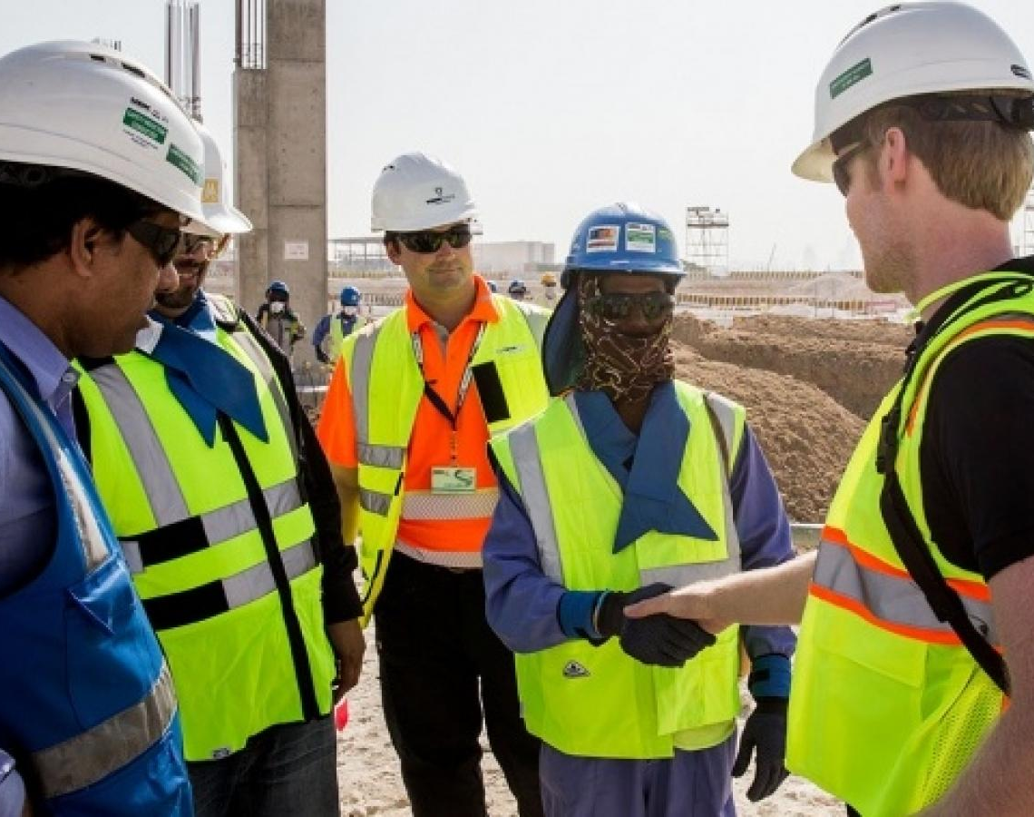
When to meet
Mostly office work = quarterly
Not mostly office work = monthly

Slide 26
Additional Educational Resources
Oregon OSHA’s YouTube Channel
A-Z Topic Index – Safety Committees and Meetings
PESO – English to Español

Slide 27
Thank You!

