Slide 1
NFPA 70E - How to Comply with OSHA’s Electrical Standards
Oregon OSHA Grant # 13-15-01-01
NECA-IBEW Electrical Training Center’s Free Online Course
This material has been made possible by a grant from the Oregon Occupational Safety and Health Division, Department of Consumer and Business Services.

Slide 2
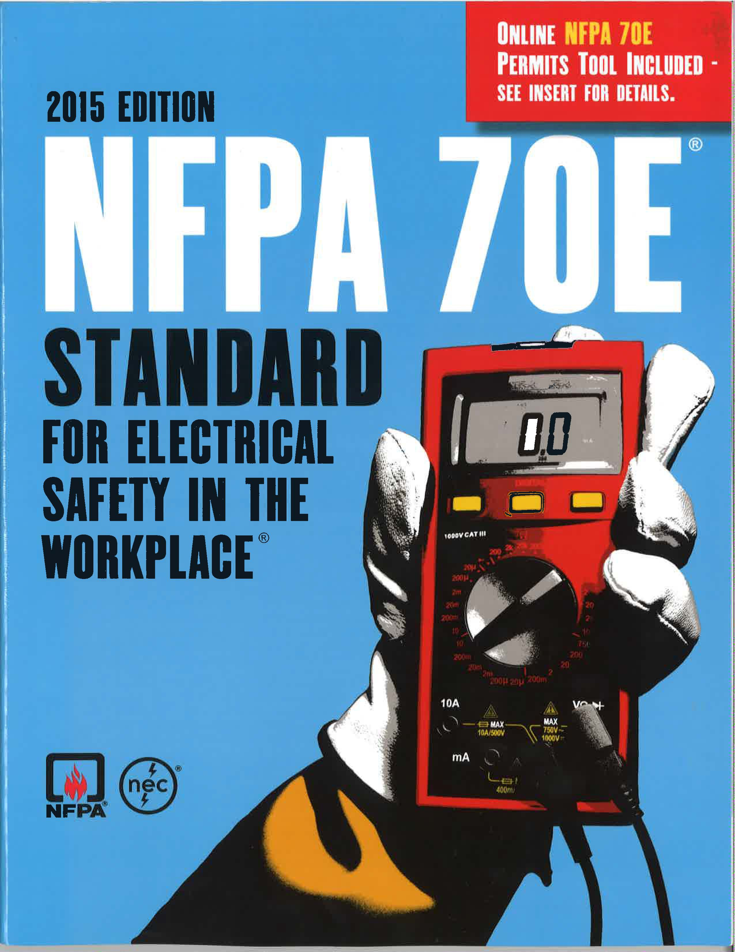
Electrical Safety Training Course
OR-OSHA Grant Provides New Online
Free access at:
www.nietc.org/online-education
5 Lesson modules and quizzes on:
Electrical hazards and injuries
OSHA electrical regulations
Control of hazardous energy
Electrical specific PPE & OPE
Introduction and application of NFPA 70E concepts

Slide 3
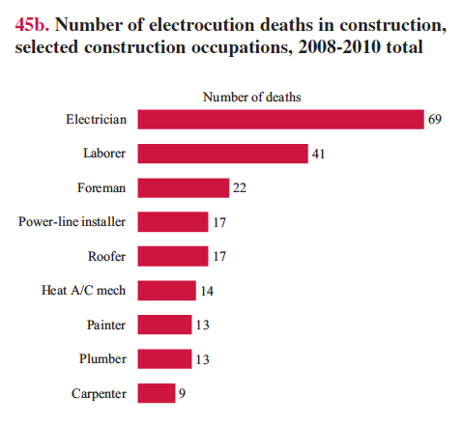
Electrical Hazards and Injury Statistics
Lesson 1
Learning Objectives - Students will:
Summarize types of electrical related injuries
Identify basic electrical theory and terminology
Recognize factors contributing to severity of electrical shock
Recognize factors contributing to arc flash & blast intensity
Review leading occupations and tasks contributing to electrical fatalities

Slide 4

OSHA’s 1910 & 1926 Electrical Regulations
Lesson 2
Learning Objectives - Students will:
Compare OSHA’s General Industry and Construction electrical standards
Evaluate “Shall vs. How-to” comply language
Assess role and application of industry consensus standards
Identify Personal Protective Equipment requirements
In 2014 & 2015, OSHA electrical citations ranked #8 and # 10 most frequently cited standards.

Slide 5
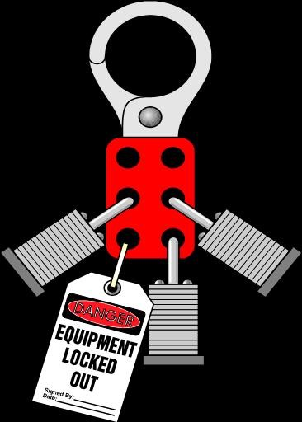
Control of Hazardous Energy
Lesson 3
Learning Objectives - Students will:
Examine types of hazardous energy
Determine which OSHA rules apply per industry
Review lock-out/tag-out basic requirements
Compare NFPA 70E Article 120 to OSHA’s LOTO requirements

Slide 6
Electrical Specific PPE & OPE
Lesson 4
Learning Objectives - Students will:
Review OSHA’s electrical PPE and Other Protective Equipment (OPE) requirements
Define electrical PPE ratings
Address equipment pre-use and periodic inspection criteria
Identity equipment maintenance and care procedures
Q - What does OSHA prescribe as appropriate PPE for electrical hazards?
A - Take the free online class to find out.

Slide 7
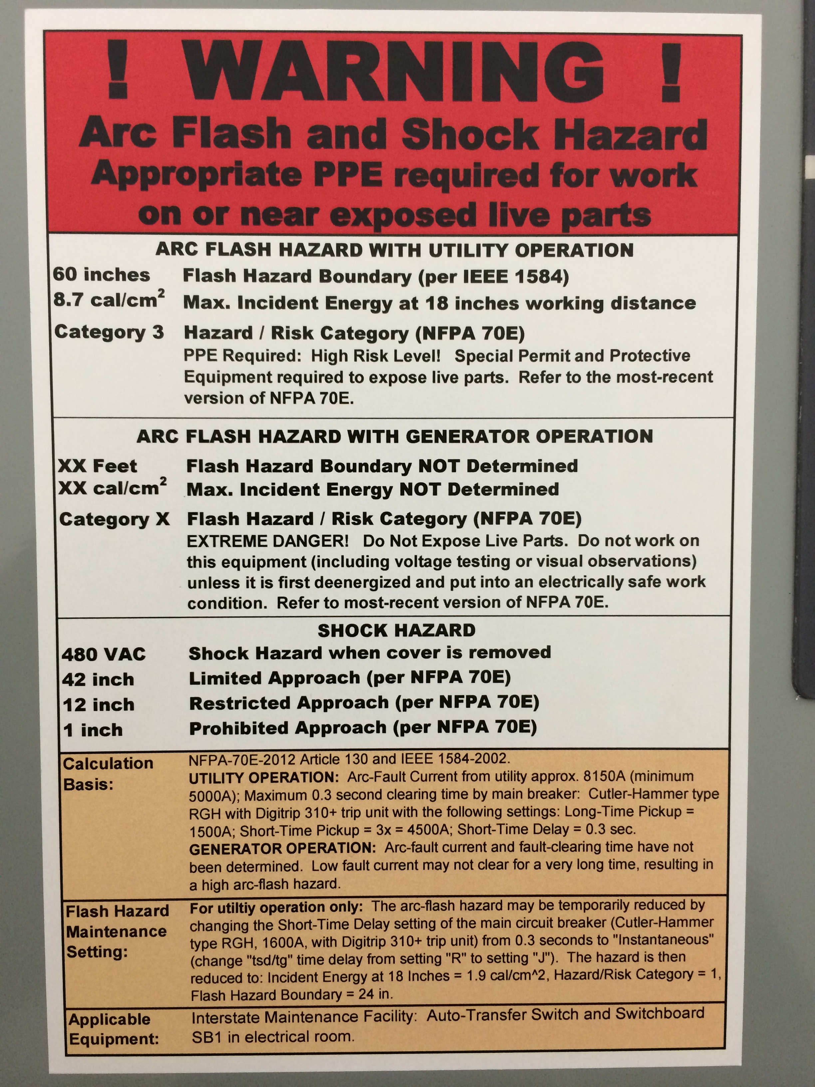
Application of NFPA 70E Concepts
Lesson 5
Learning Objectives - Students will:
Recognize origin and evolution of the NFPA 70E
Review key definitions - Article 100
Identify general electrical safety requirements - Article 110
Review procedures for working on, or near, energized electrical equipment - Article 130

Slide 8
Lesson Quizzes
Each lesson has at least one quiz that is automatically graded.
Students can retake if necessary to meet minimum passing score of 75%
Employers can use this online course to supplement their in-house electrical safety training efforts.

Slide 9
Other Resources
Lessons contain other resources such as:
Electrical safety and LOTO fact sheets
Rubber insulating glove tool box talk
Electrical hazard warning labels tool box talk

Slide 10
How to Access Course
To audit the course without formal username and password registration (quizzes not accessible) visit www.nietc.org/online-education
To obtain full course access, or for any questions about the course, contact Barry Moreland, Safety Director at the NECA-IBEW Electrical Training Center. 1/1/2016
bmoreland@nietc.org
503.501.5066

