Slide 1
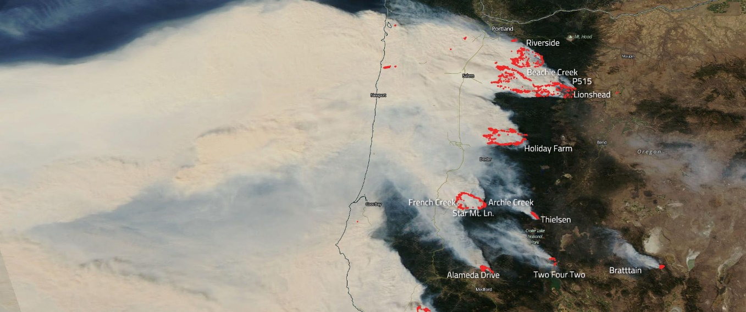
Low-cost sensors for informational PM-2.5 monitoring in Oregon
Oregon Department of Environmental Quality
May 6, 2021
SensOR Team
Anthony Barnack (Project Manager: Barnack.Anthony@deq.state.or.us)
Daniel Johnson (Outreach: Daniel.johnson@deq.state.or.us)
Lance Hochmuth
Aaron Fellows
Luke Mattheis
Marissa Meyer
Matthew Shrensel
Ben Ayres
Meenakshi Rao
Evan Bing
Phillip Orlando
Tom Roick
Wildfire Smoke
Aug 13, 2018
September 2020 Wildfires in Oregon
Tom Roick | Oregon Department of Environmental Quality
Notes:
Our low-cost sensor project’s overall objective was to expand our informational PM2.5 network using a lower-cost instrument that would still provide the accuracy we need for sharing information with the public. Our SensOR project has been a team effort, over the past few years.

Slide 2
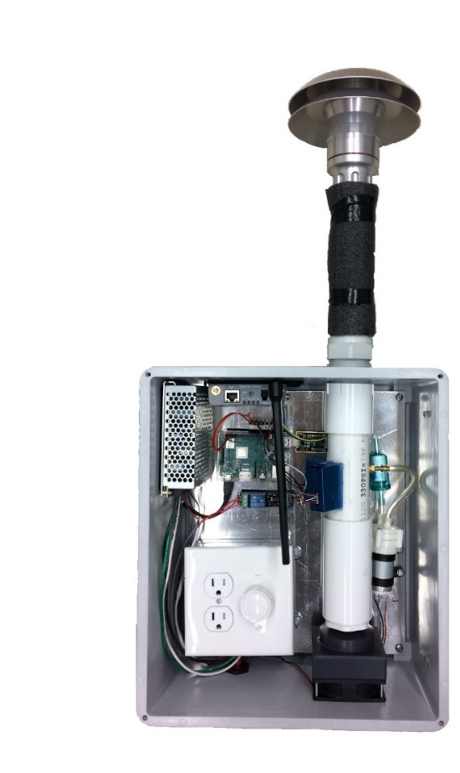
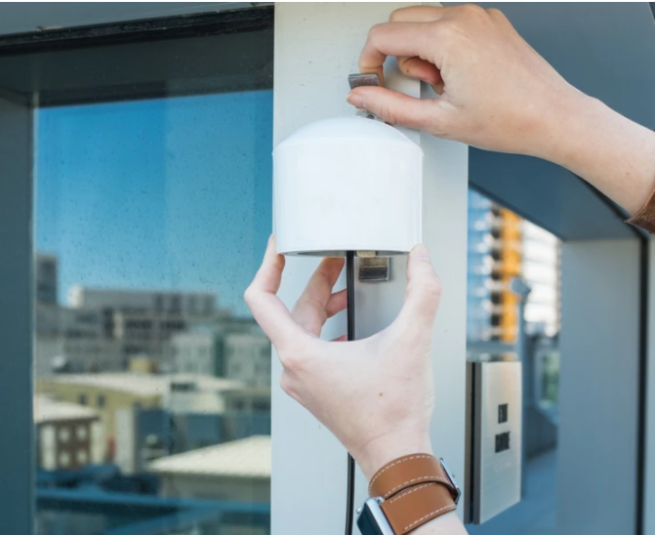
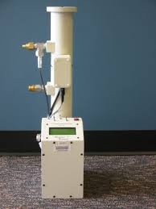
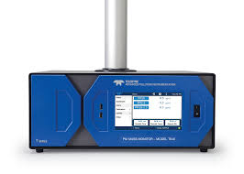
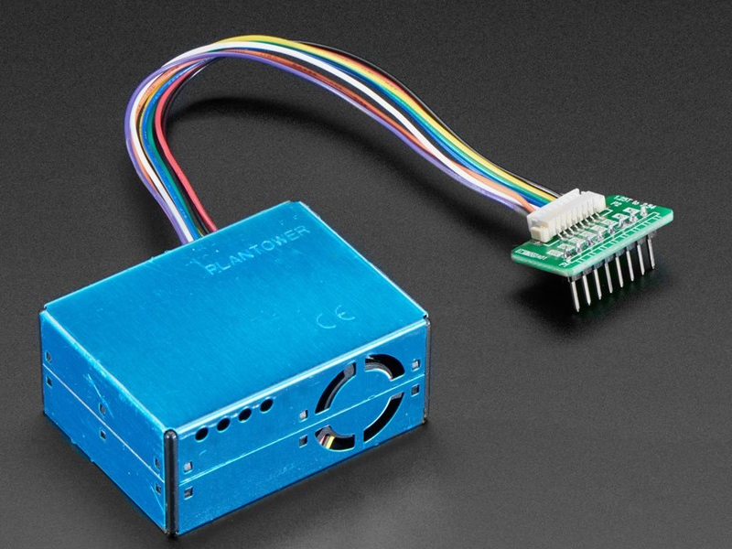

Monitoring Cost and Accuracy
Highly Accurate & Expensive
Lower Accuracy & Cheaper
Purpleair
Federal Equivalent Method
Oregon DEQ SensOR
Teledyne T640
Radiance Nephelometer
Plantower
Sensor evaluation by South Coast AQMD at http://www.aqmd.gov/aq-spec
Notes:
With the availability of low cost sensors, citizens, businesses, and other government agencies are now starting to monitor for themselves. The lowest cost sensor is around $250 and is precise but not accurate. DEQ recognizes the value of all these samplers depending on the monitoring objectives.

Slide 3
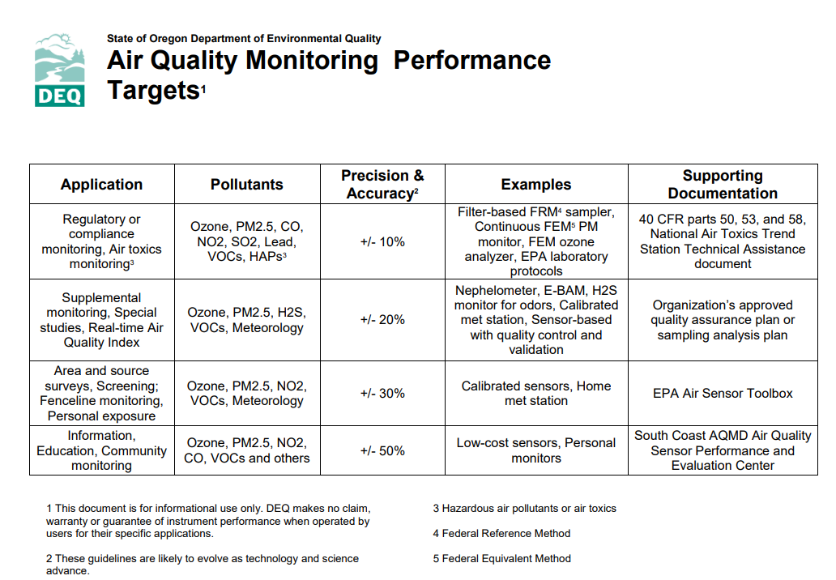
  Oregon DEQ data quality objectives
Data completeness >= 75%
https://www.oregon.gov/deq/FilterDocs/aqmlowcost.pdf
https://www.oregon.gov/deq/FilterDocs/aqmtargets.pdf
Air Quality Index data should be within +/- 20% FRM Data
Notes:
The low-cost PM 2.5 sensors measure light scattering and use a formula to give a rough estimate of PM 2.5 concentrations. We have learned that we can improve the accuracy and understand the data quality by applying sound quality control and quality assurance procedures to these measurements.

Slide 4
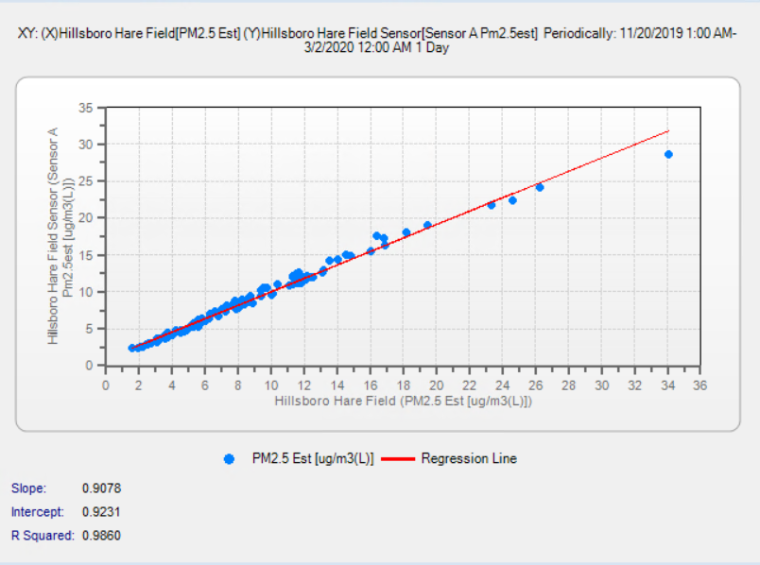
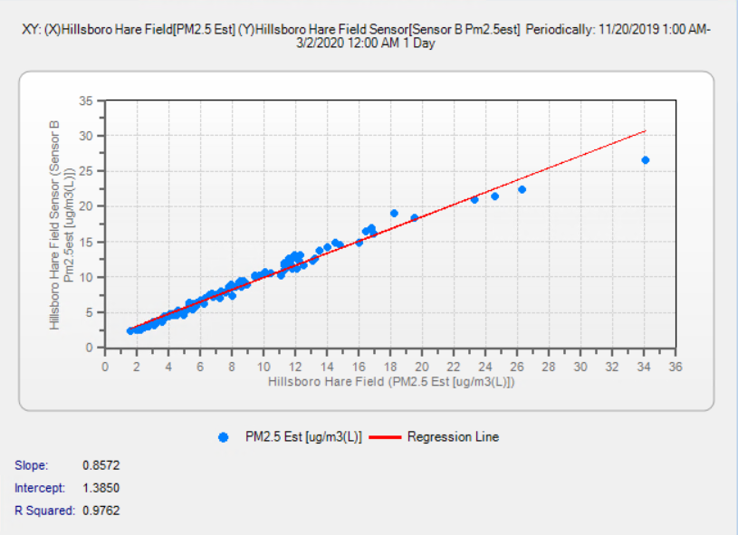
Comparison of SensOR™ PM 2.5 to Neph PM 2.5
Notes:
Corrected 24 hr. data showing comparison of the SensOR to the Nephelometer – left side is within 10%, right side within 15%.

Slide 5
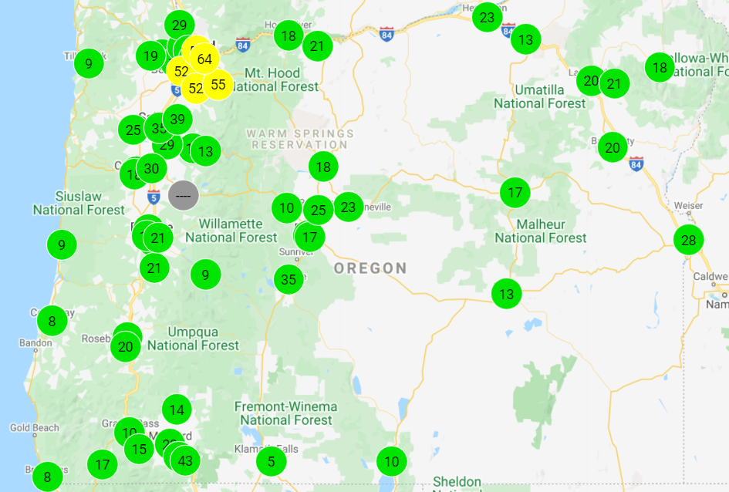
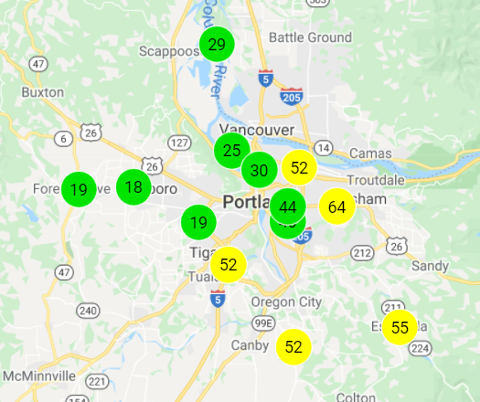
  Oregon DEQ Particulate Monitoring Network
https://oraqi.deq.state.or.us/home/map
Notes:
We are expanding our monitoring coverage to areas of rural Oregon that have not been represented previously, and also filling in gaps in urban areas. So far we have added 23 new sites, and are on the way to doubling the size of the monitoring network. Data are presented on our AQI website as well as our OregonAir mobile apps for iOS and Android.

